Slide 1
ANTIMICROBIAL STEWARDSHIP
MERIN VARGHESE, MD
PHYSICIAN, NGPG INFECTIOUS DISESASE
CHAIR AND PHYSICIAN LEAD, NGHS ANTIMICROBIAL STEWARDSHIP COMMITTEE

Slide 2
NO FINANCIANCIAL DISCLOSURES

Slide 3
Objectives
Define antimicrobial stewardship program
Purpose of antimicrobial stewardship program
Understanding B-lactam allergies​ with respect to antimicrobial stewardship

Slide 4
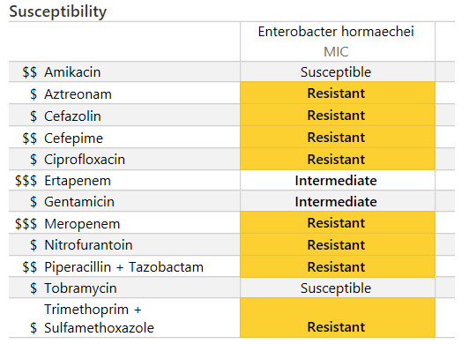
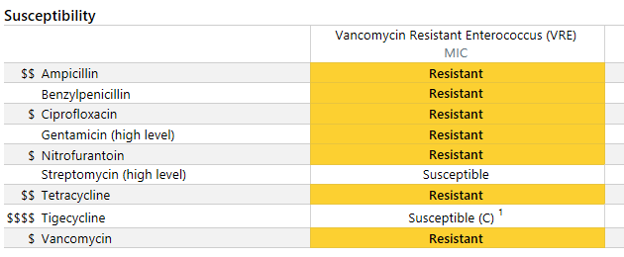
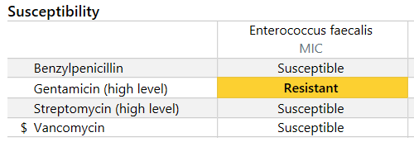
THE BUGS ARE WINNING…

Slide 5
Antimicrobial Resistance is a Growing Problem
More than 2.8 million antibiotic-resistant infections occur in the U.S. each year.
More than 35,000 people die as a result, according to CDC’s 2019 Antibiotic Resistance Threats Report.
The estimated national cost to treat infections caused by six multidrug-resistant germs frequently found in health care can be substantial—more than $4.6 billion annually
https://www.cdc.gov/drugresistance/national-estimates.html

Slide 6
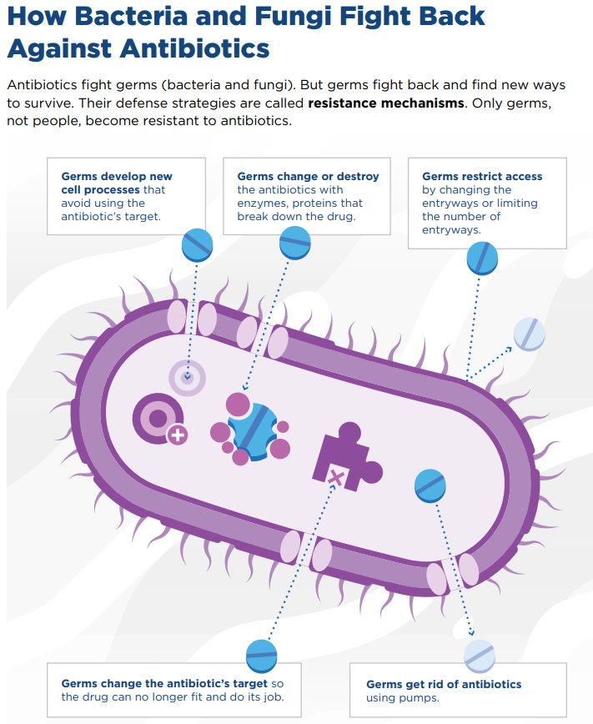
ANTIMICROBIAL RESISTANCE

Slide 7
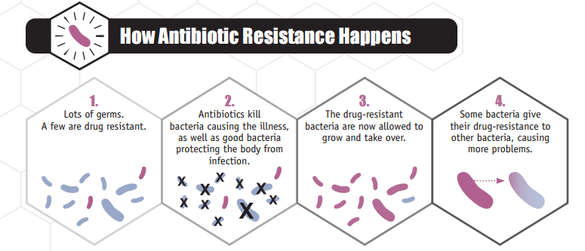
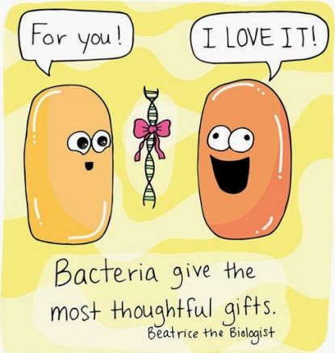
Problem Statement
Centers for Disease Control and Prevention. Antibiotic Resistance Threats in the United States, 2013.
Notes:
Here’s how antibiotic resistance develops. In field 1, we can see a bunch of bacteria, much like what is in the normal human gut. If you give the resident antibiotics, only a few bacteria survive—and these tend to be resistant to that antibiotic. These resistant bacteria multiply and take over. Even worse, in panel 4, the resistant bacteria share their resistance traits with other bacteria, now making them resistant too. This can also happen in the human intestine. Every course of antibiotics carries these risks—and nursing home residents get a lot of antibiotics each year. Many of these rounds of antibiotics are unnecessary. And that is why we are talking about antibiotic stewardship today. We are learning when to give antibiotics and when to withhold antibiotics.

Slide 8
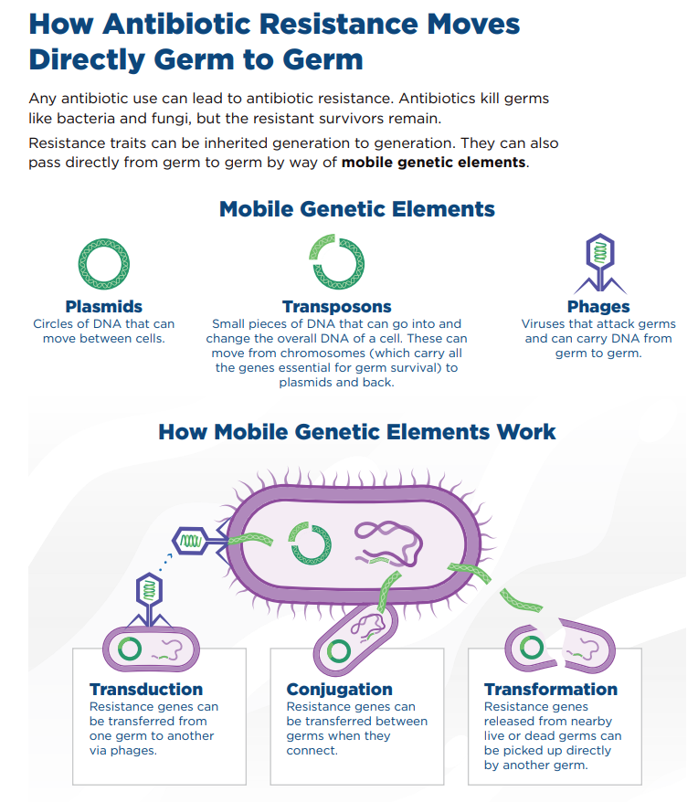
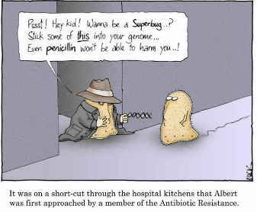
SHARING THE RESTISTANCE

Slide 9
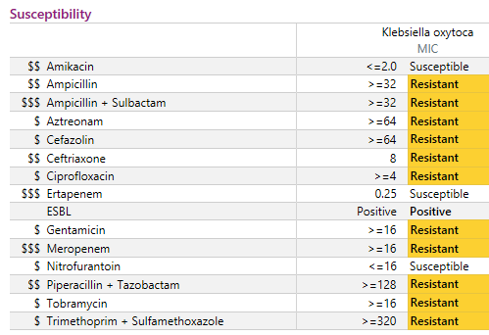
SHARING THE RESISTANCE

Slide 10
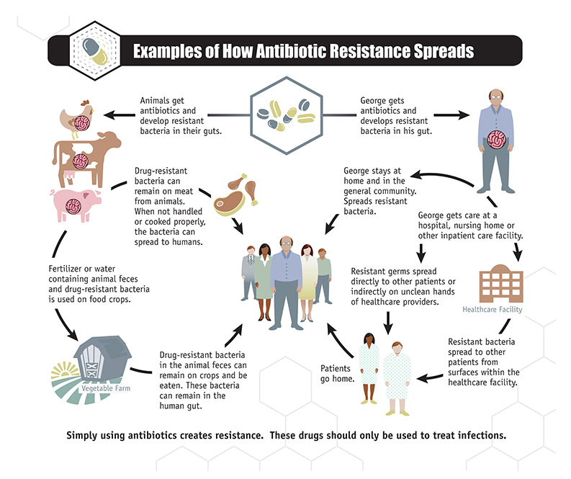
HOW ANTIMICROBIAL RESISTANCE SPREADS
https://www.cdc.gov/narms/faq.html

Slide 11
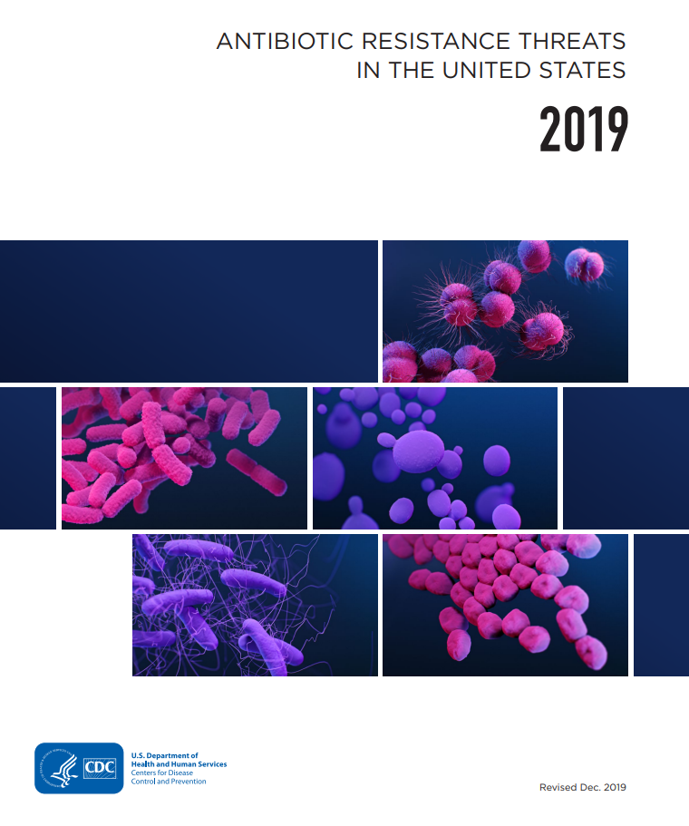
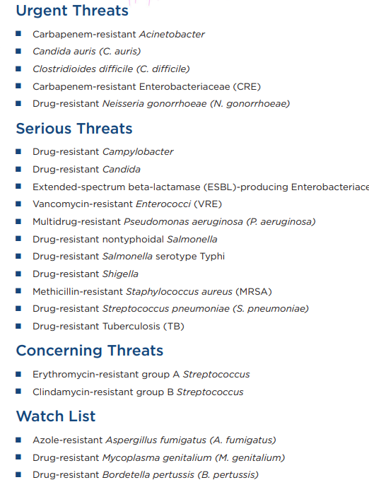
ANTIMICROBIAL RESISTANCE THREATS

Slide 12

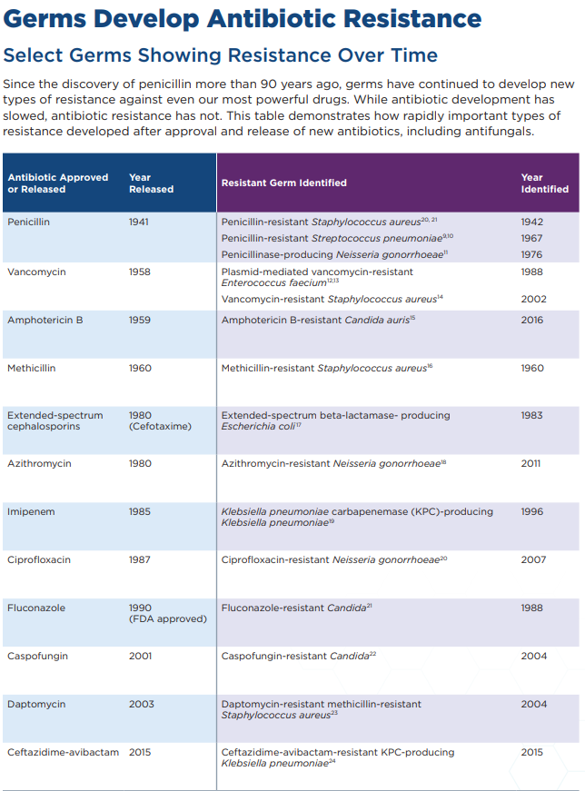
BUGS FIGHTING BACK

Slide 13
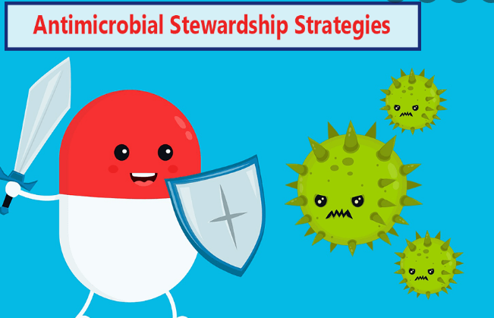
ANTIMICROBIAL STEWARDSHIP
Per Infectious Disease Society of America (IDSA) –
Antimicrobial stewardship is an activity that promotes
  Appropriate selection of antimicrobials
  Appropriate dosing of antimicrobials
  Appropriate route and duration of antimicrobial therapy

Slide 14
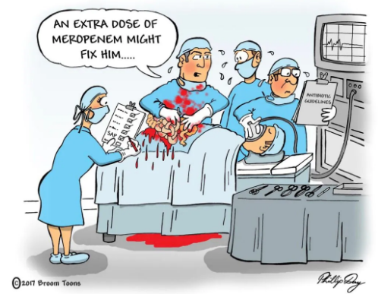
GOALS OF ANTIMICROBIAL STEWARDSHIP
What is antimicrobial stewardship?
Antibiotic stewardship refers to a set of commitments and activities designed to “optimize the treatment of infections while reducing the adverse events associated with antibiotic use.”
    The goal is…
      to have the RIGHT DRUG
      for the RIGHT PERSON
      over the RIGHT TIME FRAME
Notes:
So what is antibiotic stewardship?
[CLICK]
Antibiotic stewardship is a set of commitments and activities designed to optimize the treatment of infections while reducing the harmful events that can be associated with antibiotic use.
[CLICK]
Basically, it is having the right drug, for the right person, over the right time frame.

Slide 15
GOALS OF ANTIMICROBIAL STEWARDSHIP
Primary goal
  Optimize clinical outcomes while minimizing unintended consequences of antimicrobial use
    Unintended consequence
      Toxicity
      Selection of pathogenic organisms such as C. difficile
      Emergence of resistant pathogens
Secondary goal
  Reduce healthcare costs without adversely impacting the quality of care

Slide 16
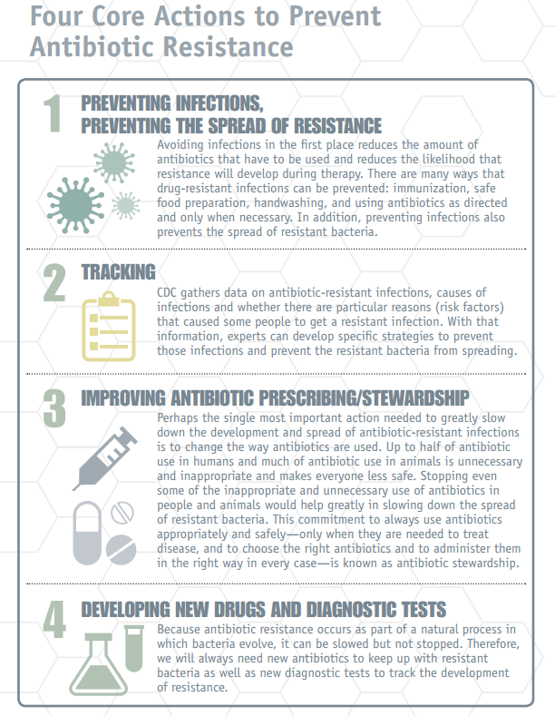
PREVENT ANTIMICROBIAL RESISTANCE
Infection prevention IS antimicrobial stewardship!
Tracking infection prevention data has double value
  Hospital acquired infection prevention
  Informs antibiotic stewardship programs
Improving antibiotic prescribing
Bacteria are constantly evolving, requiring the need for new antibiotics
Source: Centers for Disease Control and Prevention. Antibiotic Resistance Threats in the United States, 2013.
Notes:
How can we fight back against antibiotic resistance? The Centers for Disease Control and Prevention, or CDC, devised four key strategies to combat resistance.
[CLICK]
First, preventing infections prevents the spread of resistance. By participating in this program, you are taking the key step to prevent antimicrobial resistance. Fewer CAUTIs mean fewer courses of antibiotics, and that in turn means fewer chances for bacteria to become resistant to antibiotics.
[CLICK]
Second—tracking. The CDC gathers data on antibiotic-resistant infections and works with experts to develop specific strategies to prevent those infections and prevent resistant bacteria from spreading. Through this program, you should be tracking and reporting CAUTI, catheter use and urine cultures. These data are also important to antimicrobial stewardship. So your surveillance work has double value—preventing CAUT, and informing antimicrobial stewardship programs.
[CLICK]
Third—improving antibiotic prescribing and stewardship. Changing the way we use antibiotics is probably the most important step to fight resistance. Through this program you may have learned about not ordering and collecting a urine culture unless a resident has signs or symptoms of a CAUTI or UTI. Avoiding unnecessary testing, such as urine cultures, is part of antibiotic stewardship.
[CLICK]
Fourth—developing new drugs and tests. Bacteria are constantly evolving; we can only slow their evolution, we can’t stop it. Therefore, we need new antibiotics to keep up with the changing bacteria. While developing new drugs is beyond the scope of our project, it is still important to understand this need.
We will spend the rest of this module discussing strategies to promote antibiotic stewardship in long-term care.

Slide 17
WE MUST WORK TOGETHER…
Working relationship between infection control and antimicrobial management.
Selection of antimicrobials from each class of drugs that does the LEAST collateral damage
  Collateral damage
    Methicillin-resistant Staphylococcus aureus
    Extended spectrum B-lactamase (ESBL)
    Clostridioides difficile (C. difficile)
    Vancomycin-resistant enterococci (VRE)
    Metalloenzymes & other carbapenemases
  Appropriate de-escalation when culture results are available

Slide 18
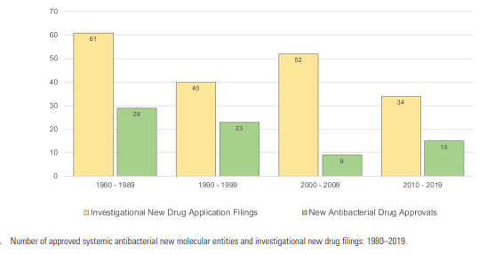
DRUGS CAN’T KEEP UP
Notes:
https://academic.oup.com/cid/article/73/11/e4444/5862690

Slide 19
NGHS ASP Structure
Antimicrobial Stewardship Program
Microbiology
Senior Leadership
Infection Control
Information Technology
Medical Staff
Pharmacy
Nursing
Quality
Acute Care Campuses
Gainesville
Braselton
Barrow
Lumpkin
Skilled Nursing
Limestone
Lanier Park
Outpatient
NGPG Urgent Care
NGPG Clinics
Reports to:
Pharmacy & Therapeutics Committee
Infection Control Committee
NGMC Quality Committee
Notes:
Core members: infectious diseases physician and a clinical pharmacist with infectious diseases training (AII) who should be compensated for their time (A-III), the program is usually directed by an infectious diseases physician or codirected by an infectious diseases physician and a clinical pharmacist with infectious diseases training
Other members:a clinical microbiologist, an information system specialist, an infection control professional, and hospital epidemiologist being optimal (A-III)
Because antimicrobial stewardship, an important component of patient safety, is considered to be a medical staff function, (A-III). • Collaboration between the antimicrobial stewardship team and the hospital infection control and pharmacy and therapeutics committees, or their equivalents, is essential (AIII). • The support and collaboration of hospital administration, medical staff leadership, and local providers in the development and maintenance of antimicrobial stewardship programs is essential (A-III). It is desirable that antimicrobial stewardship programs function under the auspices of quality assurance and patient safety (A-III). • The infectious diseases physician and the head of pharmacy, as appropriate, should negotiate with hospital administration to obtain adequate authority, compensation, and expected outcomes for the program (A-III). • Hospital administrative support for the necessary infrastructure to measure antimicrobial use and to track use on an ongoing basis is essential (A-III).

Slide 20
TODAY’S FOCUS
What is antimicrobial stewardship?
Antibiotic stewardship refers to a set of commitments and activities designed to “optimize the treatment of infections while reducing the adverse events associated with antibiotic use.”
    The goal is…
      to have the RIGHT DRUG
      for the RIGHT PERSON
      over the RIGHT TIME FRAME

Slide 21

TODAY’S FOCUS
Penicillin allergy

Slide 22
PENICILLIN ALLERGY
Up to 10% of the general population and 15% of hospitalized patients list penicillin as an allergy.

Slide 23
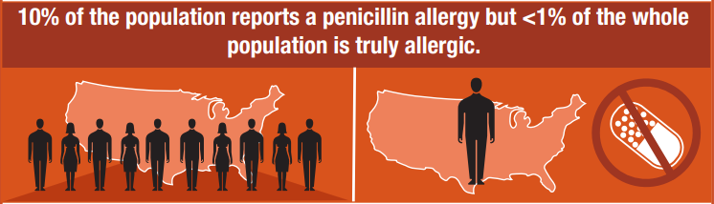
PENICILLIN ALLERGY
https://www.cdc.gov/antibiotic-use/community/pdfs/penicillin-factsheet.pdf

Slide 24
PENICILLIN ALLERGY
Penicillin “allergic” patients are more likely to
  Received fluroquinolones, vancomycin, clindamycin
  Harbor drug resistant organisms such as MRSA and VRE
  Develop C diff colitis
    Increased mortality
  Experience --
    treatment failure, infection recurrence, death from MSSA bacteremia
    treatment failure in gram negative bacteremia
    a delay in empiric antimicrobial treatment
    a surgical site infection

Slide 25
PENICILLIN ALLERGY
Pencillin “allergic” patients are more likely to
  Develop new antibiotic “allergies” with alternative therapies
  Have an allergic reaction to vancomycin than cefazolin
  Have side effects or toxicities from second-line therapies

Slide 26
PENCILLIN ALLERGY
Penicillin allergic patients have higher drug costs
  Higher outpatient antibiotic costs per patient
  $300 more per patient per day of inpatient antibiotic therapy
  $1253 more in length of stay costs per patient per admission
Penicillin allergic patients have longer hospital stays
  10% longer hospital stays, estimated cost of $21.5 million per year.

Slide 27
PENICILLIN ALLERGY: ACCURATE DIAGNOSIS?
Less than 10% of these allergies are confirmed when tested
Childhood viral rashes are often misdiagnosed as drug rashes
  Only 7-16% of kids with “drug allergy” during an infection later test positive to the drug.
Even if a patient is truly allergic, most people “outgrow” penicillin allergy
  Over 50% of people with confirmed allergy to penicillin ‘lose their allergy’ after 5 years
  Over 80% will lose it in 10 years

Slide 28
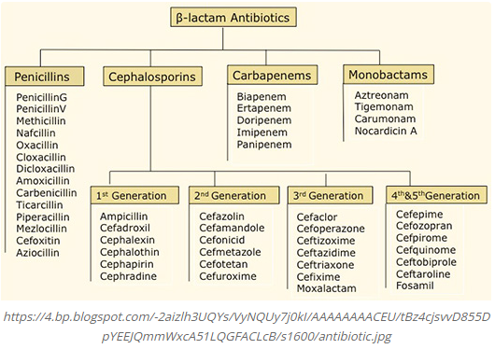
BETA LACTAMS

Slide 29
CEPHALOPSORIN VS PENICILLIN
Overall cross-reactivity based on multiple studies is actually very low:
  Reported (but unconfirmed) penicillin allergy: 0.1%
  Confirmed penicillin allergy: 2%
  Above exclude patients with penicillin anaphylaxis

Slide 30
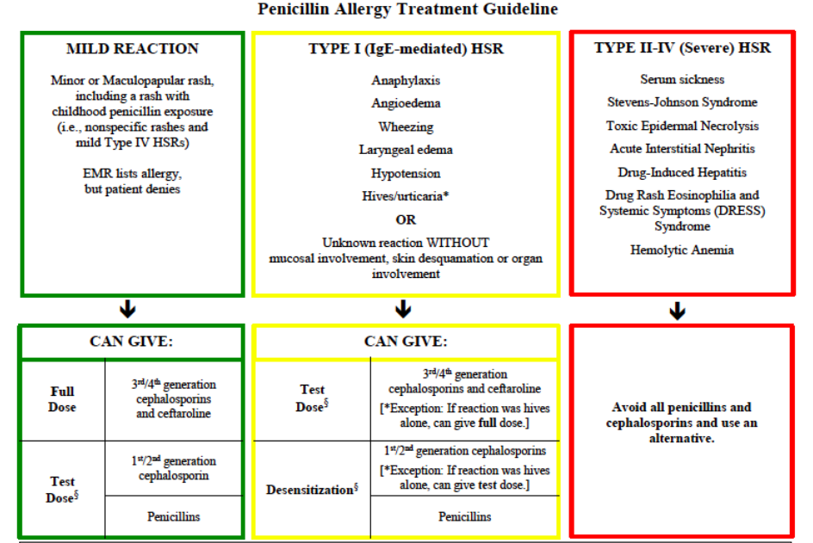
PENICILLIN ALLERGY

Slide 31
OUR EFFORTS
Cascading susceptibilities
Drug desensitization
Drug challenge

Slide 32
Cascading Susceptibilities
Definition
  a strategy of reporting antimicrobial susceptibility test results in which secondary (e.g., broader-spectrum, more costly) agents may only be reported if an organism is resistant to primary agents within a particular drug class

Slide 33
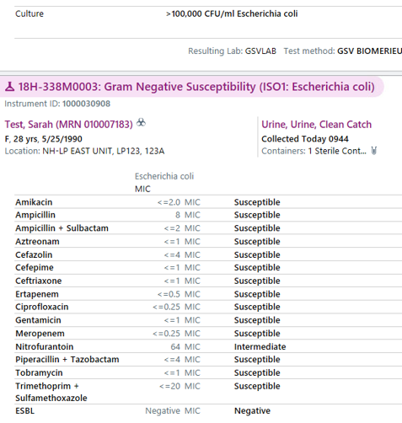
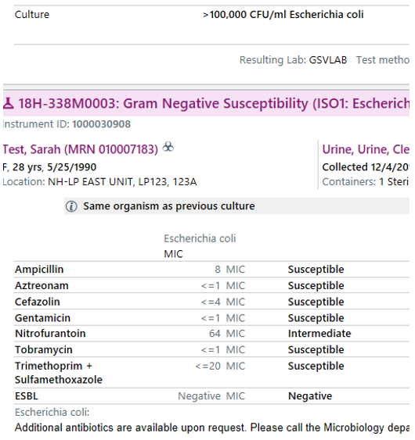
Old New

Slide 34
Graded Challenge/Test Doses
1%/10%/20%
Monitoring
Ampicillin 20 mg IV once
Observe for 30 minutes
Ampicillin 200 mg IV once
Observe for 30 minutes
Ampicillin 2000 mg IV once
Observe for 30 minutes
Scheduled Maintenance Dosing
  Vital signs every 30 minutes
  Rescue meds available (diphenhydramine, epinephrine, methylprednisolone)
  Update allergy profile after challenge

Slide 35
Graded Challenge (GC)
Contraindications
Severe-delayed reactions such as SJS or DRESS
When to Use
Severe Type1 IgE mediated allergy and using Agent with dissimilar side- chain
Pros/Cons
Allows allergy de-labeling
Tests for existence of true allergy
Non-life threatening reaction and using agent with similar side chain
When a reaction is likely (a recent reaction to the same agent)

Slide 36
Desensitization
18 step process
Monitoring
  Requires 1:1 nursing ratio
    ICU admission likely required
  Airway box at bedside
  Vital signs every 30 minutes
  Rescue meds available (diphenhydramine, epinephrine, methylprednisolone)
Desensitization establishes a temporary tolerance so allergy on profile is relevant and should remain there

Slide 37
Desensitization
Contraindications
SJS, DRESS, other delayed reactions
When to Use
Failed PCN skin test
Pros/Cons
Allows treatment if true IgE mediated allergy
Short-term tolerability
Time and resource intensive
Does not mitigate (Type II-IV) delayed reactions
Anaphylaxis within the past 5 years
Failed Graded Challenge
Allergic reaction is highly likely

Slide 38
Graded Challenge vs Desensitization
 | Graded-Challenge | Desensitization
Method | 2-3 doses every 30 min | 10+ doses every 15-30 min
Rational | Test of tolerance | Establishes tolerance despite allergy
Immune modification | No | Yes (temporary)
Effect of Therapy Interruption | None | Must repeat/restart
Indication | If unlikely to have severe allergy | If Type1 IgE mediated allergy is likely
Outcome (if successful) | Allergy can be removed | Allergy remains
Site of care | Ambulatory Practice Any Inpatient Unit Nursing Home | Intensive Care/Specialty Unit Allergist’s Office
Solensky. Immunol Allergy Clin N Am 24 (2004) 425–443
Solensky. Ann Allergy Asthma Immunol 2010;105:259

Slide 39
Is The Risk Worth It?
Risk of life-threatening reaction to beta lactams in those with reported allergies – very low if they are screened for mild reactions and antimicrobials are chosen carefully.
With the use of LIFE THREATENING infection - MUCH HIGHER when ALTERNATIVE agents are used.
  C. difficile colitis kills about 29,000 per year
  Fatal drug induced anaphylaxis (1999-2010) – antibiotics were identified as culprits in 585 deaths (12 year period).
https://www.sciencedirect.com/science/article/pii/S0091674914011907?via%3Dihub

Slide 40
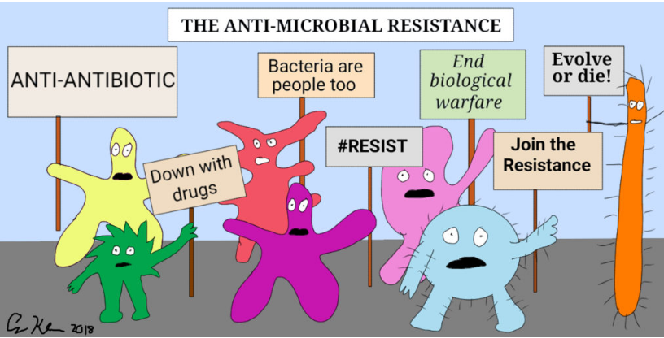
THANK YOU

Slide 41
REFERENCES
Cdc.gov
https://www.sciencedirect.com/science/article/pii/S0091674914011907?via%3Dihub
Solensky. Immunol Allergy Clin N Am 24 (2004) 425–443.
Solensky. Ann Allergy Asthma Immunol 2010;105:259
https://www.publichealthontario.ca/apps/asp-strategies/data/pdf/ASP_Strategy_Cascading_Microbiology_Reporting.pdf
https://www.researchgate.net/figure/The-Partners-Penicillin-and-Cephalosporin-Hypersensitivity-Pathway-These-pathway_fig2_316781890
https://www.ryah.ca/2014/09/29/animal-health-week-antibiotic-responsible-and-appropriate-use/
https://www.istockphoto.com/illustrations/antibiotic-resistance
http://love-life-science.blogspot.com/2014/09/bacterial-gifts.html?spref=pi

