Slide 1
The Importance of Infection Prevention in All Healthcare Settings
Mike Bailey
Principal, Bailey Consulting Services, LLC
Master Trainer- AHE Signature Programs

Slide 2
Disclosures
Independent contractor/consultant working with the American Hospital Association (AHA) and the Association for the Healthcare Environment (AHE)
No ties or interest to any healthcare provider or healthcare supplier

Slide 3
Objectives
Understand the importance of infection prevention in different healthcare settings
Importance of EVS leader and staff education and evidence of competence
Discuss and communicate proper cleaning and disinfecting techniques
Understand different quality monitoring tools and techniques
Recognize future challenges for EVS leaders and professionals
Recognize opportunities for improvement in your areas)s) of responsibility

Slide 4
Healthcare Settings
Acute Care- (hospitals)
Long-Term Acute Care Hospitals (L-TACH’s)
Skilled Care- (Nursing homes, memory care, long-tern care)
Continuing Care Retirement Communities (CCRC’s)
Day Care Facilities
Non-Acute Care (clinics, ambulatory care, gyms, childcare)
Home Health Care (in-home services)
Public Settings (malls, parking lots)

Slide 5
Education
EVS Leader Education- not easily obtained on the local level
Online programs through AHE, vendors and/or others
CHESP
CMIP
Frontline EVS staff education- easily obtained locally
Solid Orientation Program?
Solid Re-training Program?
On-going education Program?
Annual Competency Program
CHEST
CSCT
CNACC
Notes:
Ways to describe contact time to surveyors

Slide 6
Cleaning
“Cleaning is the movement of material from an undesirable location to a more desirable location”.
Cleaning is the physical removal of dust, dirt, debris, bio-burden etc. (visible soiling)
Cleaning can be accomplished in multiple ways
Hands- mechanical action
Dry or wet textiles
Dry or wet paper products
Detergents
Water
Multiple tools
Cleaning is always required prior to disinfection or sterilization

Slide 7
Disinfecting
The destruction or inactivation of pathogens
Can be accomplished with heat, chemicals or ultraviolet light
Most common disinfectants are:
Quaternary ammonium compounds
Accelerated hydrogen peroxide
Sodium hypochlorite
Peracetic/peroxyacedic acid and hydrogen peroxide blends (smell like vinegar)
Contact Times
Application Methods
Microfiber vs. cotton vs. disposable wipes, etc.
An item/object/area/surface that has not been properly cleaned cannot be properly disinfected or sterilized

Slide 8
Cleaning and Disinfecting Process
High to Low (Top to Bottom)
Left to Right (Clockwise or counterclockwise)
Clean toward Dirty
Unidirectional Wiping
Responsibility Matrix

Slide 9
Education Should Include
Cleaning vs. Sanitizing vs. Disinfecting vs. Sterilizing
Everyday behaviors to prevent the spread of infection
Hand Hygiene
Proper use of Personal Protective Equipment (Donning and Doffing)
Understanding of the Chain of Infection
Common Pathogens (microbiology)
Proper tools and processes
Standard and Transmission-Based Precautions

Slide 10
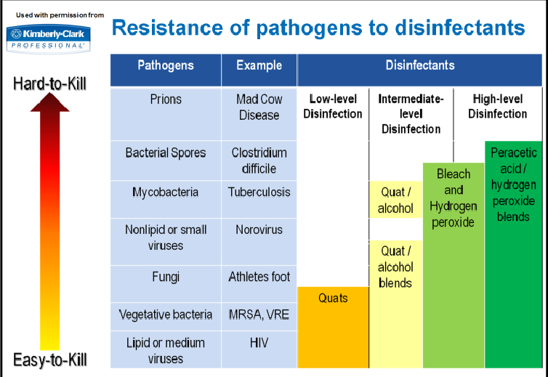
Hierarchy of Pathogens

Slide 11
Quality Monitoring Techniques
Observational (Visual)
Invisible Fluorescent Marking Systems
Adenosine Tri-Phosphate Monitoring (ATP)
Cultures
Swabs

Slide 12
Questions to Ponder
Does EVS staff receive a thorough orientation and training prior to deployment to their unit/area?
Is your EVS leader/ Infection Preventionist relationship strong?
Is your EVS leader considered an infection prevention expert on the units?
Does EVS staff understand why we do what we do?
Are staff confident in their ability to do their jobs?
Are EVS staff on the units considered infection prevention experts?
How are you verifying competence?
What is your current quality monitoring program and is it effective?
What does your EVS leadership succession plan look like?

Slide 13
Opportunities for Improvement
Educational Systems
Instructional Materials
Daily EVS Rounding
Daily Patient Interviews
Communication and Committee Assignments
Infection Prevention/EVS Leader Rounding

Slide 14
Questions or Comments?

