Slide 1
Environmental Pathogens of Concern
Northeast GA Regional Infection Prevention Symposium
March 18, 2022

Slide 2
Presented by
Jim Gauthier, MLT, CIC
Senior Clinical Advisor Infection Prevention
james.gauthier@diversey.com

Slide 3
Disclosure
Jim is employed by Diversey. His expenses to present at this meeting (salary) are paid by this company. Diversey has had no input into this presentation from a commercial interest.

Slide 4
Objectives
Define an 'environmental' organism
List at least two organisms, whose isolation should make practitioners think: "Environment issues"
Collect specimens with minimal contamination allowing clinically relevant results to be generated

Slide 5
Environmental Organisms
Organisms whose presence indicates that it is not from another patient/healthcare worker
Construction/dust
Water
Contaminated cleaning items

Slide 6
Jim’s Short List
Aspergillus – Construction/HVAC that you don’t know about
Stenotrophomonas – Taps, spigots
Serratia – cleaning tools with biofilm
Topping up
Legionella – water, dust
Pseudomonas - water

Slide 7
Aspergillus

Slide 8
Aspergillus
Is a fungi
1.5 million species on earth
~300 human pathogens
Reproduce by spores
Tiny!
Can be from 5 to 100 um
Location and shape of sporangium helps with identification

Slide 9
Aspergillus Human Disease
Invasive Diseases
Lungs
Immunocompromised are susceptible
Lymphocytic or myelogenous leukemia and lymphoma
Stem cell transplant (higher risk in allogeneic vs autologous
Steroids
HIV with CD4 counts <50/ul
Notes:
Sensitivity to Apergillus can mimic asthma!

Slide 10
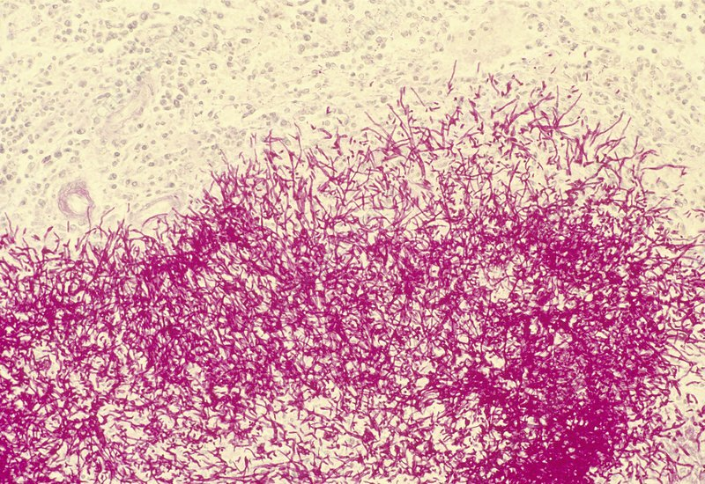
Histologically:
0
Aspergillus in kidney section
Aspergillus in lung section
Science Photo Library
Lung Tissue Riedel

Slide 11
Construction: False Ceiling Repair
Done after a leak
Above IV supplies
Contaminated adhesive tape and arm boards
6 infected, 2 died
Grossman ME, et al. Primary cutaneous Aspergillosis in six leukemic children. J Am Acad Dermatol 1985;12(2, part 1):313-18.

Slide 12
Demolition
Ducts, false ceiling, glass fibre insulation
Work on roller-blind casings
22 cancer patients infected, 18 died
Perraud M, et al. Invasive nosocomial pulmonary Aspergillosis: risk factors and hospital building works. Epidemiol Infect 1987;99:407-12.

Slide 13
Outside Construction
Road construction
Air conditioner heavily contaminated with Aspergillus spores
10 cancer patients infected, all 10 died
Lentino JR, et al. Nosocomial Aspergillosis: a retrospective review of airborne disease secondary to road construction and contaminated air conditioners. Am J Epidemiol 1982;116(3):430-37.

Slide 14
During Construction
Wet fireproofing material installed
Spores dispersed when the dry fireproofing was disturbed during maintenance or renovation
8 cancer patients infected, 3 died
Aisner J, et al. Aspergillus infections in cancer patients: association with fireproofing materials in a new hospital. JAMA 1976;235(4):411-12.

Slide 15
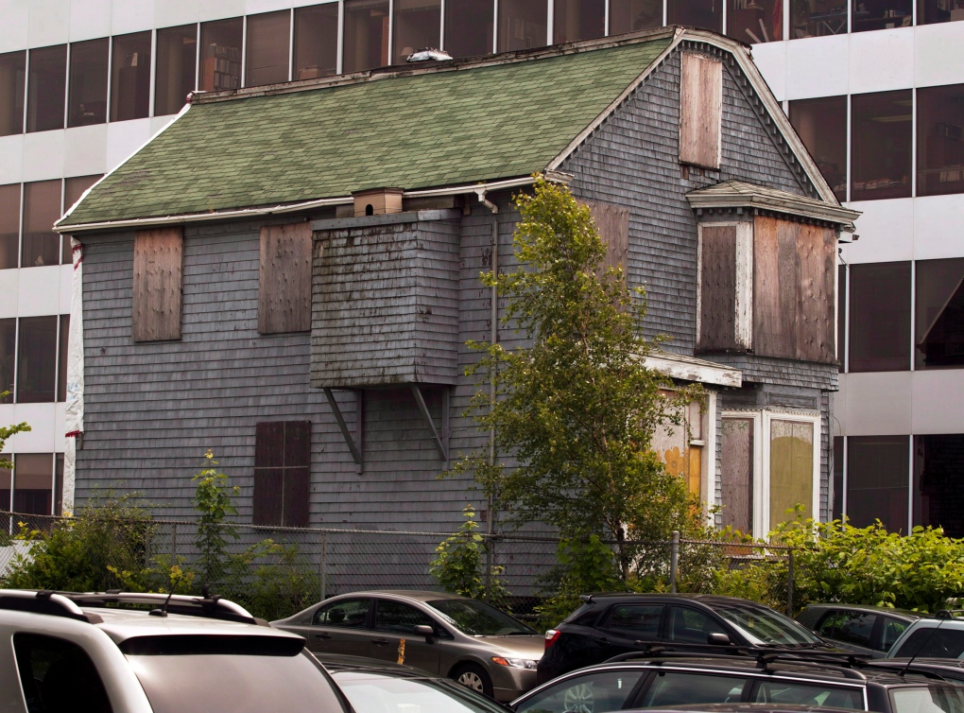
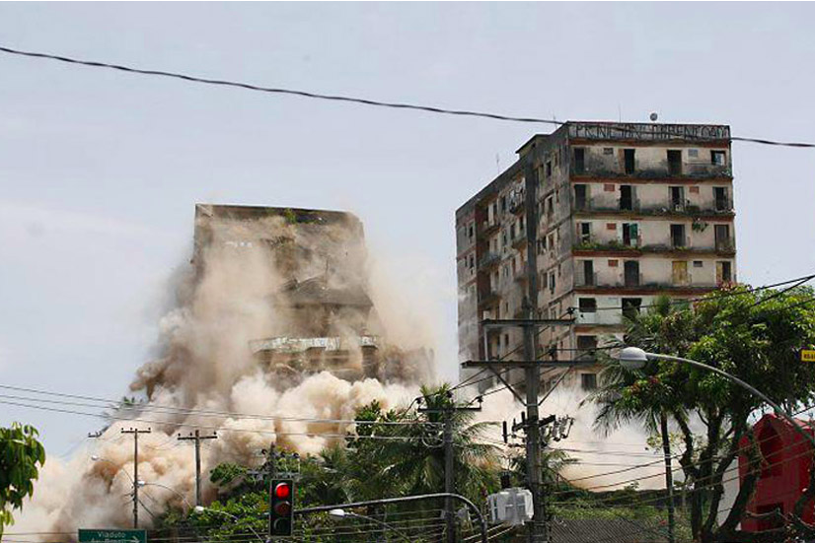
When to Investigate?
Any isolate from the lab
Who is doing construction?
Who is in the HVAC system?
Fire dampers
Filter changes
Have we disturbed soil and the windows are open?
Other sources of dust – nearby demolition
Notes:
Estimating distance to house from air intake system.

Slide 16
Assessment for Mould
Air Sampling
Not typically required in investigations
Might be needed for ‘evidence’
Sometimes performed after abatement procedures
Need outside background, pre and post tests

Slide 18
Stenotrophomonas maltophilia

Slide 19
Stenotrophomonas maltophilia
Gram negative rod
First classified as
Pseudomonas maltophilia
Xanthomonas maltophilia
Associated with
Plants
Water
Drains

Slide 20
Recovered from:
Soils and plant roots
Animals
Invertebrates
water treatment and distribution systems
wastewater plants
Sinkholes
Lakes and rivers
biofilms on fracture surfaces in aquifers
washed salads
hemodialysis water and dialysate samples
Faucets, tap water, bottled water
contaminated chlorhexidine-cetrimide topical antiseptic
hand-washing soap
contact lens solutions
ice machines
sink drains
Brooke 2012

Slide 21
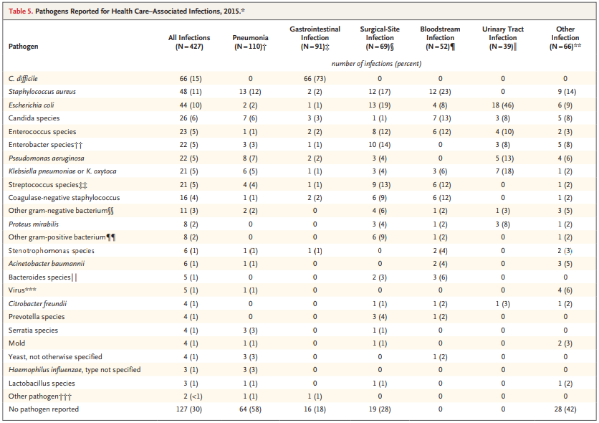
11th place
Magill 2018

Slide 22
Stenotrophomonas maltophilia
Good at forming biofilms
Isolated from
Respiratory tract secretions
Colonization of CF patients
Urine
Wounds
Blood
Usually associated with indwelling IV catheters
Mortality Rate 14-69% (Riedel 2019)

Slide 23
Magill 2018

Slide 24
Stenotrophomonas maltophilia
Sensitive to Septra, ticarcillin-clavulanic acid
Resistant to other broad spectrum antibiotics e.g.:
Aminoglycosides, imipenem, quinolones
Resistant to heavy metals
Tolerant of silver coated catheters
Develops resistance
On exposure to antibiotics
Gene transfer

Slide 25
Pseudomonas aeruginosa
Tap water
Vented patients
Flushing feeding tubes
Ice chips

Slide 26
Serratia marcescens

Slide 27
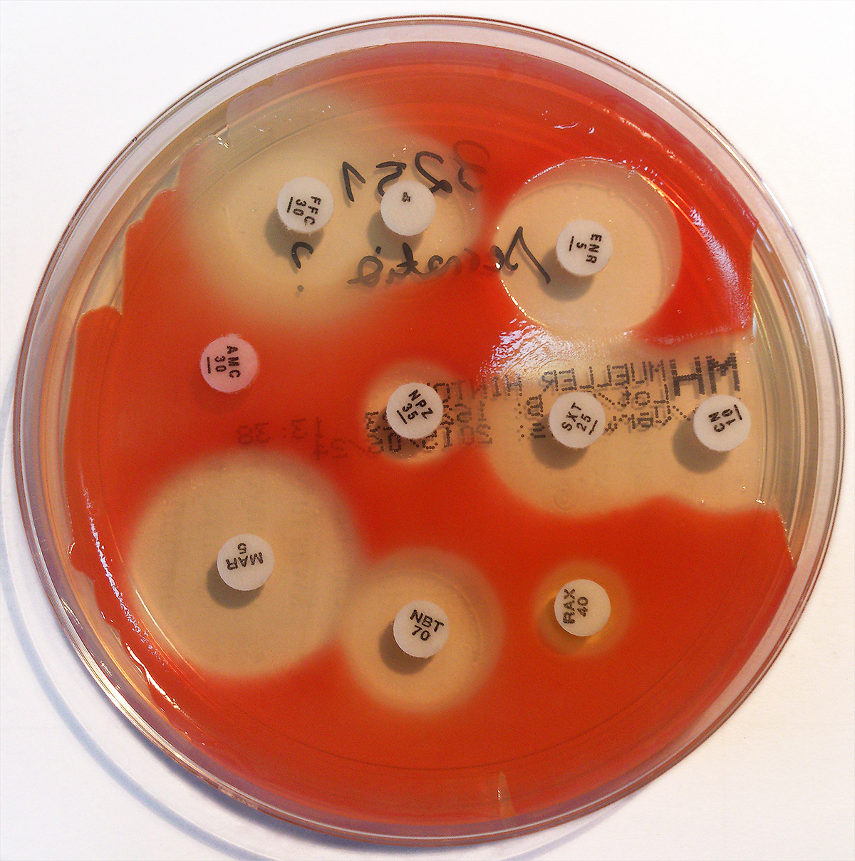
Serratia marcescens
Opportunistic pathogen, colonizer
Transmission seen
medical devices
intravenous fluids
indwelling catheters
Harder to treat
inducible, chromosomal Amp C β-lactamase
Resistance to fluoroquinolones and Septra
Riedel 2019
https://www.wikiwand.com/en/Serratia_marcescens

Slide 28
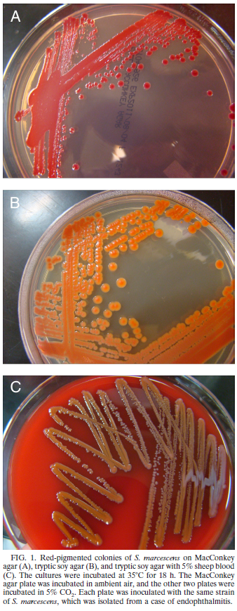
Serratia marcescens
Found in
Water
Soil
Plants
Contaminated disinfectants
chlorhexidine, benzalkonium chloride, and hexetidine
Good at forming biofilms
Topped up disinfectant bottles
‘Bathtub ring’ in mop buckets
Insects
Animals
Mahlen 2011

Slide 29
Sources of Outbreaks
contaminated breast milk, formula, and breast pumps
contaminated parenteral nutrition
infants equipment such as incubators, laryngoscopes, suction tubes, soap dispensers and waste jars
air conditioning ducts
contaminated hand brushes contaminated disinfectants and soap
cotton wool pads
multidose nebulizer dropper bottles
multidose medications
Mahlen 2011

Slide 30
Legionella

Slide 31
Legionella
Water borne in majority of cases
Dust, soil can play a role
Construction!
Cooling tower maintenance
Dead legs
Removal of plumbing fixtures

Slide 32
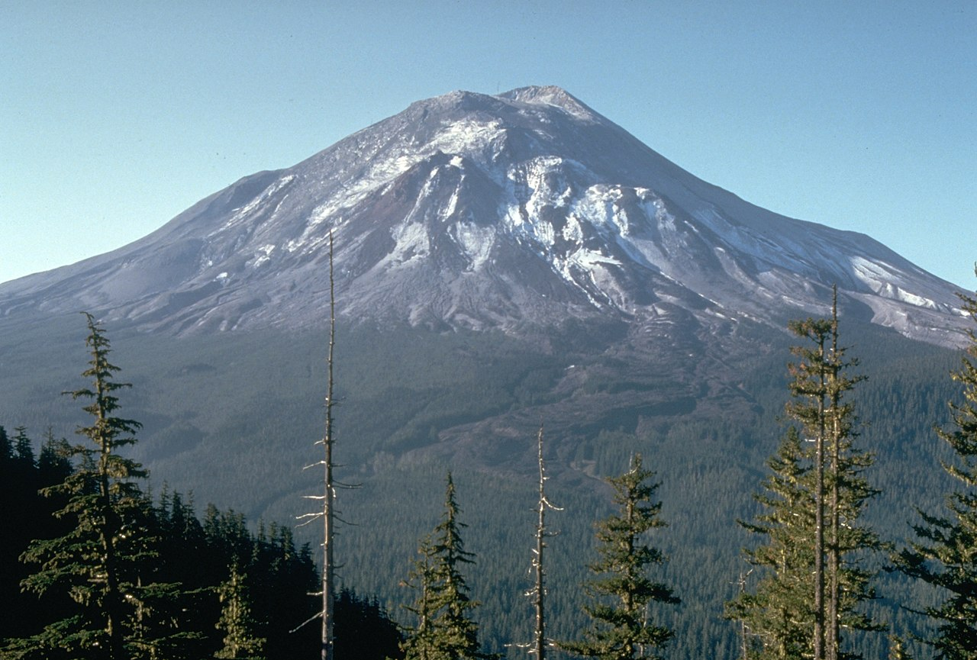
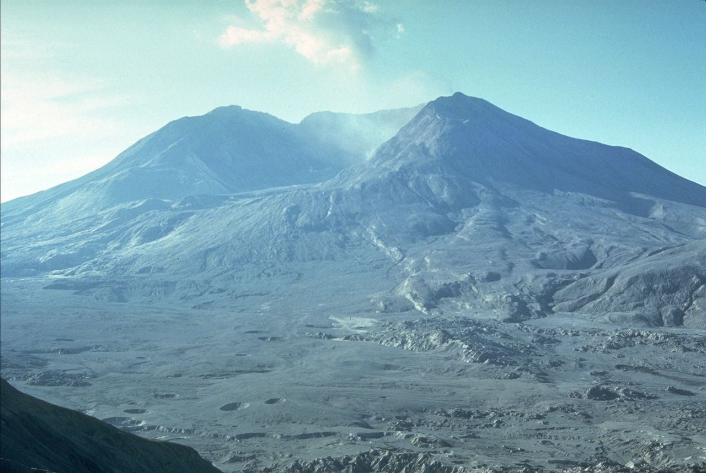
Legionella Trivia
Mount St. Helen’s Explosion
May 18, 1980
“sterilized’ lakes and streams
First microorganism to return
Amoeba
Second microorganism to return
Legionella
Harry Glicken - USGS Cascades Volcano Observatory, Public Domain, https://commons.wikimedia.org/w/index.php?curid=672199

Slide 33
Legionella Risk Factors
Age ≥50 years (?male?)
Smoking (current or historical)
Chronic lung disease (such as emphysema or COPD)
Immune system disorders due to disease or medication
Systemic malignancy
Underlying illness such as diabetes, renal failure, or hepatic failure
Recent travel with an overnight stay outside of the home
Recent care at a healthcare facility
Exposure to hot tubs
https://www.cdc.gov/legionella/clinicians/disease-specifics.html

Slide 34
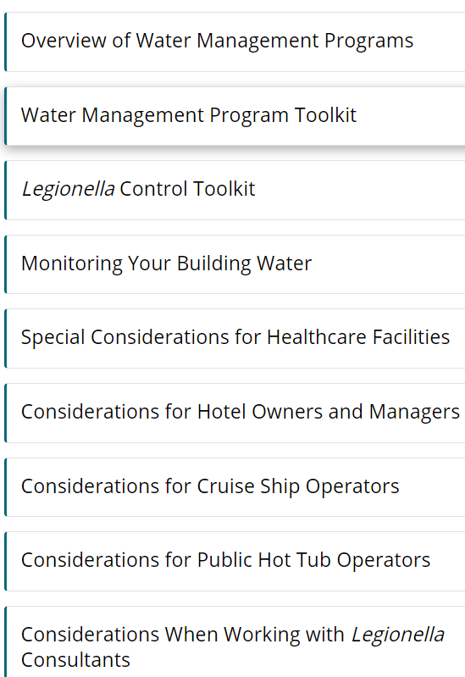
Legionella Water Plans
Need good understanding of risks
CDC (Free)
https://www.cdc.gov/legionella/wmp/index.html
ASHRAE 188-2021 ($100)
https://www.techstreet.com/ashrae/standards/ashrae-188-2021?product_id=2229689
ASHRAE overview
https://www.ashrae.org/file%20library/technical%20resources/standards%20and%20guidelines/risk-management-for-legionellosis.pdf

Slide 35
Legionella Water Plans (new)
Need good understanding of risks
CDC Reduce Risk from Water
https://www.cdc.gov/hai/prevent/environment/water.html
ICHE - Investigation of healthcare infection risks from water-related organisms: Summary of CDC consultations, 2014-2017
https://www.ncbi.nlm.nih.gov/pmc/articles/PMC7883772/

Slide 36
Specimen collection

Slide 37
Laboratory Rules
Provide as much information to the lab as possible:
site, appearance, time of collection, antibiotics in use
Bad: leg swab
Better: Left leg lesion swab
Best: Aspiration Left leg post op draining abscess
Anything unusual if suspicious
E.g., Travel hx, Yeast, gonorrhea,
At least two identifiers
Name, birthdate, number

Slide 38
Laboratory Rules
Get to lab as soon as possible
delays will allow susceptible bugs to die
delays will allow hardier bugs to grow
Check with lab on refrigeration if there is a delay
Urines for sure!

Slide 39
Swabs
Moisten swab if swabbing dry body parts
Use transport media or sterile saline
Different swabs for different specimens
Will vary by hospital/clinic
C&S, PCR, chlamydia, anaerobic, charcoal

Slide 40
Urines
Midstream or in/out catheter
For Culture and Sensitivity (C&S) or Urinalysis (UA)
A negative dipstick tells you there is not an infection
A positive dipstick tells you nothing!
Specimen quality
Bacteriuria

Slide 41
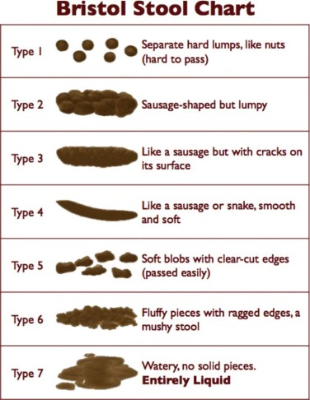
Stool (Feces)
Not contaminated by urine or water (if possible)
Just enough specimen to bring transport fluid up to line on container!
C. difficile: must assume shape of dry container
Bristol stool scale 5-7
Diarrhea not by other causes
J Pediatrics

Slide 42
Swab by Anatomy
Throat
Tonsillar crypt
Nose
Never for sinusitis
Usually bilateral
Indicate if wound/lesion/trauma
Mouth
Indicate why sending: thrush?, Lesion?

Slide 43
Swab by Anatomy
Eye
Remove debris, rub along conjunctiva and lid junction
If glued together: bacterial
If able to open: viral
Sputum
First morning
No ‘swirling’: direct to container!
Ear
Not to be sent for otitis media, note if ear drum has ruptured!

Slide 44
Swab by Anatomy
Genital
Vaginal
Remove mucous
Cervix
Remove mucous
Insert swab until ‘cotton’ not visible
Urethral
Express pus on slide (gonorrhea)
For Chlamydia, 2-3 cm, rotate 10 times

Slide 45
Swab by Anatomy
Wounds
Aspirate leading edge of erythema
Clean wound with saline then swab
Do NOT want pus
Debride?
Fluids
Proper skin prep first

Slide 46
Best Nasopharyngeal Video
https://www.youtube.com/watch?v=DVJNWefmHjE

Slide 47
Summary
Environmental organisms can cause issues in our healthcare settings
Getting good specimens gets good results
Garbage on…garbage out! (GOGO)

Slide 48
Summary
Aspergillus
Construction/HVAC that you don’t know about
Stenotrophomonas
Taps, spigots
Serratia
cleaning tools with biofilm
Pseudomonas
water

Slide 49
References/Resources
An S, et al. Stenotrophomonas maltophilia. Trends in Microbiology https://doi.org/10.1016/j.tim.2018.04.006
APIC Text: Chapter 24 – Microbiology Basics. https://text.apic.org/toc/microbiology-and-risk-factors-for-transmission/microbiology-basics
CDC Aspergillus https://www.cdc.gov/fungal/diseases/aspergillosis/index.html
Benedict K, et al. Invasive fungal infections after natural disasters. Emerg Infect Dis 2014;20(3):349-355
Brooke JS. Stenotrophomonas maltophilia: an emerging global opportunistic pathogen. Clin Micro Rev 2012;25(1):1-42 http://dx.doi.org/10.1128/CMR.00019-11

Slide 50
References/Resources
Canadian Standards Association. Z317.13-17. Infection control during construction, renovation and maintenance of health care facilities. 2017
Canadian Construction Association. CCA 82-2004. Mould guidelines for the Canadian construction industry. 2004
http://www.cca-acc.com/documents/cca-documents/ Accessed August 14, 2018
Cavallo M, et al. Monitoring environmental Aspergillus spp. contamination and meteorological factors in a haematological unit. Mycopathologia 2013;176:387-94

Slide 51
References/Resources
Environmental Protection Agency (402-K-01-001) Sept 2008
www.epa.gov/mold/moldguide.html
https://www.epa.gov/mold/mold-remediation-schools-and-commercial-buildings-guide
Jarvis WD. Bennett and Brachman's Hospital Infections, 6th ed. Philadelphia: Lippincott Williams & Wilkins, 2013. Chapter 11
Magill SS, et al. Changes in prevalence of health care– associated infections in U.S. hospitals. N Engl J Med 2018;379:1732-44. DOI: 10.1056/NEJMoa1801550
Mahlen SD. Serratia Infections: from Military Experiments to Current Practice. Clin Microbiol Rev 2011;24(4):755-91

Slide 52
References/Resources
Riedel S, Hobden JA, Miller S, Morse SA, Mietzner TA, Detrick B, et al. Jawetz, Melnick & Adelberg’s medical microbiology. 28th edition. New York: McGraw-Hill Education; 2019.

Slide 53
Contact
Jim Gauthier, MLT, CIC
Senior Clinical Advisor, Infection Prevention
(613) 328-2288
james.gauthier@diversey.com
Linda Sowell
Healthcare Sales Executive
(404) 295-5077
linda.sowell@diversey.com

