Slide 1
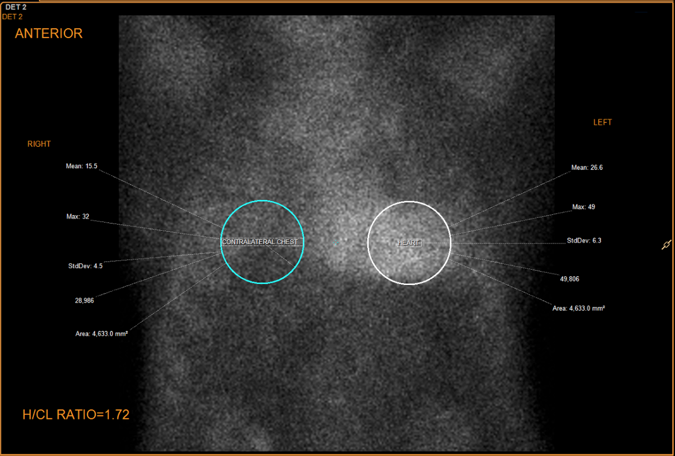
Complete Heart Block (CHB) as an Alerting Symptom of Wild-Type ATTR Amyloid Cardiomyopathy
Tariq Odeh, MD¹; Gary Dalley, MD¹, Ugochukwo Egolum, MD², James Kruer, MD¹
¹Department of Internal Medicine, GME Northeast Georgia Medical Center, Gainesville & Braselton, GA
² Advanced heart failure, The Heart Center, Northeast Georgia Medical Center, Gainesville, GA
INTRODUCTION
DISEASE TIMELINE
LEARNING POINTS FOR INTERNIST
Age-related cardiac amyloidosis is present in up to 13% of cases of heart failure with reduced ejection fraction (HFrEF). Presenting in the 7th decade with a life expectancy of 3-5 years from time of diagnosis. ¹ Standard heart failure (HF) treatment with some modifications relieves symptoms. Until recently, no treatments with proven mortality benefit were available.
We will present a case that illustrates the unfortunately common delay in diagnosis and the potential benefit of a new drug in wild-type transthyretin (TTR) cardiac amyloidosis.
Multiple encounters for chest pain, dyspnea, and HF exacerbations throughout 2016-2019
2016 | 2017
August - TTE: Stable moderate LVH LV EF reduced 40-45% October - TTE: Stable moderate LVH Stable LV EF 40-45% October - LHC: No change and patent stent | January - TTE: LV EF reduced 35-40% February - TTE: LV EF reduced 30-35% August - TTE: LV EF reduced 30% Severe LVH with restrictive pattern 10% global longitudinal strain
2018 | 2019
March Endomyocardial Biopsy: Cardiac Amyloid Mass-SPEC: Wild-Type (non-hereditary) TTR Amyloid Tc-99m PYP scan showing amyloid uptake Treatment: Monotherapy: Diflunisal 500 mg p.o. BID | February - TTE: LV EF reduced 25% CRT-P for symptomatic HF (Patient deferred defibrillator) Triple therapy: Diflunisal plus Doxycycline 100 mg p.o. BID Tauroursodeoxycholic acid 250 mg p.o. TID June Tafamidis was initiated
Conduction abnormalities, particularly CHB should bring cardiac amyloidosis forward in the differential diagnosis.
Cardiac amyloidosis is far more common than previously believed and can now be detected before the onset of classic symptoms of restrictive physiology
99mTc-PYP is non-invasive, relatively inexpensive with sensitivity of 82%, specificity 98.8% for ATTR cardiac amyloidosis with a positive predictive value of 88% for TTR amyloid ^{4,5} making the need for endomyocardial biopsy not essential for an actionable diagnosis.
Tafamidis is a newly available disease-modifying agent with mortality benefit (RR 13.4%) ² that may be enhanced with treatment initiation earlier in the disease process.
Patient symptoms, quality of life, and health care overutilization often improve once a treatable disease is identified and addressed.
CASE PRESENTATION
This is an 81-year-old Caucasian gentleman with history coronary artery disease (CAD), gastroesophageal reflux disease, and chronic pain secondary to cervical spinal stenosis. He is a retired autoworker and a former smoker. Family history is unremarkable.
Initial Findings:
Steady symptoms including chest pain, dyspnea, dyspepsia, and arm and neck pain consistent with his medical history.
Admitted for chest pain and dyspnea in January 2015 with no formal diagnosis made. Left heart catheterization (LHC) revealing patent stent.
In April 2015, he was admitted for new-onset HF associated with new frequent PVC’s, bigeminy, and RBBB. A Cardiac MRI revealed an increased LV mass with normal LV cavity size. No evidence of scarring.
Inciting Event:
June 2016
CHB and a dual-chamber PPM was placed
TTE: Moderate LVH; LV EF 55-60%
TECHNETIUM PYROPHOSPHATE SCAN AND TAFAMIDIS
FOLLOW UP
PYROPHOSPHATE SCAN (99mTc-PYP)
Patient image shows a heart (white circle) to contralateral (blue circle) uptake ratio of 1.72.
Image is from the department of nuclear medicine at NGMC Gainesville.
TAFAMIDIS : 60 MG ORAL ONCE DAILY
FDA-approved in May 03, 2019 Stabilizes the TTR tetramer and may thus reduce formation of TTR amyloid
Reduced mortality compared with placebo (29.5 vs 42.9% ; HR 0.70; 95% CI 0.51 to 0.96). NNT is 7.5 to prevent 1 death over the 2.5-year study period ².
Reduced cardiovascular-related hospitalizations (0.48 vs 0.70 per year; RR 0.68; 95% CI 0.56 to 0.81). Reduced the rate of decline in six-minute walk distance and Kansas City Cardiomyopathy Questionnaire-Overall Summary (KCCQ-OS) ³.
The patient is currently 85 years old and has an active lifestyle and reports less symptoms of dyspnea and fatigue. He is now able to brisk walk three times weekly.
He continues to have cardiology follow-ups every 3 months with stable EF
REFERENCES
1. Eur Heart J. 2015 Oct 7;36(38):2585-94. doi: 10.1093/eurheartj/ehv338. Epub 2015 Jul 28.
2. Maurer MS, Mann DL. The Tafamidis Drug Development Program: A Translational Triumph. JACC Basic Transl Sci. 2018;3(6):871-873. Published 2018 Dec 31. doi:10.1016/j.jacbts.2018.10.001
3. Tafamidis Treatment for Patients with Transthyretin Amyloid Cardiomyopathy. Maurer MS, Schwartz JH, Gundapaneni B, Elliott PM,, ATTR-ACT Study Investigators, N Engl J Med. 2018;379(11):1007. Epub 2018 Aug 27
4. ESC Heart Fail. 2019 Oct;6(5):1041-1051. doi: 10.1002/ehf2.12511. Epub 2019 Sep 5.
5. Bokhari S, Shahzad R, Castaño A, Maurer MS. Nuclear imaging modalities for cardiac amyloidosis. J Nucl Cardiol. 2014;21(1):175-184. doi:10.1007/s12350-013-9803-2

