Slide 1
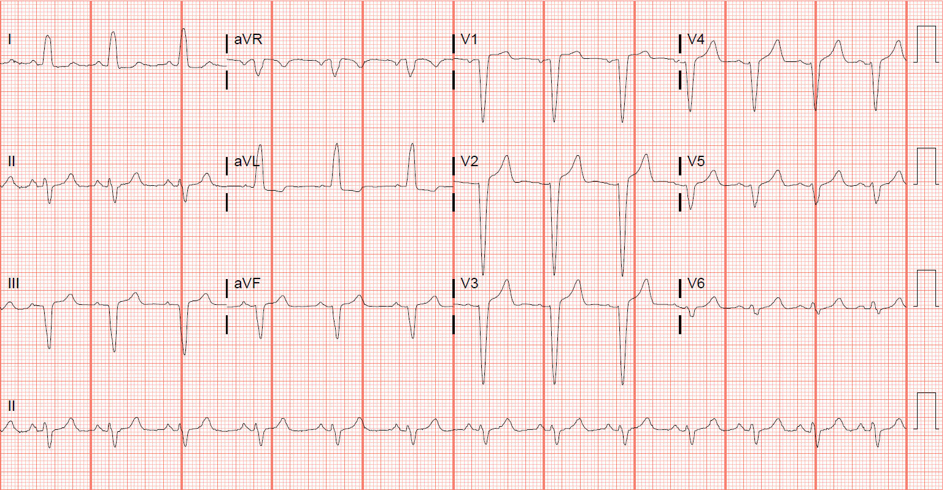
Greece and its Cardiac Sequelae
Tariq Odeh, MD¹; Robert Oberman, DO¹; Dilesh Patel, MD²
¹Department of Internal Medicine, NGMC GME
²Faculty, Inpatient Medicine, NGMC
INTRODUCTION
HOSPITAL COURSE
FOLLOW UP
Self-administered supraphysiologic doses of steroids have been associated with cardiovascular toxicities secondary to direct myocardial cell injury and fibrosis as a result of mitochondrial disruption and induction of intra-fibrillar collagen dysplasia.
Cardiovascular toxicities include arrhythmias, accelerated atherosclerosis, myocardial infarction, and heart failure.¹
Day 1 | Day 2 | Day 3 | Day 4
Vitals - within normal, except for sinus tachycardia (104) Patient reports symptom resolution, except for hand tingling & numbness Troponins trended TTE: LVEF 40 – 45% ß-blocker started Cardiology’s recommendation: Lexiscan MPI to evaluate for coronary artery disease Cardiac MRI to evaluate for prior infarction or myocarditis Neurology’s recommendation: Cervical MRI for numbness & tingling Aspirin for primary prevention | Vitals - within normal limits Tingling & numbness are present On Aspirin and Lopressor Imaging results: MPI: Post-stress EF 32% Cervical MRI: Small broad-based disc bulge at C3-4 Cardiology’s dilemma: To cath or not to cath? Neurology’s recommendation: Out-patient follow up for EMG Endocrinology consulted for steroid taper & risk of adrenal insufficiency | Vitals - within normal limits Tingling & numbness are present Rx: aspirin, carvedilol, losartan Cardiology’s decision? The wall motion abnormality is likely related to her conduction abnormality versus an actual myocarditis or ischemic disease. Cardiac CTA outweigh LHC Cardiac CTA results: No coronary disease CAC score 0 Continue HF therapy with current medications | Discharge day with medical optimization for HF therapy Aspirin 81 mg QD Carvedilol 12.5 mg BID Losartan 50 mg QD Out-patient follow up with cardiac EP to evaluate LBBB Endocrinology: Steroid taper regimen: decrease hydrocortisone by 5mg per week
Six month follow-up with out-patient cardiology:
Exertional dyspnea (strenuous activity)
Euvolemic status; warm and well perfused
S1 and S2 normal, no murmurs, gallops, or JVD
TTE: LVEF 40 – 45%
Plan: Continue current medical management
Out-patient follow-up with neurology:
EMG was unremarkable; symptoms improved with gabapentin
Out-patient follow-up with endocrinology:
Due to concerns for adrenal insufficiency; hydrocortisone 10 mg QD was started
One year follow-up with out-patient cardiology:
No exertional dyspnea; has feelings of palpitations
Euvolemic status; warm and well perfused
S1 and S2 normal, no murmurs, gallops, or JVD
TTE: LVEF 45 – 50%, Grade 1 diastolic dysfunction
Plan: Continue current medical management + spironolactone 25 mg & furosemide 20 mg daily
CASE PRESENTATION
A 53 year-old female presents to the ED with left facial and bilateral hand tingling & numbness, light-headedness, and diaphoresis for nine hours.
Past Medical History
Hypothyroidism on Armour Thyroid 120 mg QD
Type 2 diabetes mellitus on Metformin XR 500 mg QD
Self medicates with hydrocortisone (Cortef) 10 mg QID
Illness anxiety disorder
Obesity- BMI 35 kg/m²
History of Present Illness
Woke up from sleep at 3:00 AM with feelings of numbness involving her left face and bilateral hands that persisted for 9 hours prior to presenting to the ED. Her last known normal was the previous night.
She doesn’t report having weakness, speech difficulty, chest pain, palpitations, lower extremity swelling or dyspnea, nor did she report a history of alcohol usage or other recreational drug usage.
EVIDENCE OF ASYMPTOMATIC LV DYSFUNCTION VS HEART FAILURE
Findings during hospital course:
Exogenous steroid use
Transthoracic echocardiogram: LV EF 40 – 45%
Myocardial perfusion imaging: Post-stress EF 32%
Cardiac MRI: within normal
Cardiac CTA: within normal
LEARNING POINTS FOR THE INTERNIST
Steroid use has been previously associated with non-ischemic cardiomyopathy, a potentially life-threatening cardiotoxicity as an adverse effect of using exogenous glucocorticoids at supraphysiologic doses.
Glucocorticoid cardiotoxicity can potentially be non-reversible, and early recognition is essential to prevent further deterioration of cardiomyopathy.
INITIAL FINDINGS
Figure 1: EKG on admission: NSR with LBBB
STEROID-INDUCED HFmrEF AS A DIAGNOSIS OF EXCLUSION – A DISUSSION
Vitals: T 36.8 °C, HR 105, RR 16, BP 169/83, SpO2 98%
Physical Exam:
Diaphoretic, anxious, and crying
CV: tachycardic, regular rhythm with no murmurs, JVD, edema
Lungs: clear to auscultation bilaterally
Neuro:
Alert and oriented x 3
Left facial and b/l hand and feet numbness
Motor 5/5 throughout upper and lower extremities b/l
Tone, DTR’s, and coordination are within normal
CARDIAC IMAGING
Predisposing conditions for HF:
NHANES-I Study (PAR)²
ACKNOWLEDGMENTS
Coronary heart disease (62%)
Cigarette smoking (17%)
Hypertension (10%)
Obesity (8%)
Diabetes (3%)
Valvular heart disease (2%)
James Kruer, MD, our program director for his continuous support, guidance, and encouragement throughout the preparation process, Dilesh Patel, MD, inpatient medicine, for his thought process regarding the pathophysiologic phenomena regarding cardiomyopathy, and Gretchen Holmes, PhD, for her advise and constructive feedback.
Work-up on admission
CBC and CMP – Normal
Troponin I – Normal
TSH and ESR - Normal
Vitamin B12 – Elevated
Vitamin D – Low
EKG- NSR with LBBB
Imaging studies on admission
1. CTA head & neck: No stenosis, aneurysm, dissection, or hematoma.
2. MRI brain with contrast: No evidence of recent infarction or acute intracranial process.
Prevalence of asymptomatic LV dysfunction: Cross-sectional study³
REFERENCES
Figure 2: Cardiac MRI
The prevalence of asymptomatic LV systolic dysfunction was 1.4%, similar to that of overt heart failure.
Over 80% of the subjects with LV dysfunction had evidence of ischemic heart disease.
Figure 3: Cardiac CTA
Stergiopoulos, K., Mathews, R., Brennan, J., Setaro, J., & Kort, S. (2008). Anabolic steroids, acute myocardial infarction and polycythemia: A case report and review of the literature. Vascular Health And Risk Management, Volume 4, 1475-1480. doi: 10.2147/vhrm.s4261
He, J., Ogden, L., Bazzano, L., Vupputuri, S., Loria, C., & Whelton, P. (2001). Risk Factors for Congestive Heart Failure in US Men and Women. Archives Of Internal Medicine, 161(7), 996. doi: 10.1001/archinte.161.7.996
McDonagh, T., Morrison, C., Lawrence, A., Ford, I., Tunstall-Pedoe, H., McMurray, J., & Dargie, H. (1997). Symptomatic and asymptomatic left-ventricular systolic dysfunction in an urban population. The Lancet, 350(9081), 829-833. doi: 10.1016/s0140-6736(97)03033-x
Moderately decreased LVSF with wall motion dyskinesis- LVEF 40%
No evidence of prior infarction, scar, or myocarditis
LAD – no atherosclerosis
No evidence of coronary artery disease; CAC score = 0

