Slide 1
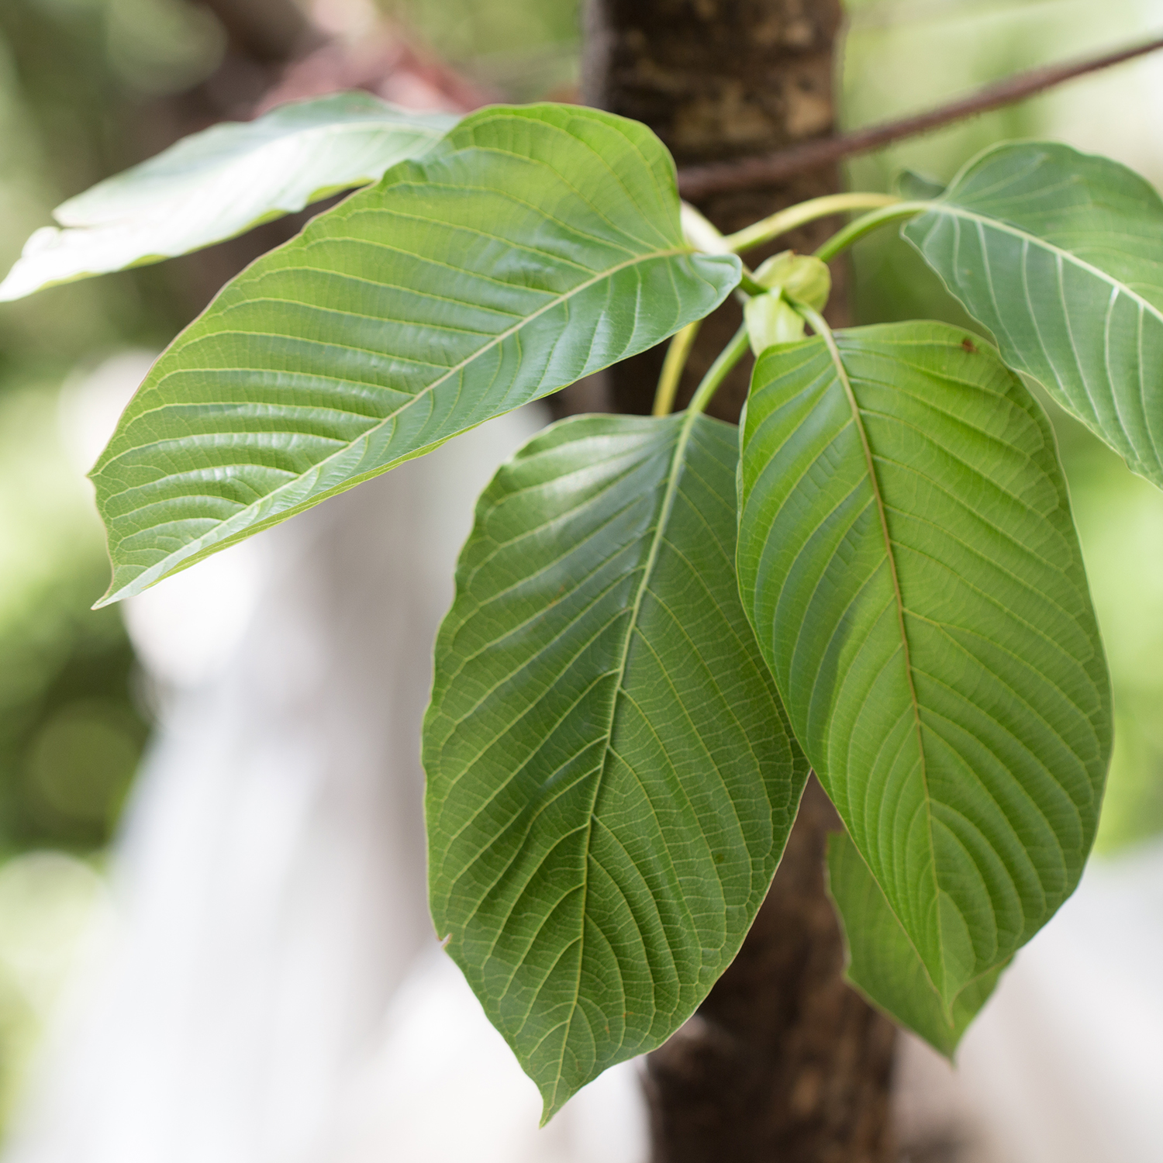
Severe encephalopathy with hyponatremia in a 34-year-old male secondary to Kratom toxicity
Loida Del Rio Lopez, MD; Comfort Adewunmi, DO; Tariq Odeh, MD; Riyadh Al-Rubaye, MD FASN.
Background
Clinical Vignette
Conclusion
Kratom, a product of a deciduous tree Mitragyna speciosa, is a plant-based substance used in Southwest Asia for the management of opioid withdrawal symptoms, with the first reports dating back to 1836. The leaf contains a psychoactive substance that has a variety of effects ranging from sedative, stimulant to euphoric effects. Electrolytes abnormalities are not reported in Kratom users. Here, we report a 34-year-old male patient who presented with severe hyponatremia in the setting of acute Kratom ingestion.
A 34-year-old gentleman with a previous history of opiate and methamphetamine substance use was brought to the emergency department from a drug rehabilitation program for acute-onset confusion and belligerent behavior which required sedation and mechanical ventilation.
The patient had ingested several tablets of kratom for the past week for sedation effect and as a replacement for opiate and amphetamine.
His vital signs on admission were stable, he was euvolemic, his pupils were equally round and reactive to light, there were no signs of head trauma, and breath sounds were normal.
Initial metabolic panel showed a sodium level of 118 mEq/L with mild elevation in white blood cell count; urine and serum osmolality were obtained and were 250 and 251 mosm/kg, respectively.
Laboratory and imaging studies including a urine drug screen, cerebrospinal fluid analysis, a computed tomography and magnetic resonance imaging were normal.
Emergent hypertonic fluids were administered.
Despite an appropriate gradual improvement in serum sodium, the patient was difficult to wean as he was combative, prompting for an electroencephalogram to evaluate for an underlying seizure; however, there were no epileptiform discharges observed.
Over the course of a week, the patient was extubated and was functioning at his baseline.
The diagnosis of hyponatremia-induced altered level of consciousness secondary to Kratom use represents a diagnosis of exclusion after we ruled out the possible causes of hyponatremia.
It appears that a majority of Kratom-dependent users had a prior substance use disorder or were seeking relief from a chronic pain condition but wanted to avoid opioid. Although the U.S and drug administration warned consumers not to use kratom due to the risk of addictive properties, it’s easily purchased online which poses problem for the physicians who are often unaware of this plant’s existence or side effects. We know that hyponatremia can be a side effect of substance abuse like amphetamines, but we don’t know how kratom toxicity can be manifested as hyponatremia. Additional research is paramount to support and expand on current findings.
Images
References
Eggleston, W., Stoppacher, R., Suen, K., Marraffa, J. M., & Nelson, L. S. (2019). Kratom Use and Toxicities in the United States. Pharmacotherapy: The Journal of Human Pharmacology and Drug Therapy, 39(7), 775-777. doi:10.1002/phar.2280
Meireles, V., Rosado, T., Barroso, M., Soares, S., Gonçalves, J., Luís, Â, . . . Gallardo, E. (2019). Mitragyna speciosa: Clinical, Toxicological Aspects and Analysis in Biological and Non-Biological Samples. Medicines, 6(1), 35. doi:10.3390/medicines6010035
Tayabali, K., Bolzon, C., Foster, P., Patel, J., & Kalim, M. O. (2018). Kratom: A dangerous player in the opioid crisis. Journal of Community Hospital Internal Medicine Perspectives, 8(3), 107-110. doi:10.1080/20009666.2018.1468693
Discussion
Poison control centers report incidences of kratom use in the United States as early as 2008. Due to its adverse reactions associated with long-term use, such as anorexia, paranoia, seizures, and coma, the FDA advises against the use of Kratom.
Kratom has a potent mu- and delta-opioid dual agonist action. Early recognition of the emerging kratom use and its serious adverse effects is essential to prevent significant patient harm and death. In light of the rarity of Kratom use, this case is intended to portray potentially life-threatening hyponatremia as an adverse effect of using Kratom.
Kratom (Mitragyna speciosa). Image obtained from National Center for Complimentary and Integrative Health
Retrieved from https://www.nccih.nih.gov/health/kratom

