Slide 1
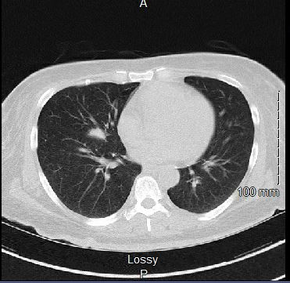
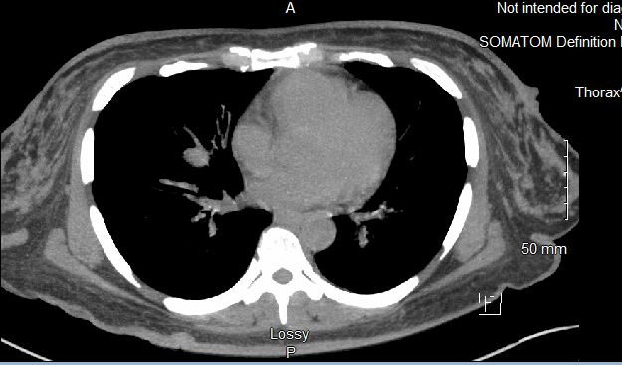
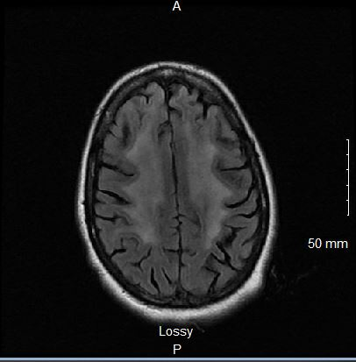
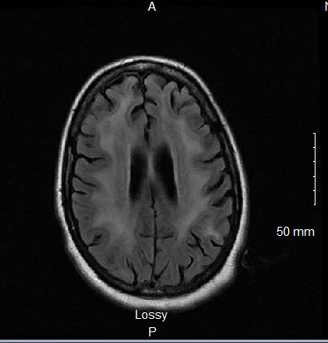
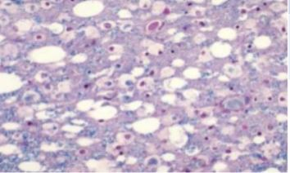
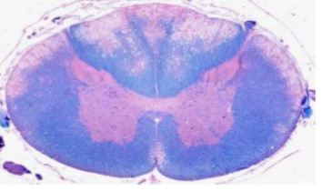
Vacuolar Myelopathy Presenting in an Undiagnosed HIV Positive Patient
Sahil Parag, DO¹; Izzeldin Abdalla, MD¹
¹: Northeast Georgia Medical Center- Department of Internal Medicine
Objectives
Case Presentation
Discussion
Typical onset of HIV Myelopathy
Understanding the rapid progression of HIV Myelopathy
Differentials to consider in a patient presenting with bilateral leg weakness and a history of HIV
Diagnosis of HIV Myelopathy
Pathogenesis of Vacuolar Myelopathy
How this case serves as a unique example of vacuolar myelopathy symptoms on presentation leading to the diagnosis of HIV
A 45-year-old African American female presented to a community hospital for evaluation of bilateral leg weakness
Described as a rapidly progressive weakness, causing her to fall backward
MRI Brain: confluent white matter abnormalities which were significant for the patient's age and concerning for possible leukoencephalopathy.
HIV preliminary test was positive, confirmation send out test positive
PT consulted; patient recommended to be discharged with Home Health
Four weeks later, the patient presented for a second time to a community hospital complaining of worsening leg weakness and progressive loss of bladder control
Physical Exam: She denied associated paresthesia or specific loss at a sensory level. Alert and oriented to person, place, and time. CN intact, cerebellar and gait testing was negative, she had normal muscle tone, 4/5 muscle strength in upper and lower extremities, and +1 deep tendon reflexes bilaterally and was found to have an upgoing Babinski bilaterally.
Given the patients progressively worsening leg weakness in the setting of HIV/AIDS, there was a concern regarding a possible infectious vs. malignant etiology.
Further investigation was conducted with an MRI Cervical-spine and CT Chest. MRI was unremarkable, and CT chest showed a spiculated infrahilar right middle lobe lesion measuring 1.7cm with a ground-glass opacity in the left upper lobe.
Infectious disease was consulted and started the patient on empiric treatment for Pneumocystis Pneumonia (PCP) and Mycobacterium Avium Complex (MAC), with Azithromycin and Bactrim.
It was thought the opacity was likely due to Mycobacterium Avium Complex (MAC),
Given her extensive negative workup with a new diagnosis of HIV, low CD4 count, and MRI brain findings, it was thought that her bilateral lower extremity weakness progression was secondary to HIV associated Myelopathy
HIV genotyping was ordered for the patient to be started on specific Anti Retroviral Therapy(ART) within a week
Physical therapy evaluated the patient again, plans for safe discharge were discussed with her family, and the patient was discharged home with home health again
In this patient, bilateral leg weakness, leading to falling backwards was her symptom that caused initial presentation
HIV status was unknown, and eventually tested during first admission after MRI brain findings
Preliminary HIV test was positive and send out was ordered. This case serves as a unique example of a which the symptoms of bilateral leg weakness lead to the diagnosis of HIV and vacuolar myelopathy
During each admission, the patient presented with worsening bilateral leg weakness which eventual led to progression of urinary frequency, urgency then incontinence
Extensive infectious etiology studies and analysis were found to be negative and patient was diagnosed with HIV myelopathy off clinical presentation, imaging, and exclusion
She was also found to have imaging findings suspicious for MAC and on last presentation concern for lymphoma was present
In the span of three months, an initial presentation of lower extremity weakness progressed to findings of ground glass opacity in left upper lobe and then significant lymphadenopathy
Given the rapid progression and prognosis of HIV myelopathy, home hospice was discussed and agreed upon with the patient
There are many reported cases covering the progression and life expectancy of vacuolar myelopathy, but rarely is the presenting symptoms the leading findings towards a patient’s HIV case
Introduction
HIV myelopathy is found in up to half of the patients with AIDS when taken for autopsy.
Rarely is it the presenting symptom leading to the diagnosis of HIV/AIDS.
Clinical changes occur when the pathology of HIV myelopathy is advanced and approximately only a quarter of patients that have myelopathy findings during the autopsy, have symptoms during life.
It is a disease typically seen in the later stages of AIDS with a short life expectancy after diagnosis. Typically, patients die within 6 months of diagnosis.
Diagnosis
Labs and Imaging
Conclusion
Can be difficult given the advancement in AIDS typically needed
Many of these patients have HIV related dementia, obscuring the myelopathy symptoms needed to aid in diagnosis.
Symptoms usually involve a progressive decline, loss of vibration/position sense, urinary frequency/urgency, spastic paraparesis, and incontinence.
Lower extremity function is most often involved, and many presentations have normal upper extremity function.
Diagnosis is made by exclusion, given HIV diagnosis, CSF studies, and specific pathogen studies are useful to rule out. CSF studies in these patients are usually nonspecific, with mild protein elevation.
CD4 Count: | 31
HIV Viral Load | 6.59 log copies/ml
JC Virus | Negative
HTLV I/II antibody | Negative
CMV | Negative
Coccidioides Immitis | Negative
Syphilis RPR | Negative
HSV | Negative
Enterovirus | Negative
B12 | Normal
Acid Fast Bacilli | Positive
QuantiFERON gold | Indeterminate
Meningitis/Encephalitis panel | Negative
SARS Coronavirus | Negative
VZV | Negative
Histoplasma | Negative
Toxoplasma Gondii | Negative
Right Inguinal Lymph Node Biopsy | HIV-associated diffuse large B-cell lymphoma
EBV | Positive
Vacuolar Myelopathy is a late presentation in HIV positive patients
It typically manifests with lower extremity spastic paraparesis along with loss of vibration/position sense, urinary frequency/urgency/ and incontinence, with vacuolar myelin appearance in the dorsal and lateral columns
We are presenting a case where a patient presented with lower extremity weakness, unknown HIV history, who was found to have the clinical picture of HIV myelopathy
Given the rapid decline in patients after a diagnosis has been made, cases like this can be useful in rapid diagnosis in a patient that may have a HIV unknown history
Pathogenesis
References
Pathogenesis is not fully known, with possible thought to a link between abnormal transmethylation mechanisms caused by HIV over time.
This is thought to cause demyelination of the dorsal columns and lateral columns.
The name of vacuolar myelopathy stems from the appearance of vacuoles in the myelin sheaths.
Given the location of the vacuoles in the dorsal and lateral columns, the presentation can be like those seen in subacute combined degeneration, but with a normal B12 level.
-Di Rocco A, Simpson DM. AIDS-associated vacuolar myelopathy. AIDS Patient Care STDS. 1998 Jun;12(6):457-61. doi: 10.1089/apc.1998.12.457. PMID: 11361993.
-Levin SN, Lyons JL. HIV and spinal cord disease. Handb Clin Neurol. 2018;152:213-227. doi: 10.1016/B978-0-444-63849-6.00017-7. PMID: 29604979.
-Ernst F, Klausner F, Kleindienst W, Bartsch H, Taylor N, Trinka E. Diagnostic challenges in vacuolar myelopathy: a didactic case report. Spinal Cord Ser Cases. 2016 Sep 15;2:16020. doi: 10.1038/scsandc.2016.20. PMID: 28053763; PMCID: PMC5129393.
-Tan SV, Guiloff RJ. Hypothesis on the pathogenesis of vacuolar myelopathy, dementia, and peripheral neuropathy in AIDS. J Neurol Neurosurg Psychiatry. 1998 Jul;65(1):23-8. doi: 10.1136/jnnp.65.1.23. PMID: 9667556; PMCID: PMC2170156.
-R. Staudinger and K. Henry, “Remission of HIV myelopathy after highly active antiretroviral therapy,” Neurology, vol. 54, no. 1, p. 267, 2000.
-Natalia Wuliji, Matthew J. Mandell, Jason M. Lunt, Adam Merando, "HIV-Associated Vacuolar Myelopathy and HIV-Associated Dementia as the Initial Manifestation of HIV/AIDS", Case Reports in Infectious Diseases, vol. 2019, Article ID 3842425, 4 pages, 2019. https://doi.org/10.1155/2019/3842425
B
A
C
D
Figure 2. CT Chest without contrast evaluating spiculated mass. A) Spiculated infrahilar right middle lobe lesion along the minor fissure. B) Same CT as in A but used for measurement, 1.7 x. 1.2cm. This mass appeared increasing in size and concerning for neoplasm.
Figure 3. MRI Brain with and without contrast for initial evaluation of bilateral leg weakness. C &D) Confluent white matter abnormalities noted throughout both hemispheres, this is significant for the patient age and atypical for small vessel ischemic changes, findings concerning for leukoencephalopathy
Figure 1) On the left, an example of vacuolar changes seen in myelin sheaths in a patient with HIV associated Vacuolar Myelopathy. On the right, and example of changes seen in B12 deficiency

