Slide 1
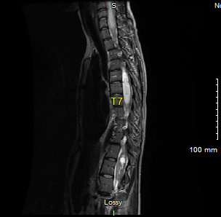
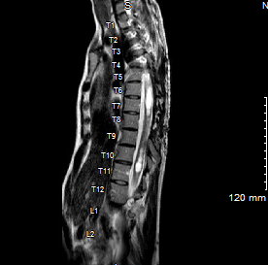
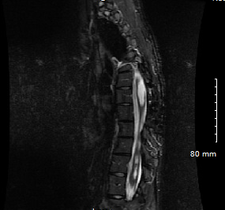
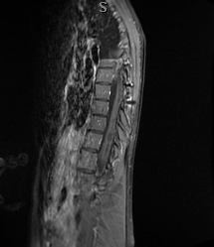
Pilomyxoid Astrocytoma of Thoracic Spinal Cord with Neurofibromatosis Type 1 Responsive to Neurosurgery and Chemotherapy
Cesar Sanchez MD, Celine Fadel DO, Aman Kaur DO, Idopise Umana, MD
Northeast Georgia Medical Center, department of Internal Medicine, Gainesville, GA
Introduction
Images
Timeline of Disease Progression
Pilomyxoid Astrocytoma (PMA)
WHO grade II, aggressive, rare, central nervous system tumors
Most commonly pediatric patients
Usually in cerebellum, thalamus, or hypothalamus/optic pathways
Few case reports of PMAs with coexisting diagnosis of Neurofibromatosis Type 1 (NF1)
PMAs in the spinal cord, rather than brain, identifies an uncommon presentation.
This presentation requires a novel treatment approach
This case presented to Hematology Oncology clinic
Case will identify first and second line chemotherapy options
Patient initially diagnosed with Pilomyxoid Astrocytoma and Neurofibromatosis type 1 in 2015.
Initially treated with Carboplatin for a year which showed progression of the disease [Figure 2].
Management changed to Camptosar and Avastin.
Dual therapy helped control her condition, subsequently continued for a year [Figure 3].
Other than occasional headaches, no other side effects noted
Condition continued to improve meriting de-escalation to monotherapy with Avastin [Figure 4].
Weakness and numbness of extremities noted following trail of Avastin discontinuation; likely due to progression of condition when not on the therapy
Astrocytoma remains controlled with Avastin.
Initial Diagnosis
23-year-old female with a past medical history of severe levoscoliosis
Progressively worsening back pain, and bilateral numbness to upper extremities, distally to fingertips.
Endorses abnormal gait and weakness when standing upright.
MRI of spine: Large intermedullary tumor extending from T2-T12, consistent with a neoplasm [Figure 1]
Neurosurgery performs T4-T8 laminectomy and subtotal excision of thoracic tumor
Pathology confirms Pilomyxoid Astrocytoma grade (I/II)
Genetic markers: negative for IDH1 and BRAF:KIAA1549
Further genetic testing yields mutation in NF1 gene, indicative of Neurofibromatosis Type 1.
Discussion
Unique presentation of rare, pediatric CNS tumor in adult, complicated by the unusual primary tumor site in the spinal cord
Associate NF1 with predisposition of PMAs in adults
Review of current literature shows scarcity of formal recommendations for treatment of spinal PMAs
Negative tumor markers decrease therapeutic options
TOC: Surgery when lesion is amenable to resection
Post-surgical radiation therapy therapeutic but can precipitate further peripheral sheath tumors + secondary future malignancies in NF1 patients.
Management initiated based on pathology of tumor as opposed to location
First line: Carboplatin showed progression after 1 year
Second line: Combination of Irinotecan, topoisomerase I inhibitor, + Bevacizumab, antiangiogenic
Second line therapy proved effective therapeutic approach
Figure 1 (Initial diagnosis): MRI of Thoracic spine indicating an intramedullary mass spanning from T4-T5 through T7-T8 consistent with neoplasm. (Image used with permission from Northeast Georgia Medical Center Diagnostic Radiology)
Figure 2 (After a year on Carboplatin): Concerning for mild progression of disease within the thoracic spine with enlarging areas of postcontrast enhancement predominantly at T5 through T7. (Image used with permission from Northeast Georgia Medical Center Diagnostic Radiology)
Case Presentation
History of Present Illness:
26-year-old female with a past medical history of Neurofibromatosis type 1 and astrocytoma presents to the emergency department with bilateral lower extremity weakness and numbness of 1-day duration. Patient had recently finished her chemotherapy with Avastin. She stated that she gets these kind of symptoms when her chemotherapy is stopped. Her astrocytoma has been controlled with multiple regimen of chemotherapy.
Family History:
Father - Factor V Leiden deficiency
Mother – Stroke
Social History:
No tobacco history. Social alcohol consumption. Denies recreational drug use.
Hospital course:
Treated with IV Decadron, with mild alleviation of symptoms, but no complete symptoms resolution
Conclusion
Treatment PMA in NF1 with negative tumor markers
Surgical resection
First line: Carboplatin
Second line: Irinotecan and Bevacizumab
No history NF1, consider surgery with radiotherapy
Positive tumor markers: IDH1 or BRAF:KIAA1549
Targeted therapies are appropriate
Recognition and hope for future patients with similar presentations.
Figure 3 (Status-post 1-year therapy with Camptosar/Avastin): Large expansile cystic lesion within the thoracic spinal cord consistent with the patient’s clinical history of spinal cord malignancy. No major increase in size. (Image used with permission from Northeast Georgia Medical Center Diagnostic Radiology)
Figure 4 (Avastin monotherapy): Considerable improvement from previous studies with only a thin smooth rim of enhancement along the posterior and right side of the cord at the T6-7 through T8 levels. No new findings. (Image used with permission from Northeast Georgia Medical Center Diagnostic Radiology)
References
Lowe GM. Magnetic resonance imaging of intramedullary spinal cord tumors. J Neurooncol. 2000;47(3):195-210. doi:10.1023/a:1006462321234
Kibola AH, McClelland III S, Hlavin J, Friedman JA. Pilomyxoid astrocytoma in an adult woman: Case report. J Can Res Ther 2015;11:667
Mukherji SK. Bevacizumab (Avastin). AJNR Am J Neuroradiol. 2010;31(2):235-236. doi:10.3174/ajnr.A1987
Rodriguez F.J., Perry A., Gutmann D.H., O’Neill B.P., Leonard J., Bryant S., Giannini C. Gliomas in neurofibromatosis type 1: A clinicopathologic study of 100 patients. J. Neuropathol. Exp. Neurol. 2008;67:240–249. doi: 10.1097/NEN.0b013e318165eb75.
Ullrich, N. (2016). Neurofibromatosis type 1-associated brain tumors. Journal of Rare Diseases Research & Treatment, 1(2), 11-16. doi:10.29245/2572-9411/2016/2.1017

