Slide 1
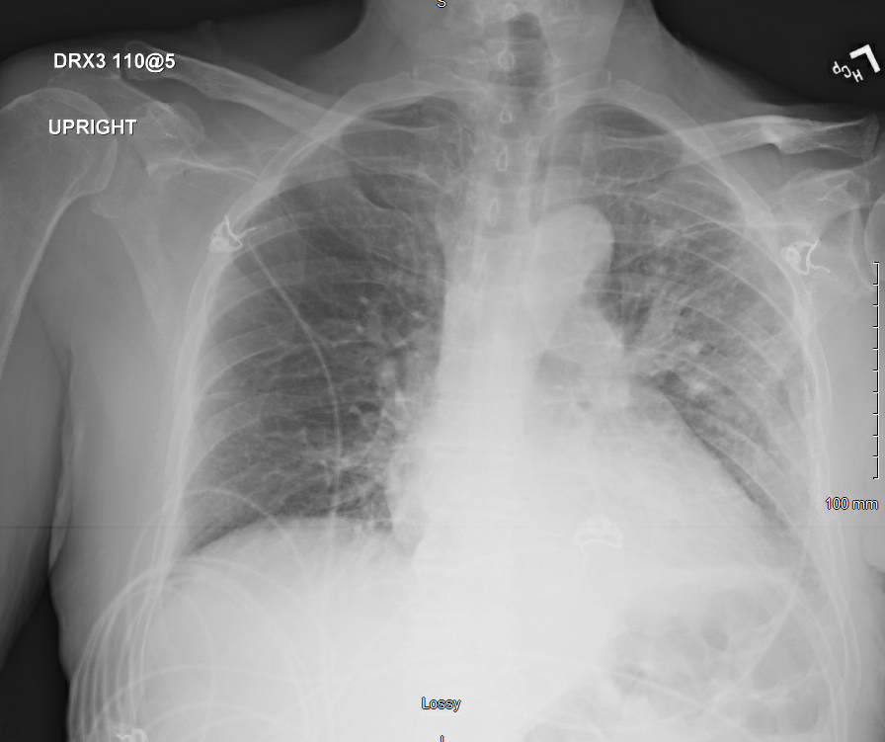
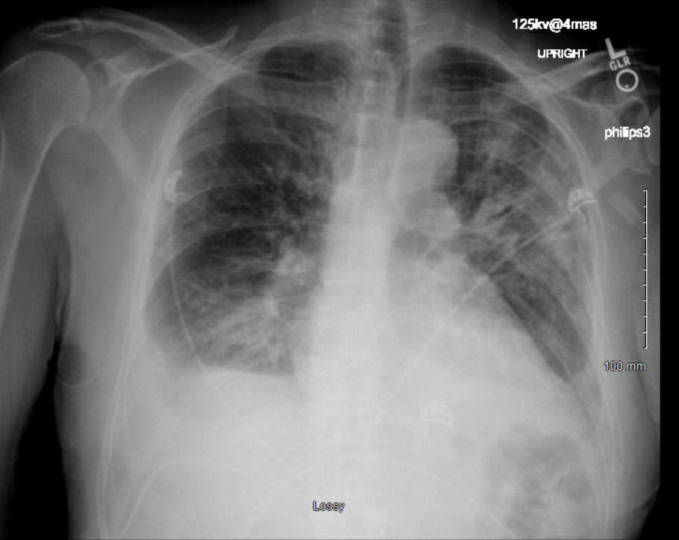
Dasatinib-induced recurrent pleural effusion in a 72-year-old man with a history of bone marrow transplantation
Comfort Adewunmi, DO; Loida Del Rio Lopez, MD; Riyadh Alrubaye, MD.
Introduction
Case Presentation
Conclusion
Dasatinib is a second-generation selective tyrosine kinase inhibitor (TKI) that has long been proven to be effective in the long-term treatment of CML, especially Philadelphia chromosome positive CML, and acute lymphoblastic leukemia (ALL) resistant or intolerant to Imatinib. [1]
Pleural effusion is an accumulation of fluid in the pleural cavity that presents with worsening shortness of breath.
We present a 72-year-old man with a history of bone marrow transplantation due to acute lymphoblastic leukemia who presented with Dasatinib-associated pleural effusion.
A 72-year-old man with a past medical history of acute lymphoblastic leukemia (status post bone marrow transplantation 6 months ago) on Dasatinib and sirolimus presented with a 2-week history of progressive cough, fever, and shortness of breath. The patient denied any known sick contacts.
On examination, the patient had a body temperature of 103 F, a heart rate of 106 beats per minute, a respiratory rate of 33 cycles per minute, and an oxygen saturation of 89% while breathing room air. His respiratory examination revealed crackles and decreased air entry bilaterally.
He had a white blood cell count of 3900 cell/mm, and an LDH titer of 152 unit/L. The patient’s chest X-ray showed features of bilateral interstitial infiltrates and bilateral pleural effusion.
The patient was admitted to the hospital with a diagnosis of bilateral interstitial pneumonia and bilateral pleural effusion. Pleural fluid analysis showed features of an exudate according to the light criteria with leukocytosis of 800 cells/mm and mixed cell counts including lymphocytes, neutrophils, and macrophages. The fluid cytology and bacterial culture were both negative. Although broad-spectrum intravenous antibiotics were administered, the patient’s clinical condition did not improve.
Therapeutic thoracentesis was done several times during his hospital stay because of the recurrence of the pleural effusion. After ruling out infectious and cardiac causes, we discontinued Dasatinib based on its ability to cause fluid retention. As a result, the pleural effusion stabilized, and the patient’s condition improved significantly. We, therefore, posed a final diagnosis of recurrent pleural effusion secondary to Dasatinib toxicity.
Although pleural effusion is most commonly caused by cardiac, infectious, or malignant processes, hospitalists should be aware of its rare causes after excluding the common etiologies.
Pleural effusion is a rare side effect of Dasatinib; therefore, patients on Dasatinib should be monitored for the development of early manifestations of fluid retention and pleural effusion. [1]
In the event of recurrent pleural effusions, Dasatinib should be substituted with another tyrosine kinase inhibitor. [4]
Imaging
Imaging
Discussion
Pictures above: One view Chest X-ray.
1 day after thoracentesis. Image used with permission from the Northeast Georgia Medical Center Diagnostic Radiology
Drug induced pleural disease is rare, and may present as an isolated occurrence, accompany parenchymal diseases or present in the context of generalized and even life-threatening systemic reactions. [2]
The exact mechanism Dasatinib induces pleural effusion is unclear. Dasatinib inhibits targets other than BCR‐ABL, potent inhibition of PDGFR‐β leading to a reduction in interstitial fluid pressure or inhibition of SRC‐family kinases leading to changes in vascular permeability. [3]
In patients with grade 2 to 3 pleural effusion, Dasatinib therapy must be discontinued; a short trial of diuretics and possibly oral steroids may be considered. [4]
After the effusion has resolved, Dasatinib can be resumed at a reduced dose. With adequate management, most patients continue therapy and have the opportunity to achieve the antileukemic effect reported with Dasatinib. [4]
Picture above: One view Chest X-ray. Worsening pulmonary vascular congestion pulmonary edema prior to thoracentesis. Image used with permission from the Northeast Georgia Medical Center Diagnostic Radiology
Reference
1. Goldblatt, M., Huggins, J. T., Doelken, P., Gurung, P., & Sahn, S. A. (2009). Dasatinib-Induced Pleural Effusions: A Lymphatic Network Disorder? The American Journal of the Medical Sciences, 338(5), 414-417. doi:10.1097/maj.0b013e3181ae9227
2. Kaiafa, G., Kakaletsis, N., Savopoulos, C., Perifanis, V., Giannouli, A., Papadopoulos, N., . . . Hatzitolios, A. (2013). Simultaneous manifestation of pleural effusion and acute renal failure associated with dasatinib: A case report. Journal of Clinical Pharmacy and Therapeutics, 39(1), 102-105. doi:10.1111/jcpt.12107
3. Quintás-Cardama, A., Kantarjian, H., Obrien, S., Borthakur, G., Bruzzi, J., Munden, R., & Cortes, J. (2007). Pleural Effusion in Patients With Chronic Myelogenous Leukemia Treated With Dasatinib After Imatinib Failure. Journal of Clinical Oncology, 25(25), 3908-3914. doi:10.1200/jco.2007.12.0329
4. Riou, M., Seferian, A., Savale, L., Chaumais, M., Guignabert, C., Canuet, M., . . . Montani, D. (2016). Deterioration of pulmonary hypertension and pleural effusion with bosutinib following dasatinib lung toxicity. European Respiratory Journal, 48(5), 1517-1519. doi:10.1183/13993003.01410-2016

