Slide 1
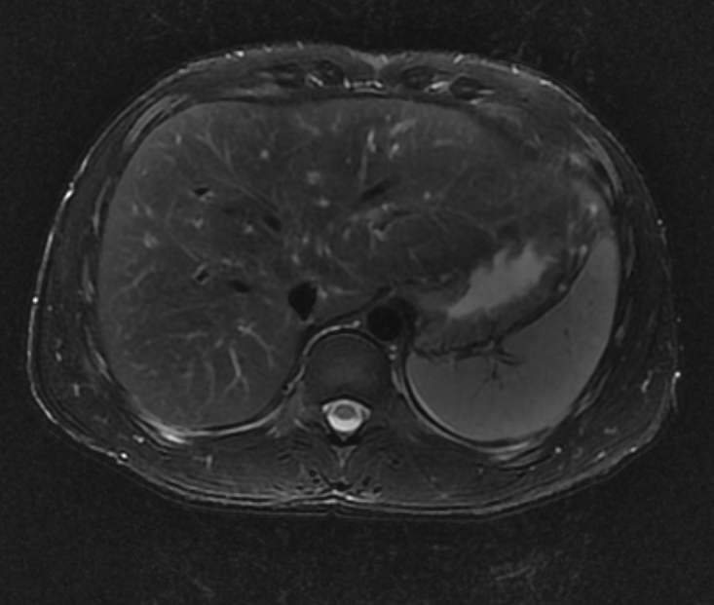
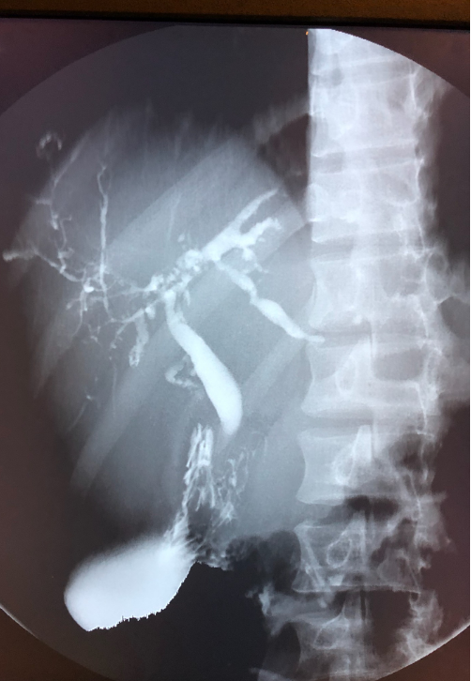
AN ATYPICAL PRESENTATION OF PRIMARY SCLEROSING CHOLANGITIS – A CASE REPORT
YUSUF ALIMI MD, JAWAD. A. ILYAS MD, JAMES. A. KRUER MD
Northeast Georgia Medical Center, Department of Internal Medicine; Gainesville, Georgia 30501
OBJECTIVES
CASE DESCRIPTION
LIVER TRANSPLANTATION IN PSC
Sclerosing cholangitis is the progressive damage and constriction of the biliary tree secondary to inflammation and fibrosis.
The three main categories are; primary, secondary, and IgG4-related sclerosing cholangitis. Even though they all present with features such as jaundice, pruritus, and elevated cholestatic enzymes, they have different etiologies, treatment response, and outcomes.
Often referred to as the last black box remaining in hepatology, Primary Sclerosing Cholangitis (PSC) has an unknown etiopathogenesis albeit strongly associated with IBD with up to 80% of individuals with PSC having IBD.
Without any known proven medical management that prolongs survival, PSC patients ultimately need liver transplantation.
The purpose of this report is to create awareness for an atypical presentation of PSC and ensure that physicians keep a keen eye on atypical patient presentations that might require further workup.
We report a case of a 24-year-old African American male with no significant past medical history whose symptoms began two years prior. His hospital course is as follows:
Liver transplantation is the ultimate treatment for PSC patients with decompensated cirrhosis and does offer survival benefit for PSC patients.
The natural history of PSC is extremely variable multiple studies showing the median time for progression of disease from diagnosis until death or liver transplantation to be about 10–12 years.
Similarly to other etiologies of liver cirrhosis, the MELD score is used as a measure of severity of liver dysfunction.
MELD score greater than 15 can be recommended for liver transplantation
Currently, our patient does not have decompensated liver cirrhosis and does not meet criteria for liver transplantation.
Our patient is to be enrolled in a hepatobiliary malignancy screening protocol for cholangiocarcinoma and has been encouraged to seek a living donor within his family for the ultimate goal of liver transplantation
Recurrence of PSC after liver transplantation is not a rarity, occurring in as many as 20% of patients at 5 years after transplant. However, most patients tolerate recurrent disease without significant morbidity or mortality.
2017
2018
2019
- Onset of patient’s symptoms
- Patient presents to the ED with acute onset lower back pain of one day duration
- Negative for nausea, vomiting, or any other GI symptoms.
- Vitals within normal limits.
-Unremarkable physical examination.
-Labs: AST 270 4U/L, ALT 450 8U/L, ALP 1656U/L, total bilirubin 1.5 mg/dL. Lipase within normal limits.
-Patient was prescribed some Zofran and is to follow-up with his PCP.
-Patient presents to the ED with complaints of upper right back and RUQ pain of 2 days duration.
-Negative for nausea, vomiting or any other GI symptoms
Vitals within normal limits
-Physical examination shows right upper back and RUQ tenderness as well as scleral icterus
-Labs: AST 186U/L, ALT 210U/L, ALP 966U/L, total bilirubin 3.0 mg/dL, lipase normal.
-Gastroenterology consulted. RUQ ultrasound showed gallbladder sludge and a prominent bile duct.
-MRCP showed irregularities of the left intrahepatic biliary tree suggestive of primary sclerosing cholangitis.
-Hepatitis and other viral causes as well as inflammatory causes were ruled out
-Patient to follow-up with GI and colonoscopy recommended
-Patient presents to the ED with right-sided chest pain and RUQ abdominal pain.
-Denies any trauma. Pain increased with movement.
-ROS negative except abdominal and chest pain
-Vitals within normal limits
-Physical examination shows mild tenderness to palpation of the RUQ
-Labs: AST 260 U/L, ALT 319U/L, ALP 1425U/L, total bilirubin 2.0. Lipase normal.
-ERCP and liver biopsy performed.
-Colonoscopy to be performed
ACG RECOMMENDATIONS ON MANAGING PSC PATIENTS
Step 1
Measure IgG4 levels and outpatient to diagnosis
Step 2
Monitor liver biochemistries every 3 to 4 months for signs of strictures, tumors, or symptoms of autoimmune hepatitis
Step 3
Consider screening every 6 to 12 months for cholangiocarcinoma with cross-sectional imaging (ultrasound or MRI) and CA 19-9.
Assess for varices in patients with platelet count below 150 x 10³ /dl for cirrhosis.
Assess bone density every 2 to 4 years with DEXA
Assess for fat-soluble vitamin deficiency in patients with advanced disease/jaundice
MRI abdomen with and without contrast of our patient showing normal extrahepatic bile ducts with a pruned appearance of the intrahepatic bile ducts
Cholangiogram in our patient showing some beading and dilatation of the intrahepatic bile duct
REFERENCES
DISCUSSION
Lindor, K. D., Kowdley, K. V., & Harrison, E. M. (2015). ACG Clinical Guideline: Primary Sclerosing Cholangitis. American Journal of Gastroenterology, 110(5), 646–659. doi: 10.1038/ajg.2015.112
Chapman, R. W. (2017). Update on primary sclerosing cholangitis. Clinical Liver Disease, 9(5), 107–110. doi: 10.1002/cld.633
Bjarnason, I., Hayee, B., Pavlidis, P., Kvasnovsky, C., Scalori, A., Sisson, G., Heneghan, M. A. (2015). Contrasting Pattern of Chronic Inflammatory Bowel Disease in Primary and Autoimmune Sclerosing Cholangitis. EBioMedicine, 2(10), 1523–1527. doi: 10.1016/j.ebiom.2015.08.041
Campsen, J., Zimmerman, M.A,, Trotter, J.F., Wachs, M., Bak, T., Steinberg, T., Kam, I. (2008). Clinically recurrent primary sclerosing cholangitis following liver transplantation: a time course. Liver Transpl,14:181–185. doi:10.1002/lt.21313.
Patients with PSC typically present with chronic elevation of cholestatic enzymes in particular serum alkaline phosphate.
According to the American College of Gastroenterology Guidelines for Primary Sclerosing Cholangitis, MRCP is the preferred modality for diagnosing PSC which will show evidence of multifocal strictures of the intrahepatic and/or extrahepatic bile ducts.
Our patient’s MRCP showed a normal extrahepatic common bile duct with a pruned appearance of the intrahepatic bile ducts as seen above.
Liver biopsy is not necessary to make a diagnosis in patients with suspected PSC on diagnostic cholangiographic findings but is recommended in patients with small duct PSC.
Our patient did undergo a liver biopsy an we are still awaiting results
Although at this time, there is no established medical management for patients with PSC, the use of ursodeoxycholic acid (UDCA) in PSC has been studied extensively and is controversial. It is thought to exert its effects in cholestatic conditions via protection of cholangiocytes against cytotoxic hydrophobic bile acids, stimulation of hepatobiliary secretion, protection of hepatocytes against bile acid-induced apoptosis, and induction of antioxidants.
Our patient was started on UDCA and is to be enrolled in a hepatobiliary malignancy screening protocol for cholangiocarcinoma.
Step 4
Provide colonoscopy screening annually in patients with coexistent inflammatory bowel disease
Step 5
In patients with deterioration and a dominant stricture, perform ERCP with peri-procedure antibiotics and consider balloon dilatation with stent if needed
Step 6
Refer for liver transplantation if MELD score exceeds 14 and consider for cases suspicious for complicated cholangiocarcinoma

