Slide 1
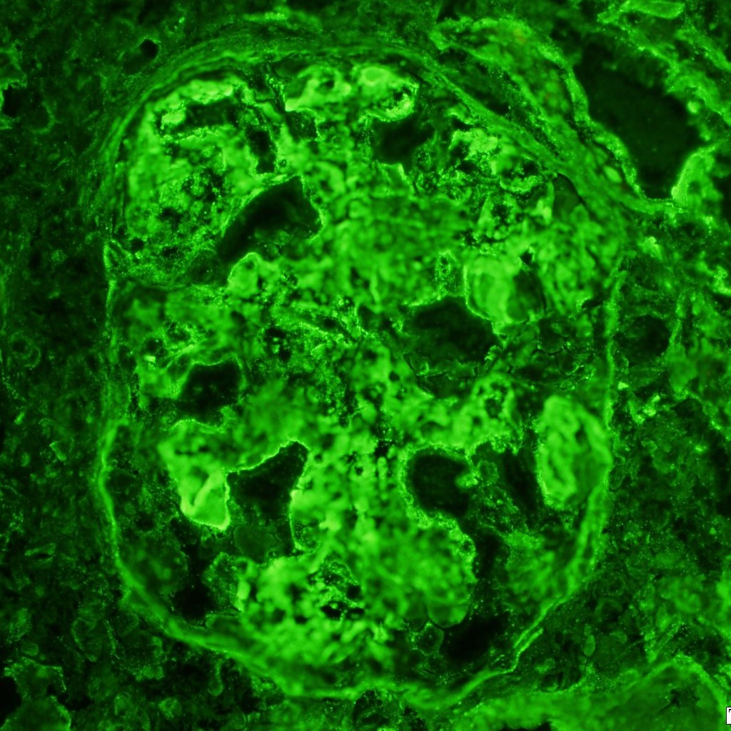
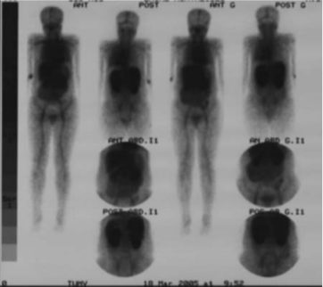
Lupus…Gastroenteropathy:
How should the general internist diagnose it?
Alex Adams, DO; Young Min Cho, MD; Ngoc Phan, DO, Faculty; Ernest Han, MD, Faculty
Learning Objectives
Clinical Case
Fig 5. EGD Biopsy Results
1) Recognize Protein-losing gastroenteropathy (PLGE) as manifestation of Systemic Lupus Erythematosus (SLE)
2) Understand that PLGE can present as a nephrotic syndrome spectrum
3) Identify the best approach of management of PLGE
Pt: 29 -year-old Vietnamese male PMH: nonsignificant
CC: “sharp epigastric pain with concurrent nausea, vomiting, and watery diarrhea”
ROS: No recent travel history or antibiotic therapy
Diagnostic Work Up:
CT ABD/Pelvis (evaluation of presumed colitis) revealed distal esophageal and gastric wall thickening, small bowel edema, small/moderate ascites without cirrhosis.
Lab work: Stool cultures and PCR were negative for infection; creatinine of 2.09 and albumin level of 1.3 (consistent with Acute Kidney Injury); and Urinalysis displayed RBC of 42, WBC of 16, with presence of hyaline casts, granular casts, and a protein creatinine ratio of 7.1.
EGD: performed for evaluation of colitis vs inflammatory bowel disease.
Diagnostic Paracentesis: (evaluation of relative ascites): albumin gradient > 1.1, suggesting ascites due to nephrotic syndrome.
Serologies:
Positive: ANA, Double Stranded DNA, anti-Sjogren’s Antibody A, ribonucleoprotein, low complement levels, antineutrophil antinuclear cytoplasmic antibodies were 33 AU/ml
Negative: Anti-glomerular basal membrane, myeloperoxidase IgG, antiphospholipid antibodies, and Hepatitis B, C, and HIV.
Renal Biopsy: Diffuse lupus nephritis, ISN/RPS class IV (A/C) with significant crescentic activity and focal lupus vasculopathy.
Treatment:
IV steroids with transition to prednisone 60 mg daily.
Cyclophosphamide 500 mg IV plus Mesna 350 mg with inhaled pentamadine 300 mg for prophylaxis of PJP were given prior to hospital discharge.
Apixaban was also started for clot prevention secondary to hypoalbuminemia.
Anatomical section | Description
Duodenum Biopsy | - Acute chronic duodenitis with epithelial erosions. - Negative for definite increased intraepithelial lymphocytes
Gastric biopsy | - Mild to moderate chronic gastritis with epithelial erosions. - H.Pylori stain was negative - Negative for intestinal metaplasia
EG junction biopsy | - Squamous-columnar junctional mucosa with mild reflux changes - Negative for intestinal metaplasia, dysplasia and increased eosinophils
Introduction
Systemic lupus erythematosus (SLE) is a chronic inflammatory disease that primarily effects women with an 8:1 prevalence. Renal disease and gastrointestinal (GI) symptoms are very common presentations of lupus, seen in 50% of patients ⁽¹⁾.
Lupus nephritis is the initial manifestation in only 5 percent with SLE, over the age of 50. Recent studies show that HLA-DR3 and DR15 conferred increased risk for LN ⁽²⁾. Common urine manifestations of LN are proteinuria with 100% prevalence, 80% with microscopic hematuria, and 70% with tubular abnormalities ⁽³⁾. 5% of SLE patients may develop Protein-losing gastroenteropathy (PLGE), that is clinically indistinguishable from nephrotic syndrome. PGLE manifests as a profound edema of the gastrointestinal (GI) tract and severe hypoalbuminemia secondary to excessive loss of serum protein from the GI tract. PLGE is more commonly seen in the Asian population ⁽⁴⁾.
Discussion and Conclusion
1) Lupus Nephritis may overlap with Protien-losing gastroenteropathy.
2) There is no diagnostic tools to probe the presence of PLGE, however we cannot exclude it as a differential for a cause of nephrotic like symptoms.
3) Both Lupus Nephritis and Protein-losing gastroenteropathy diseases; however, while they may be indistinguishable from the other, have the same treatment regimen, prednisone and cyclophosphamide.
Fig 4. ELECTRON MICROSCOPY:
Glomeruli show proliferative changes
Cellular crescents, massive mesangial and subendothelial deposits are documented
Severe foot process effacement present.
Tubulointerstitial compartment shows mild fibrosis and numerous tubular basement membrane deposits.
Clumpy interstitial, peritubular capillary, and vascular immune complex deposits are also present.
Reference
1. Almaani, Salem, Alexa Meara, and Brad H. Rovin. "Update on lupus nephritis." Clinical Journal of the American Society of Nephrology 12.5 (2017): 825-835.
2. Niu, Zhili, Pingan Zhang, and Yongqing Tong. "Value of HLA‐DR genotype in systemic lupus erythematosus and lupus nephritis: a meta‐analysis." International journal of rheumatic diseases 18.1 (2015): 17-28.
3. Cameron, J. Stewart. "Lupus nephritis." Journal of the American Society of Nephrology 10.2 (1999): 413-424.
4. Mok, C. C., et al. "Outcome of protein-losing gastroenteropathy in systemic lupus erythematosus treated with prednisolone and azathioprine." Rheumatology 45.4 (2005): 425-429.
5. Türkçapar, N., Ozyüncü, N., Cinar, K., Ensari, A., Küçük, O., Idilman, R., ... & Ozden, A. (2006). A case of systemic lupus erythematosus presenting with protein-losing enteropathy. Turk J Gastroenterol, 17(3), 226-230.
Fig 1. TC-99 human serum immunoglobulin (HIC) scintigram shows protein loss from duodenal and jejuna segments ⁽⁵⁾.
Actual patient images courtesy Mayo Clinic Pathology
Fig 3. IMMUNOFLUORESCENT HISTOLOGY:
Diffuse 3+ granular capillary wall and mesangial glomerular positivity with IgG with 2-3+ IgA, 2+ IgM, 3+ C1q and lambda, and 2-3+ staining with C3 and kappa.
Tubular basement membrane interstitial and focal vascular deposits are seen with IgG and many of the other immune reactants.
Fibrinogen shows at least two glomeruli with segmental 1-2+ positivity.
Fig 2. Antibody study:
Cryoglobulin immunofixation | Type III Cryoglobulinemia
GBM Antibody | <0.2
Anti Sjorgen’s Antibody (SS-A) | >8
Anti Sjorgen’s Antibody (SS-B) | <0.2
Tissue Transglutaminase | <1.2
Actual patient images courtesy Mayo Clinic Pathology

