Slide 1
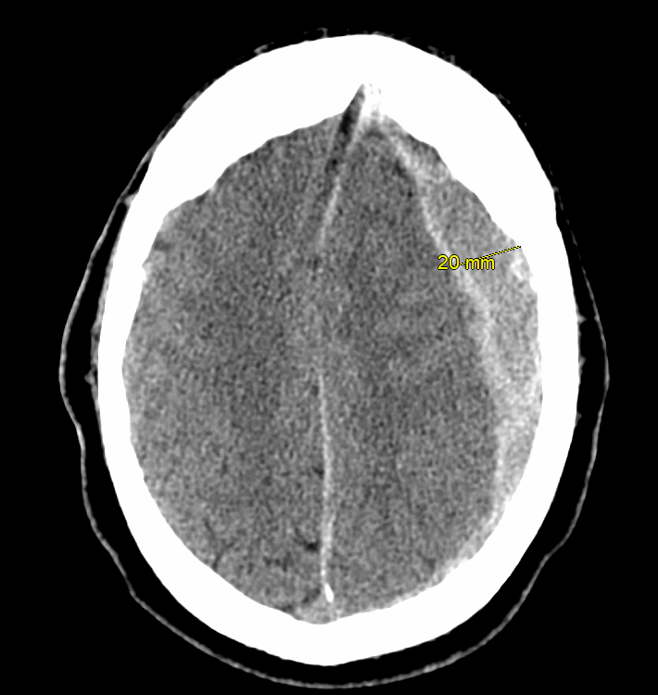
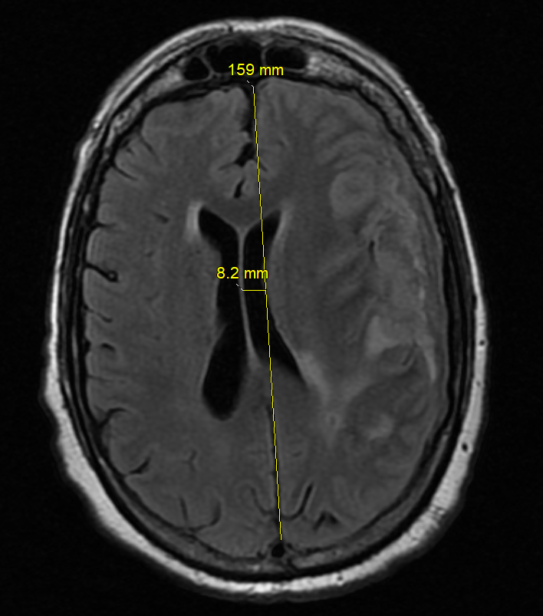
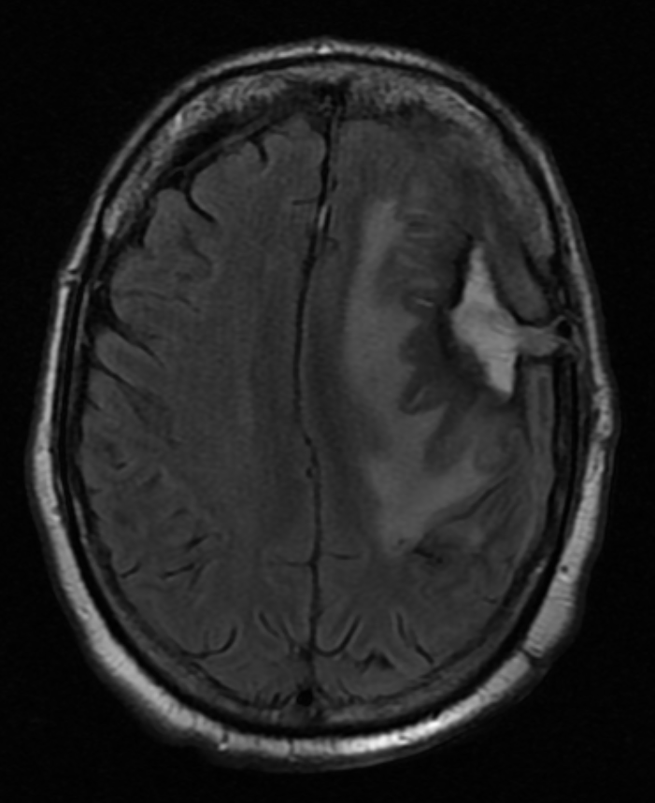
Mysterious Meningitis:
Subdural Empyema following a Burr Hole Drainage
Rob Oberman DO¹, Young Min Cho MD¹, Riyadh Al Rubaye MD¹, Matthew Newcomb MD¹
¹GME Internal Medicine, Northeast Georgia Medical Center, Gainesville Georgia
Case
Introduction
Presentation
A 63-year-old male with medical history of chronic myeloid leukemia and aortic valve replacement presented to the emergency department with fever of 102.5˚F, slurred speech, and generalized weakness.
The patient had been hospitalized one month prior after a mechanical fall resulting in a subdural hematoma. At previous hospitalization, he had an extensive hospital course including burr hole drainage, subdural hematoma evacuation, and inpatient rehabilitation.
Patient was admitted with plans to workup infectious causes vs acute stroke and metabolic encephalopathy
Hospital Course
Initial infectious work-up was largely uninformative; the patient had a mild elevation of white blood count (WBC) at 13.3 and negative urinalysis and chest x-ray.
Neurosurgery felt repeat imaging changes were consistent with expected healing from previous procedure.
A lumbar puncture was performed in the setting of altered mental status with fever and no known source.
Cerebrospinal fluid analysis: leucocyte count of 900 cells/mm3, glucose 43 mg/dL, protein 152 mg/dL, and a neutrophil-predominance. Meningitis panel and cultures were negative.
The patient was started on vancomycin, cefepime, acyclovir, and ampicillin for culture-negative meningitis.
After repeated worsening mental status, the patient underwent a brain MRI with contrast with findings of a possibly worsening subdural hematoma
The patient was subsequently taken to the operating room for expected hematoma evacuation; however, the fluid collection was found to be largely purulent.
Culture of the empyema would grow methicillin-sensitive Staphylococcus aureus, supporting a likely association with the prior burr hole procedure from his initial subdural hematoma. The patient was transitioned to IV Cefazolin and other antibiotics subsequently discontinued.
Disposition
Unfortunately, after initial stabilization with antibiotics, the patient had recurrent seizures and worsening focal deficits. Repeat drainage and continued antibiotic coverage was ineffective at improving the condition of the patient
Following unrelenting complications and resistant seizures with a poor prognosis, family elected to pursue inpatient hospice
Key Points
Subdural empyema (SDE) refers to a collection of pus in the subdural space.
Secondary to its cryptogenic presentation and dangerous location, SDE has a rapid course and poor prognosis.
Delayed diagnosis or treatment of SDE can be associated with significant morbidity and mortality resulting from severe neurologic deficits, seizures, and related complications. ¹
Following is the clinical course, diagnosis, and treatment of SDE in the setting of a recent neurosurgical procedure.
Subdural Empyema should be considered in patients with fever, focal neurologic deficits, and a possible source of recent brain surgery or sinus infection
Diagnosis involves a detailed history and physical, brain imaging with contrast, and drainage with culture
Treatment involves surgical drainage and 6-8 weeks of appropriate antibiotics with source control^{1,2,3}
Complications include seizures, cerebral infarction, cerebral thrombosis, hydrocephalus, cerebral edema^{1,3}
SDE has a significant risk of long-term disability and a high mortality rate
Common Infectious Causes^{2,3,4}
Treatment^{1,2,3,4}
Postsurgical
Local extravasation
Hematogenous Spread
Staphylococcus sp.
Pseudomonas aeruginosa
Streptococcus sp.
Staphylococcus aureus
Enterobacteriaceae, Bacteroides
P. aeruginosa
Staphylococcus sp., Streptococcus sp.
Escherichia Coli, Klebsiella Pneumoniae
Surgical drainage and culture
Early antibiotics
Serial imaging and observation
Seizure prophylaxis
Source control
Initial subdural hematoma
Post-drainage with Burr hole
Empyema development
Discussion
References
Although SDE is rare, it accounts for 15% to 20% of all intracranial infections²
SDE can have a high mortality rate and requires a rapid response in treatment
Major complications include seizure, thrombus, and cerebral edema^{1, 2}
Early surgical involvement and broad-spectrum antibiotics are essential in management^{1, 3}
Research would be beneficial in assessing peri-surgical management and prevention
Agrawal, Amit MCh*; Timothy, Jake FRCS†; Pandit, Lekha MD‡; Shetty, Lathika MD§; Shetty, J.P. MD∥ A Review of Subdural Empyema and Its Management, Infectious Diseases in Clinical Practice: May 2007 - Volume 15 - Issue 3 - p 149-153 doi: 10.1097/01.idc.0000269905.67284.c7
Gorman, J., Randhawa, N., Mendelsohn, D., Honey, C., Heran, M., & Appel-Cresswell, S. (2018). Subdural Empyema. Canadian Journal of Neurological Sciences / Journal Canadien Des Sciences Neurologiques, 45(5), 566-567. doi:10.1017/cjn.2018.67
Sexton, Daniel, and John Sampson. “Intracranial Epidural Abscess.” UpToDate, www.uptodate.com/contents/intracranial-epidural-abscess?search=subdural+empyema.
Widdrington, J.D., Bond, H., Schwab, U. et al. Pyogenic brain abscess and subdural empyema: presentation, management, and factors predicting outcome. Infection 46, 785–792 (2018). https://doi.org/10.1007/s15010-018-1182-9
Patient imaging courtesy of NGMC
Notes:
https://www.youtube.com/watch?v=MibahHcvQ7Y&t=14s&ab_channel=AUroberman

