Slide 1
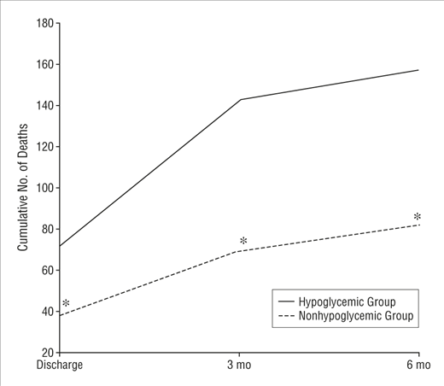
The Metabolic Mystery
Department of Internal Medicine | Northeast Georgia Medicine Center
Rob Oberman DO, Matthew Newcomb MD, and Tariq Odeh MD
Background Information^{1,2,5}
Case Presentation
Conclusions
Hypoglycemia : glucose less than 70mg/dL.
Common hypoglycemia symptoms:
Sweating, tremors, and tachycardia
Severe hypoglycemia symptoms :
AMS, confusion, and dysarthria
Common causes in patients without DM:
Drugs or alcohol-induced
Acute illness
Kidney or liver dysfunction
Approach to Workup
Glucose, C-peptide, insulin, proinsulin, β-hydroxybutyrate
Oral hypoglycemic agent profile
Fasting and postprandial hypoglycemia
Management Strategies
Carbohydrate loading
Glucagon
Dextrose
History of Present Illness:
A 77-year old white female presented after EMS were called for witnessed erratic driving
Upon EMS arrival, the patient had a glucose of 40 and she was taken to the hospital. Her family reported she was nondiabetic and did not have any access to insulin or oral hypoglycemic agents
The patient denied abnormal diet or eating habits as well as recent diarrhea, weight loss, liver, or kidney issues. Her only medications taken were antihypertensives and meclizine, without any recent medication changes
Physical Exam: No focal neurological deficits, no cardiopulmonary abnormalities, no hepatosplenomegaly, and no notable rashes or skin changes
Laboratory workup: Hemoglobin A1C of 5.3%, undetectable beta-hydroxybutyrate, inappropriately elevated insulin level, and an elevated C-peptide level
Imaging: CT of the abdomen and pelvis with contrast was obtained without notable findings
Hospital Course:
During her emergency room course, she was noted to have multiple hypoglycemic episodes down to the 40’s requiring ongoing Dextrose 50 (D50) treatments
On admission, the patient had mild disorientation that was slowly resolving and otherwise no acute concerns. The patient’s dextrose fluids were tapered as her glucose stabilized and she was monitored for more than 12 hours
An oral hypoglycemic agent profile was pending at time of discharge and subsequently found to be positive for glipizide
Upon follow-up, the patient later reported she must have accidentally taken it from one of her friends
Hypoglycemia can be a straightforward diagnosis, but it is important to keep a broad differential in mind
In non-diabetics, it is necessary to investigate possible casues such as insulinomas, surreptitious antihyperglycemic use, and other acute causes
The treatment for hypoglycemia begins with normalizing the serum glucose level with appropriate glucose supplementation and investigating the cause
Consideration of the associated endocrine lab markers can aid in diagnosis
Inpatient hypoglycemia can be a result of acute disease processes and is indicative of a worse prognosis
Although a non-diabetic patient often requires a deeper exploration into their hypoglycemia, this patient reminded us that the most common explanations are still prudent to rule out
Inpatient Hypoglycemia^{3,4}
Approach to Non-Diabetic Hypoglycemia²
118 per 10 000 admissions (≤ 60 mg/dL)
Age>65 appx 50% more likely
Common causes: alcohol dependence, renal failure, and sepsis
Associated with increased rate in mortality
Sepsis, malignancy, and low albumin levels were also predictors of developing hypoglycemia
Diagnosis | Serum insulin | Plasma C-Peptide | Plasma Proinsulin | Serum Β-Hydroxy-butyrate | Serum Insulin Antibodies | Diabetic Agent Metabolite
Insulinoma
Sulfonylurea/Meglitinide Ingestion
Surreptitious Insulin Usage
Insulin autoimmune hypoglycemia
IGF-II
References
Cryer, Phillip E., et al. “Hypoglycemia in Adults with Diabetes Mellitus.” UpToDate, www.uptodate.com/contents/hypoglycemia-in-adults-with-diabetes-mellitus
“Hypoglycemia.” Mksap 18 Endocrinology and Metabolism, by Patrick C. Alguire, et al. AMERICAN COLLEGE OF PHYSICIANS, 2018.
Kagansky, Nadya, et al. “Hypoglycemia as a Predictor of Mortality in Hospitalized Elderly Patients.” Archives of Internal Medicine, American Medical Association, 11 Aug. 2003, jamanetwork.com/journals/jamainternalmedicine/fullarticle/755868.
Nirantharakumar, Krishnarajah, et al. “Hypoglycemia in Non-Diabetic in-Patients: Clinical or Criminal?” PloS One, Public Library of Science, 2012, www.ncbi.nlm.nih.gov/pmc/articles/PMC3388042/.
Service, F John, et al. “Hypoglycemia in Adults without Diabetes Mellitus: Clinical Manifestations, Diagnosis, and Causes.” UpToDate, www.uptodate.com/contents/hypoglycemia-in-adults-without-diabetes-mellitus-clinical-manifestations-diagnosis-and-causes
Cumulative Mortality and Hypoglycemia³
Discussion
This patient satisfied Whipple’s triad: (1) hypoglycemia ≤ 55mg/dL, 2) neuroglycopenic symptoms, and 3) relief of symptoms following glucose administration, leading to increased suspicion for insulinoma
Her insulin, proinsulin, and c-peptide levels suggested excessive endogenous insulin production
Fasting versus postprandial hypoglycemia can be important branching poits of investigation
Fasting hypoglycemia includes insulinoma, surreptitious use of antihyperglycemics, insulin autoimmune hypoglycemia, and IGF-II-producing tumors (Insulin-like Growth Factor)
A frequent cause of postprandial hypoglycemia, typically occurring within five hours following a meal, is gastric bypass surgery
Treatment of hypoglycemia begins with stabilization of the patient with oral glucose, glucagon, and dextrose products

