Slide 1
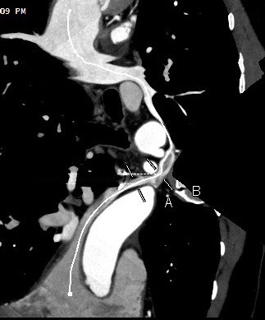
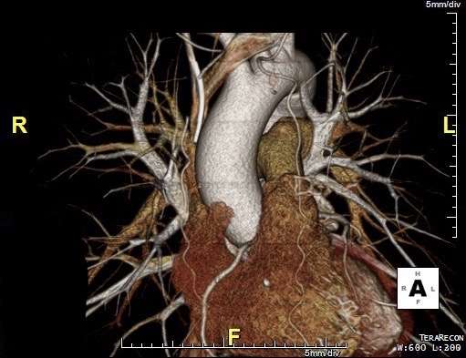
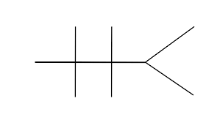
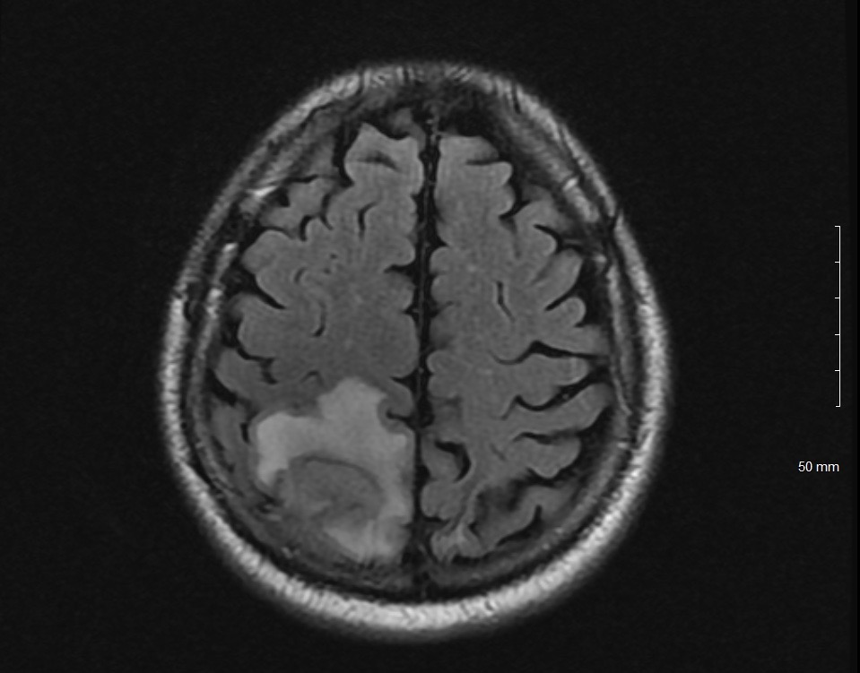
Streptococcus intermedius Brain Abscess secondary to Persistent Left Superior Vena Cava
Department of Internal Medicine | Northeast Georgia Medicine Center
Alex Adams DO, Ryan Berry MD, Aman Kaur DO, Jason Fombi, MD
Introduction
Cardiac CT angiogram confirmed a PLSVC draining into the superior left pulmonary vein
Discussion
Complications of right-to-left cardiac shunting (R-LS) are abundant and presentations can vary drastically. A very rare shunt mechanism results from a developmental variant in cardiac embryology resulting in a persistent left superior vena cava (PLSVC).
PLSVC has an incidence of 0.3-0.5% in the general population; 90% drain in the right atrium (RA) via an enlarged coronary sinus and are asymptomatic, while the other 10% drain into the left atrium (LA) and usually symptomatic. Most are discovered incidentally.
This case illustrates a rare congenital anomaly of the thoracic venous system, PLSCV, with an even rarer subtype draining into left pulmonary vein which creates a R-LS. This drastically increases the risk of:
Intracerebral abscess
Disseminated infection
Embolic cerebrovascular stroke
Heart failure
Patient was referred to cardiothoracic surgery for definitive management of the persistent left SVC after completion of 4 weeks of IV antibiotics.
Hospital Course
Conclusion
Abscesses of the brain should lead physicians to determine the source including possible R-LS.
Work up can be initiated with contrast-enhanced echocardiography with definitive diagnosis established by direct imaging with a contrast-enhanced study, such as CT angiogram or classic angiography.
Awareness of such shunts is beneficial as surgical correction of the R-LS will decrease potential for recurrent abscesses and/or hemodynamic instabilities in the future.
HPI: 55-year-old male with a past medical history of diabetes and hypertension from the Democratic Republic of Congo, who recently relocated to the United States, presented with acute onset of left upper extremity incoordination, weakness, and accompanying numbness.
ED Vitals: T: 97.6 HR:106 BP: 109/86 RR: 22 O2: 94% RA
PE: Sensation and reflexes intact in bilateral upper and lower extremities; overall unremarkable findings.
Labs:
CT Head: Right parietal mass with vasogenic edema
MRI brain: Right parietal mass and two daughter lesions surrounding the large central lesion concerning for potential abscess with subsequent acute lacunar infarct. Figure 3
Surgical investigation and biopsy by neurosurgery resulted in immediate aspiration of 7 mL purulent fluid.
Microbiology: Revealed pan-sensitive streptococcus intermedius and patient was placed on extended course IV antibiotics. Patient endorsed dental work and right axillary cyst several weeks prior to onset of symptoms.
TTE: Extra cardiac right to left shunt
Figure 1:
13.9
175
144
109
22
183
References
8.3
42
3.4
17
1.71
1.Paval, J. & Nayak, S.. 2007. A persistent left superior vena cava. Singapore Med J 48: 0-3. 2. Ugaki, S., Kasahara, S., Fujii, Y. & Sano, S.. 2010. Anatomical repair of a persistent left superior vena cava into the left atrium. Interact Cardiovasc Thorac Surg 11: 199-201. doi: 10.1510/icvts.2009.230581. 3, Memon, K. A., Cleveland, K. O. & Gelfand, M. S.. 2012. Brain abscesses associated with right-to-left shunts in adults. Am J Med Sci 343: 334-336. doi: 10.1097/MAJ.0b013e31823d35b4. 4. Lee, M. S., Pande, R. L., Rao, B., Landzberg, M. J. & Kwong, R. Y.. 2011. Cerebral abscess due to persistent left superior vena cava draining into the left atrium. Circulation 124: 2362-2364. doi: 10.1161/CIRCULATIONAHA.111.046102. https://www.ncbi.nlm.nih.gov/pubmed/22105199 5. Farazi-Chongouki, C., Dalianoudis, I., Ninos, A., Diamantopoulos, P., Filippou, D., Pierrakakis, S. & Skandalakis, P.. 2019. Double superior vena cava: presentation of two cases and review of the literature. Acta Chir Belg 119: 316-321. doi: 10.1080/00015458.2018.1438564. 6. Kougias, P., Peden, E. K., Lin, P., Buergler, J. & Lumsden, A. B.. 2006. Endovascular occlusion of right to left arteriovenous shunt associated with persistent left superior vena cava. J Vasc Surg 44: 875-878. doi: 10.1016/j.jvs.2006.06.022. 7. Aguilar, J. M., Rodríguez-Serrano, F., Ferreiro-Marzal, A., Esteban-Molina, M., Gabucio, A., García, E., Boni, L. & Garrido, J. M.. 2019. Left superior vena cava draining into the left atrium: Clinical entities, diagnosis and surgical treatment. Arch Cardiovasc Dis 112: 135-143. doi: 10.1016/j.acvd.2018.05.007. 8. Maki, R., Miyajima, M., Mishina, T. & Watanabe, A.. 2019. Left upper pulmonary vein connected to the persistent left superior vena cava and the left atrium. Gen Thorac Cardiovasc Surg 67: 723-725. doi: 10.1007/s11748-018-1018-7. 9.Ch'ng, J. K., Soon, J. L. & Lim, C. H.. 2012. Paradoxical emboli from left superior vena cava causing recurrent brain abscess. Singapore Med J 53: e21-3. 10.Hutyra, M., Skala, T., Sanak, D., Novotny, J., Köcher, M. & Taborsky, M.. 2010. Persistent left superior vena cava connected through the left upper pulmonary vein to the left atrium: an unusual pathway for paradoxical embolization and a rare cause of recurrent transient ischaemic attack. Eur J Echocardiogr 11: E35. doi: 10.1093/ejechocard/jeq079. 11. Tobbia, P., Norris, L. A. & Lane, T.. 2013. Persistent left superior vena cava draining into the left atrium. BMJ Case Rep 2013: 010167. 12. Povoski, S. P. & Khabiri, H.. 2011. Persistent left superior vena cava: review of the literature, clinical implications, and relevance of alterations in thoracic central venous anatomy as pertaining to the general principles of central venous access device placement and venography in cancer patients. World J Surg Oncol 9: 173. 13. Muthialu, N., Fajardo, D., Sullivan, I. D. & Tsang, V.. 2016. Repair of Persistent Left Superior Vena Cava to Unroofed Coronary Sinus Defect by Retro-Aortic Implantation (Modified Warden Type Procedure). J Card Surg 31: 103-105. doi: 10.1111/jocs.12684. 14. Erek, E., Aydin, S. & Suzan, D.. 2016. Right Atrial Flap Repair for Left Superior Vena Cava Draining into Left Atrium. Thorac Cardiovasc Surg 64: 59-61. doi: 10.1055/s-0035-1564931.
Figure 2:
Figure 3:

