Slide 1


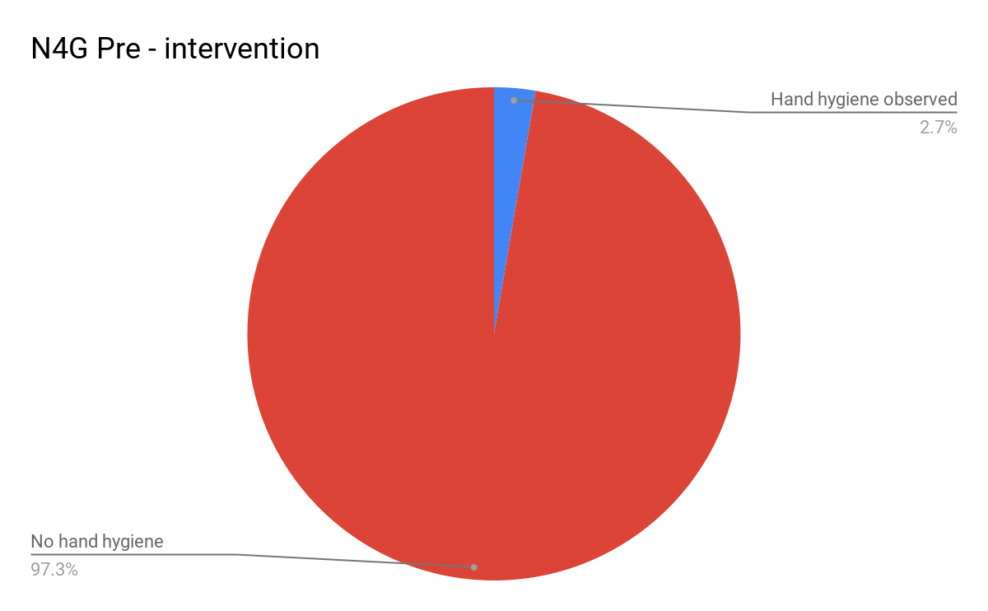
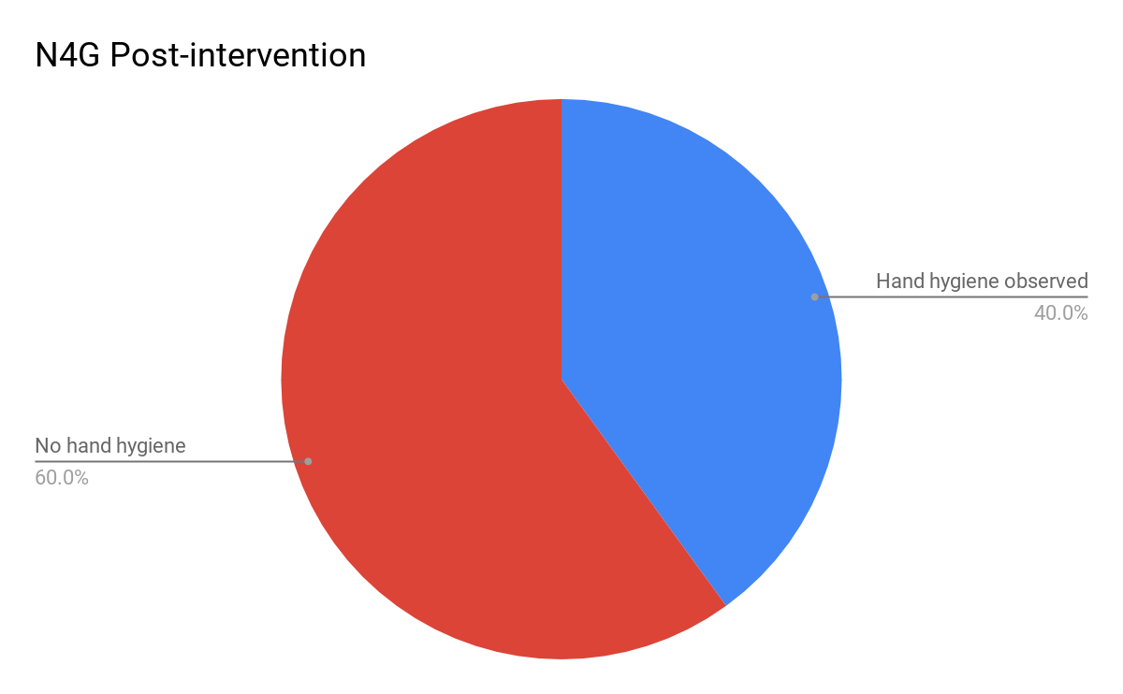
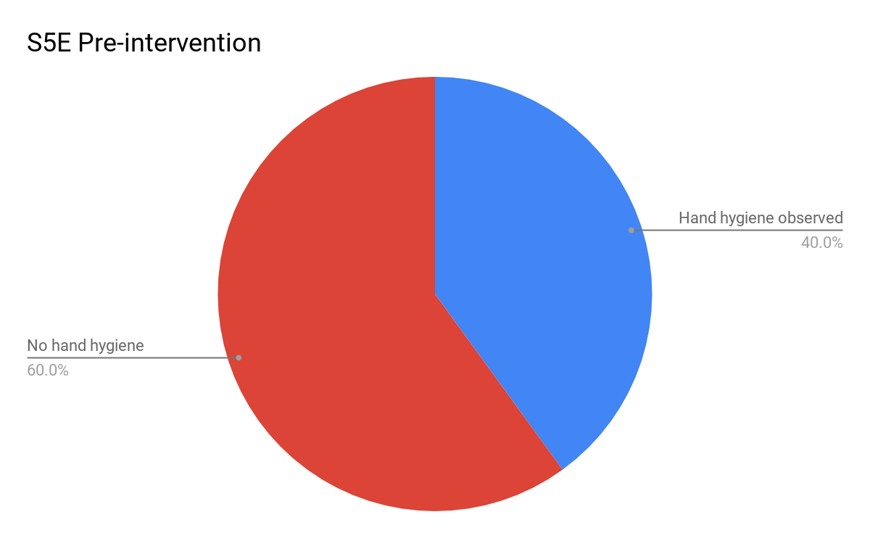

Hospital Visitor Hand Hygiene Bundle
Introduction
Project Description
Conclusions and Implications
Effective hand hygiene practice is the single most important action that individuals can do to prevent transmission of communicable diseases within the healthcare setting. Healthcare acquired infections increase morbidity, mortality and associated healthcare costs (CentersforDiseaseControlandPrevention, 2002).
Nurses play a key role in promoting visitors’ hand hygiene practices by providing education and role modeling proper techniques (McLaws, Maharlouei, Yousefi, & Askarian, 2012; Parmeggiani, Abbate, Marinelli, & Angelillo, 2010).
Hand hygiene behaviors can be impacted by peer pressure, positive reinforcement and a belief that it is personally relevant (Fuller, Besser, Savage, McAteer, Stone, & Michie, 2014; . Rowiaye, Robinson, Pantelidis, Baker, Sawicki, Clarke,... Domingos, 2015; Wilson, Jacob, & Powell, 2011).
Pre-intervention: RN observed whether or not visitors utilized available hand hygiene products located inside their assigned patient rooms for a period of 1 week.
Intervention: RN made the verbal statement “Clean hands protect you and your loved ones” to visitors inside assigned patient rooms followed by a demonstration of appropriate use of hand hygiene products.
Implementation of visitor hand hygiene scripting increased compliance to 9.1% on N4G and 36.8% on S5E.
Limitations of this project include a small sample size and inability to control for external factors that might impact visitor hand hygiene practices.
Promotion of the use of this scripting with other nurses on N4G and S5E will likely increase visitor compliance with effective hand hygiene practice.
Reference Literature
Evaluation Strategy
Centers for Disease Control and Prevention. (2002). Guideline for hand hygiene in health-care settings: Recommendations
of the Healthcare Infection Control Practices Advisory Committee and the HICPAC/SHE/APIC/IDSA Hand Hygiene Task
Force.MMWR. Morbidity and Mortality Weekly Report,51(RR-16), 1-45.
Fuller, C., Besser, S., Savage, J., McAteer, J., Stone, S., & Michie, S. (2014). Application of a theoretical framework for
behavior change to hospital workers’ real-time explanations for noncompliance with hand hygiene guidelines.American
Journal of Infection Control,42(2), 106-110. doi:10.1016/j.ajic.2013.07.019
McLaws, M. L., Maharlouei, N., Yousefi, F., & Askarian, M. (2012). Predicting hand hygiene among Iranian health care
workers using the theory of planned behavior.American Journal of Infection Control,40(4), 336-339.
doi:10.1016/j.ajic.2011.04.004
Parmeggiani, C., Abbate, R., Marinelli, P., & Angelillo, I. F. (2010). Healthcare workers and health care-associated infections:
Knowledge, attitudes, and behavior in emergency departments in Italy.Biomedical Central Infectious Diseases,10, 35.
doi:10.1186/1471-2334-10-35
Rowiaye, A., Robinson, C., Pantelidis, R., Baker, C., Sawicki, R., Clarke, E., ... Domingos, J. (2015). Hand hygiene rewards
program at William Osler Health System.Canadian Journal of Infection Control, 19-23.
Wilson, S., Jacob, C. J., & Powell, D. (2011). Behavior-change interventions to improve hand-hygiene practice: A review of
alternatives to education.Critical Public Health,21(1), 119-127. doi:10.1080/09581591003786122
Visitor compliance with hand hygiene practice data was collected through direct observation by night shift RN. Effectiveness of the intervention was determined by comparing pre and post-intervention data.
“We recommend Margie’s Travel to anyone who will listen to us. They anticipated every need and solved every potential stressor.”
~ Henriette Andersen
Project Goals
●Increase awareness of effective hand hygiene techniques among visitors on N4G and S5E at NGMC.
●Improve observed N4G visitor participation in effective hand hygiene practice from 7.1% to 21%.
●Improve observed S5E visitor participation in effective hand hygiene practice from 7.7% to 23%.
●Educate N4G and S5E nurses on the use of the visitor hand hygiene scripting by February, 2020.
margie’s travel
Acknowledgments
Findings
4567 Main Street
Raleigh, NC 02134
Jennifer Powell, BSN, RN, PCCN
Betsy Ross, BSN, RN, PCCN
Bridgette Shulman, MSNEd, RNC-OB, C-EFM, CPPS
Chip Graham, RN
Beth Downs, Manager Marketing & Public Relations
Tracy Varderman, VP-Strategic Plan/Marketing
(718) 555-1234
contact@margiestravel.com
Contact Information
www.margiestravel.com
Alexas Shirley, BSN, RN
April Childs, MSN, RN, CNL
Ngoc Le, BSN, RN

