Slide 1
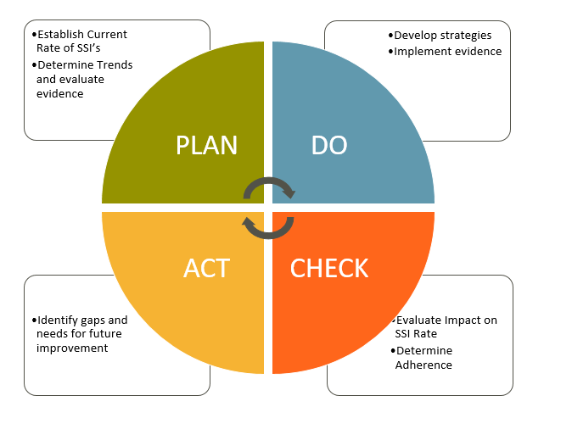
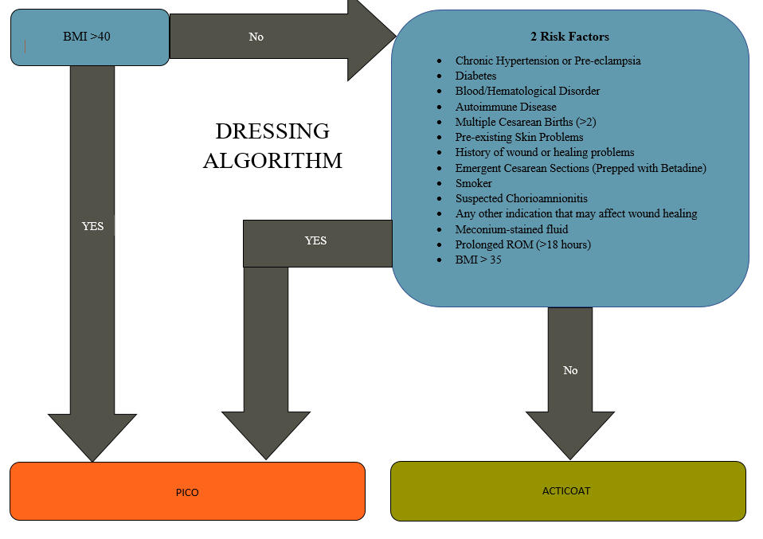
Research Week
More Than Just a Bundle: Prophylactic Dressing on Cesarean Section Patients to Reduce Surgical Site Infection
Background
Concepts
Results
References
SSI Facts:
Second most common healthcare acquired infection (HAI) in the United States
Costs more than $10 billion a year resulting in an additional 400,000 patient days in the hospital
Indicator of care quality
Associated with up to 3% of maternal mortality
Leading cause of serious complications after cesarean section with an incidence of 3-15%
Hospital History:
Increasing cesarean section SSI rate from 1.4% in FY 17 to 3.5% FY19
Long term goal to reduce SSI to zero
Inconsistent use of negative pressure wound therapy to prevent surgical site infections
The Project Question:
Will the implementation of a standardized post-operative dressing algorithm for use of negative pressure dressings and silver infused dressings versus dressings applied by provider preference result in a decrease number of surgical site infections after cesarean section from 3.5% to 2%
Goals
Design and implement a standardized post-operative dressing algorithm used by nursing
Educate and monitor success of implementation
Reduce cesarean section SSI from 3.5% to 2%
Algorithm Design and Implementation
Algorithm was designed and implemented
Approval from multidisciplinary team
Joint effort for monitoring with L&D staff and Infection Prevention Department
Education
100% nurses were educated on NPWT
Compliance
80% patients who qualified received NPWT
Data
Reduced surgical site infections after implementation YTD FY20 to 1.1%
SSI rate decreased from 3.5% to 1.1% (exceeding project goal to decrease to 2%)
Centers for Disease Control and Prevention (CDC). (2018). National Healthcare Safety Network. Retrieved from https://www.cdc.gov/nhsn/
CDC. (2019). Procedure-associated module SSI. Retrieved from https://www.cdc.gov/nhsn/pdfs/pscmanual/9pscssicurrent.pdf
Dias, M., Dick, A., Reynolds, R. M., Lahti-Pulkkinen, M., & Denison, F. C. (2019). Predictors of surgical site skin infection and clinical outcome at caesarean section in the very severely obese: A retrospective cohort study. Plos One, 14(6), e0216157. doi.org/10.1371/journal.pone.0216157
Jasim, H., Syed S., Khan, A., Dawood, O., Abdulameer, A., & Usha, R. (2017). Incidence and risk factors of surgical site infection among patients undergoing cesarean section. Clinical Medicine Insights: Therapeutics, 9, 1–7. https://doi.org/10.1177/1179559X1772527310.12968/bjom.2016.24.3.170
The Joint Commission. (2019, January). Hospital national patient safety goals. Retrieved from https://www.jointcommission.org/assets/1/6/NPSG_Chapter_HAP_Jan2019.pdf
Leapfrog. (2017, March). Cesarean birth trends in the United States, 1989–2015. Retrieved from https://www.leapfroggroup.org/sites/default/files/Files/cesarean-section-trends-1989 2015.pdf
Looby, M. A., Vogel, R. I., Bangdiwala, A., Hyer, B., & Das, K. (2017). Prophylactic negative pressure wound therapy in obese patients following cesarean delivery. Surgical Innovation, 25(1), 43-49. doi:10.1177/1553350617736652
McLaughlin, D. B., & Olson, J. R. (2017). Healthcare operations management (3rd ed.). Chicago, IL: Health Administration Press.
Office of Disease Prevention and Health Promotion. (2019). National targets and metrics. Retrieved from https://health.gov/hcq/prevent-hai-measures.asp
Saeed, K., Corcoran, P., O’Riordan, M., & Greene, R. (2019). Risk factors for surgical site infection after cesarean delivery: A case-control study. American Journal of Infection Control, 47(2), 164-169. doi: https://doi.org/10.1016/j.ajic.2018.07.023
Swift, S., Zimmerman, M., & Hardy-Fairbanks, A. (2015). Effect of single-use negative pressure wound therapy on postcesarean infections and wound complications for high-risk patients. Journal of Reproductive Medicine, 60(5-6), 211-218.
Spruce, L. (2015). Back to Basics: Implementing evidence-based practice. AORN Journal, 101(1), 106–114. https://doi.org/10.1016/j.aorn.2014.08.009
Strugala, V., & Martin, R. (2017). Meta-analysis of comparative trials evaluating a prophylactic single-use negative pressure wound therapy system for the prevention of surgical site complications. Surgical Infections, 18(7), 810-819. doi:10.1089/sur.2017.156
Vallejo, M., Attaallah, A., Shapiro, R., Elzamzamy, O., Mueller, M., & Eller, W. (2017). Independent risk factors for surgical site infection after cesarean delivery in a rural tertiary care medical center. Journal of Anesthesia, 31(1), 120–126. https://doi.org/10.1007/s00540-016-2266-2
Villers, M., Hopkins, M., Harris, B., Brancazio, L., Grotegut, C., & Heine, R. (2017). Negative pressure wound therapy reduces cesarean delivery surgical site infections in morbidly obese women. American Journal of Obstetrics and Gynecology, 216(1), S207. doi:10.1016/j.ajog.2016.11.599
World Health Organization. (n.d.). Protocol for surgical site infection surveillance with a focus on settings with limited resources. Retrieved from https://www.who.int/infectionprevention/tools/surgical/SSI-surveillance-protocol.pdf
Yu, L., Kronen, R. J., Simon, L. E., Stoll, C. R., Colditz, G. A., & Tuuli, M. G. (2018). Prophylactic negative-pressure wound therapy after cesarean is associated with reduced risk of surgical site infection: A systematic review and meta-analysis. American Journal of Obstetrics and Gynecology, 218(2), 200-210.e1. doi:10.1016/j.ajog.2017.09.017
Zuarez-Easton S, Zafran N, Garmi G, & Salim R. (2017). Postcesarean wound infection: Prevalence, impact, prevention, and management challenges. International Journal of Women’s Health, 9, 81. Retrieved from https://www.ncbi.nlm.nih.gov/pmc/articles/PMC5322852/
Algorithm
Discussion
Literature Review
Identified common risk factors to guide in development of post C/S dressing algorithm
NPWT recommended
Feasibility
Return on Investment (ROI) estimate $336,384 after implementation
Concurrent Project Contributions
Acknowledge the concurrent addition of a Vaginal Prep that introduced in same time period as the standardization of post C/S dressing
Methods
PLAN
Evaluation of SSI rates
Fish bone root cause analysis
Literature Review
Evaluation of culture
Zero harm/Safety Culture
Cost Benefit Analysis
Estimated savings of $332,571 annually
DO
Implementation
Design of the algorithm
Approval from target audience
Supplies stocked through estimates
Education
Staff meetings, Shift Huddle, Unit Skills
Post Education Evaluation
CHECK
Shift Monitoring Tools and Infection Control Dashboards
ACT/ADJUST
Evaluation of non-compliance
Root Cause analysis of SSI incidence
Results
Limitations
Monitoring will continue and the identification of future infections will continue to be evaluated for root causes and interventions will aimed at eliminating cesarean section infections
The study population was limited to patients undergoing C/S at one campus of a hospital system located in Northeast Georgia.
Future work may consider replication with a larger population sample from different organizations and varies geographic regions.
Candice Ledford, MSN, RNC-OB
Jessica Martin, BSN, RNC-OB, C-EFM

