Slide 1



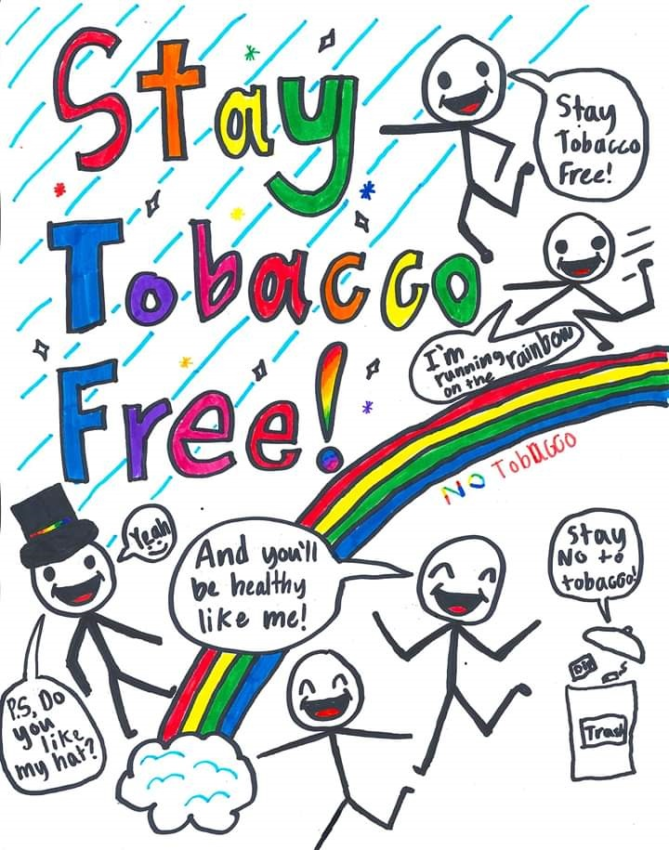
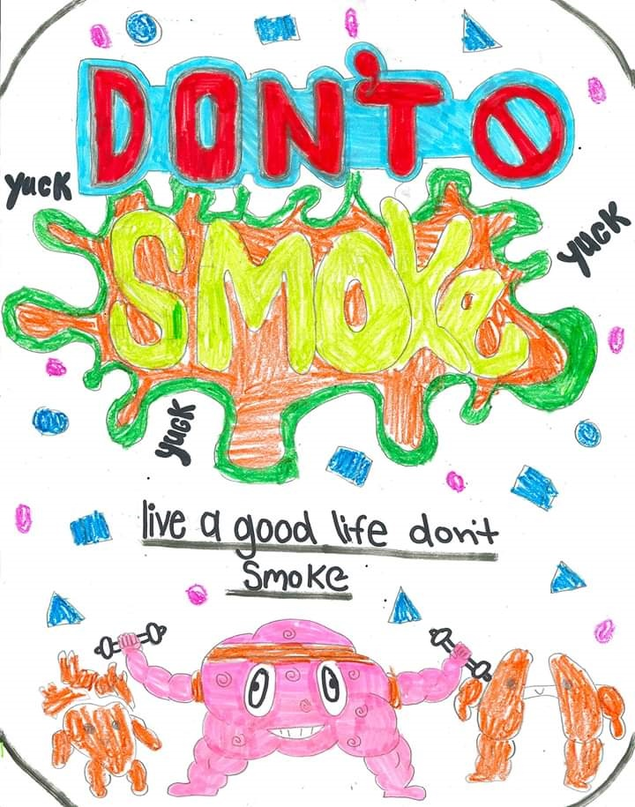
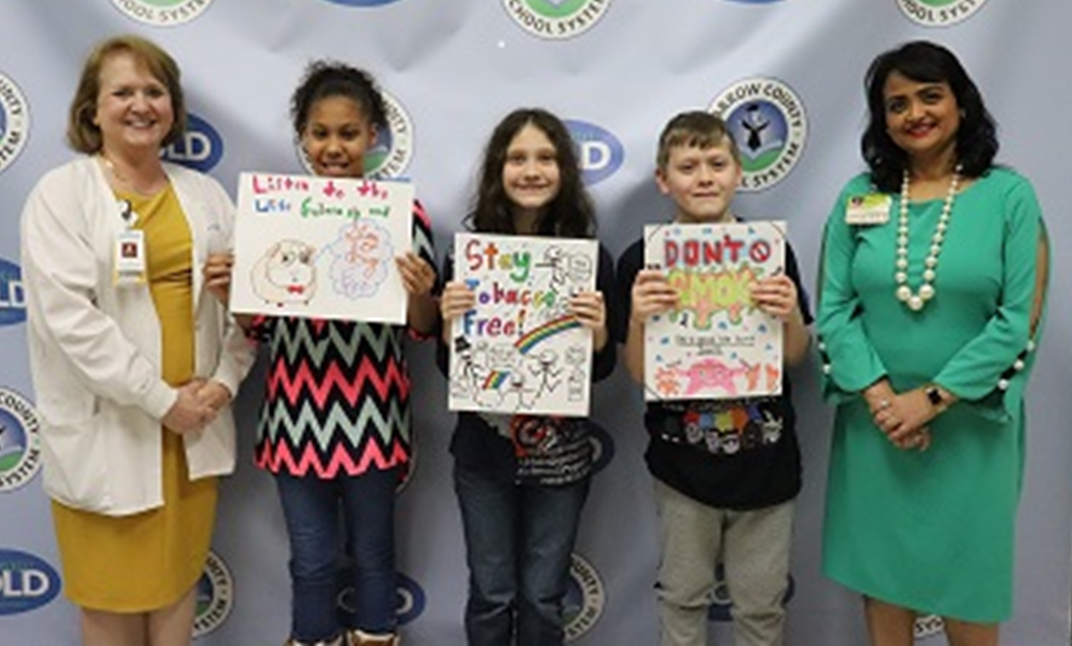

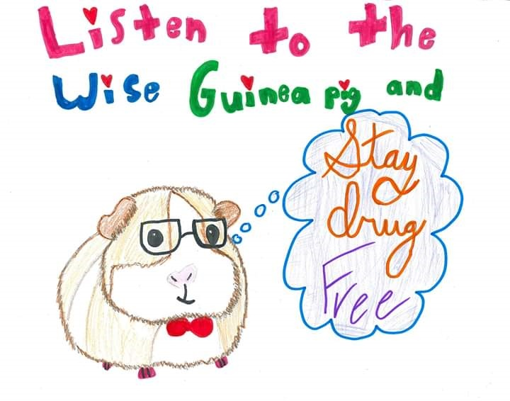
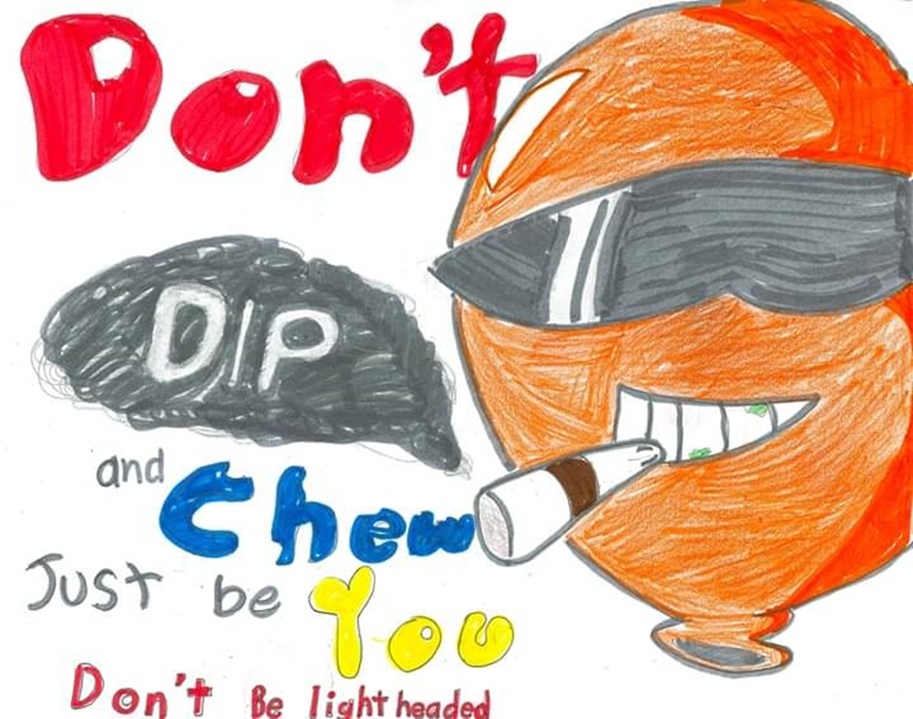

TAR WARS – May Tobacco Use Prevention Awareness be with You
Youth Tobacco Use Prevention Initiative Barrow County, Georgia
Background
Program Goals
Methods and Activities
Barriers
According to the 2016 Northeast Georgia Medical Center Community Needs Assessment conducted by Truven Health Analytics, public health indicators demonstrated that lung cancer death rates, as well as lung cancer incidence rates, were significant health concerns in Barrow County, Georgia (Northeast Georgia Health System, 2016). Furthermore, the incidence and death rates of lung cancer were occurring at higher rates per 100,000 people than the state and national benchmarks in Barrow County as compared to surrounding counties (National Cancer Institute, 2018).
For a new generation of youth in Barrow County, Georgia, raising awareness of novel nicotine products, unique marketing strategies of the tobacco industry, the long-term financial impact of nicotine addiction, and the powerful social influences of tobacco use is paramount to reducing the burden of tobacco-related diseases in the future.
As a part of a community initiative led by oncology nurses, joined by community leaders, school nurses and counselors, the TAR WARS program was implemented in nine Barrow County, Georgia elementary schools during October, 2018. Based on the Centers for Disease Control’s guidelines for youth tobacco prevention programs, the TAR WARS curriculum focused on evidence-based interventions targeted to 4th and 5th grade students (American Academy of Family Physicians, 2018). Post program outcomes included a 100% participation rate of Barrow County elementary schools in, a 53% perceived high level of engagement of the students reported by the teachers, a 41% increase in the knowledge of the harm of vaping by the students, and a 21% overall learning gain by the students. In 2019, the program will be repeated and outcomes from 2018 and 2019 will be compared.
Increase cancer prevention activities in Barrow County
Foster relationships with Barrow County school staff
Advance the image of nurses in the community setting
Provide tobacco use and vaping prevention messages to 4th and 5th students in Barrow County
  a. Increase knowledge of short-term health effects and image-based consequences of tobacco use and vaping
  b. Illustrate cost/financial impact of using tobacco or vaping and ways money could be spent better
  c. Identify reasons why people smoke or vape
  d. Explain how advertising, tobacco use in movies, and the tobacco and vaping industry markets products to youth
Evaluate the knowledge gain of 4th and 5th grade students through TAR WARS pretest and post test responses
Compare 2018 pretest and post test responses with 2019 responses.
Evaluate the Barrow County School principals, teachers, nurses, and counselor satisfaction with the tobacco use prevention program through an online survey
TAR WARS program presented to Barrow County elementary school principals and school nurses
Implementation dates set to coordinate with Red Ribbon Week
Barrow County school nurses and counselors provided with TAR WARS materials and resources.
Implementation of TAR WARS program in nine Barrow County Elementary Schools – October 2018 & October 2019
5. Pretest/post test administration to students
Evaluation of Barrow County principals, teachers, nurses, and
counselors – December 2018
7. Social media campaign to choose poster contest winners
8. Recognition of students in the poster contest at a monthly
school board meeting with monetary awards
1. Not all pre/post tests received from students
2. Inconsistent completion of pretest/post test by students
3. The large volume of pre/post tests in 2019 created
delays in data collection
4. Manual tabulations of pre/post tests were difficult and time
consuming
5. Multiple types of settings for presentations
6. Insufficient time to deliver content and answer student questions
Barrow County Elementary Schools
References
American Academy of Family Physicians. (2018). TAR WARS program. Retrieved from https://www.aafp.org/patient-care/public-health/tobacco-nicotine/tar-wars.html
Dewhirst, T. (2018). Package size matters: Tobacco packaging, retail merchandising and its influence on trial and impulse sales. Tobacco Control, 27(5), 600.
Henry, B. (2013). Impact of tobacco-control legislation. Clinical Journal of Oncology Nursing, 17(2), 195-200.
National Cancer Institute. (2018). State Cancer Profiles: Georgia. Retrieved from https://statecancerprofiles.cancer.gov/quick-profiles/index.php?statename=georgia
Northeast Georgia Health System. (2016). 2016 Community Health Needs Assessment. Retrieved from https://www.nghs.com/fullpanel/uploads/files/nghs-chna-report-2016.pdf
Park, E. & Drake, E. (2015). Systematic review: Internet-based program for youth smoking prevention and cessation. Journal of Nursing Scholarship, 47(1), 43-50.
  Auburn
100% participation from all nine schools in both 2018 and 2019
2,000+ students reached in 2018 and in 2019.
Collection of 40% more pre/post tests in 2019 than in 2018
a. 2018 Greatest knowledge increase seen in question
“Vapes are safer than regular cigarettes”
b. 2019 Greatest knowledge increase seen in question
“Advertisers tell the truth about tobacco use”
Knowledge gains demonstrated in 2018 and 2019.
Survey of teachers, nurses, and counselors reported 53% of students as highly engaged in Tar Wars activities
Barrow County 4th and 5th grade students
Barrow County Elementary School principals, school nurses, school counselors
Ellen Petree, Barrow County Schools
Kimberly Tyner-Meeks, RN, OCN, Coordinator, Outpatient Infusion
Andria Caton, MSN, RN, OCN, CHPN, Assistant Nurse Manager
Christy Moore, Manager Community Benefits
Sunita Singh, Public Relations, Barrow
Susanne McNail, Coordinator Community Health Improvement
Monica Newton, MD
Evidence Based Intervention
 | 2018 | 2019
Total Pretest Responses | 5160 | 16735
Total Pretest Correct | 3278 | 11585
% students correct | 64% | 69%
Total Posttest Responses | 5021 | 13783
Total Posttest Correct | 4251 | 11767
% students correct | 85% | 85%
Total Average Knowledge Gain | 21% | 16%
2019 Poster Contest Winners
Kimberly Tyner-Meeks Video presentation
https://youtu.be/xOS3si_teyo
https://www.aafp.org/patient-care/public-health/tobacco-nicotine/tar-wars.html
2019 student posters
April 2020

