Slide 1




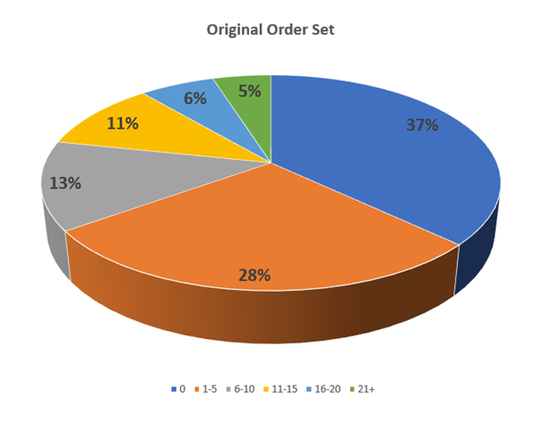
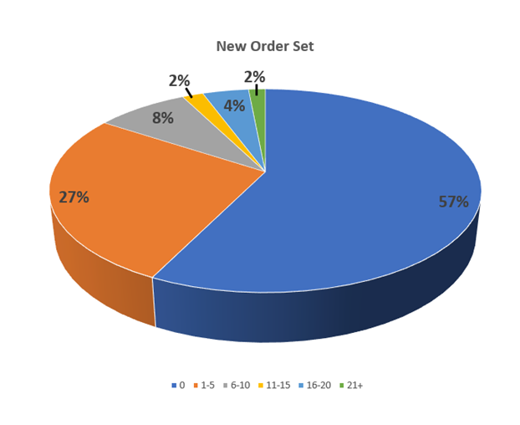

Narcotic Reduction within Women and Children’s (W/C) at
Northeast Georgia Medical Center (NGMC) – Braselton campus
Liz Griffin, MSN/Ed, RN, NPD-BC, C-EFM, MATS
Significance
Inclusions/Exclusions
Considerations
Discussion
The use of opioids has dramatically increased over the past few decades. Northeast Georgia Medical Center (NGMC) was recently provided a grant to aid in the assistance of mothers with a history of or current issues with drug use. This grant allows trained peer recovery coaches to meet with these mothers during hospital stays and follow up with them after delivery to ensure they have whatever resources they may require. The rapport provided by our panel of peer recovery coaches has proven to provide a feeling of safety and willingness to be more open to seeking help.
NGMC sought to further the aid of these patients (and others more susceptible to narcotic abuse) by reducing the usage of narcotics within our facilities, as well as the number of prescriptions provided to patients upon discharge. Research was conducted in search for current evidence-based practices for pain control. The multimodal approach of an additional non-narcotic to the routine medication administration regimen was requested, approved, and implemented on both our postpartum vaginal and cesarean delivery order sets.
Included Participants: Three months of data was collected both before and after the implementation of the new order sets. Participants included all postpartum patients who received care at NGMC on the Braselton campus during the months of July-September and January-March. The order set changes occurred in November of 2019. The deliveries from July- September were used as the control group to evaluate the average number of Percocet 5mg PO administered to patients prior to go-live. The same information was collected from deliveries in January- March to compare the amount of opioid use once the new orders were carried out.
Exclusions: Deliveries from October and November were omitted due to some providers already changing their orders to reflect the new order sets, which would skew the data. Likewise, December deliveries were omitted to allow staff time to get used to the new order sets.
Patient exclusions include those who:
Have a history of drug abuse - typically have a higher medication tolerance
Had allergies preventing administration of any medication on the order sets
Experienced any deviations from the original or new postpartum order sets
It was noted during data collection that some patients required significantly higher amounts of narcotics during their stay. These outliers began skewing the data when looking at the average number of tablets administered per day. To look at things a different way, data was also analyzed to determine if the number of patients requiring any narcotics for breakthrough pain was reduced with the new order set.
Additionally, we wanted to illustrate the shift in the average number of narcotics each patient received during her postpartum stay.
Narcotics are known for their addictive nature and for producing many side effects that can impact a patient’s ability to care for her newborn. Many patients have previously refused these supplemental pain medications for this reason, leaving their pain unresolved. In addition to reducing the number of narcotics administered, NGMC sought to provide an alternative to better care for our patients. This coincides with Northeast Georgia Health System’s mission of “Improving the health of the community in all that we do.”
The information gathered during this study demonstrates NGMC- Braselton’s achievement of decreasing narcotic administration. With the addition of scheduled Tylenol/Ofirmev to the original order set, we were able to reduce the number of prn narcotic tablets daily requested from patients by 42.4%. We also saw a 32.4% reduction in the number of patients receiving any amount of narcotics during their stay. When separated by method of delivery, it was discovered that there was a significant difference between vaginal deliveries versus cesarean section. Both delivery methods showed a decrease in the number of patients receiving narcotics, however, vaginal deliveries had a 46.6% decrease, while cesarean sections only had a 16% decrease.
There was also a significant overall shift in the total number of tablets patients received during their stay. The original order set had 37% of our patients not requesting supplemental pain medication, while the new order set increased to 57%. Additionally, 65% of our patients received 5 or less tablets in the original order set compared to 84% with the addition of scheduled Tylenol/Ofirmev
Study Design: This was a retrospective case study on all mothers who delivered 3 months before and 3 months after the implementation of the new multimodal order set to examine the number of narcotics administered during their stay. Information was obtained during review of secondary data in NGMC chart documentation.
There was no intervention involved
Data collected from items charted in the NGMC electronic health record (EHR)
Data was collected and reported in an Excel document and stored on an NGMC server protected by internal procedures
Information tracked for each patient in the study:
Obstetrical history and comorbidities
Type of delivery
Delivery complications (if applicable)
The length of stay after delivery
The number of narcotic medications administered during stay
Drug history (if applicable)
Changes Made: Order sets were changed to encourage multimodal, non-narcotic pain relief to minimize opioid use. The table below depicts the original orders and what they were changed to.
Method
Findings
First analysis of the data looks at the average number of narcotic tablets that were dispensed per patient day (defined by the time spent in the hospital after delivery when the postpartum order set was used.) This first table illustrates the overall difference in the number of narcotics administered between the two order sets.
While there was a definite overall decrease in the number of narcotics administered after the change in order sets, the data was then analyzed to determine if the method of delivery (vaginal versus cesarean section) had any impact on the outcomes.
Limitations
In addition to the change in medication regimen, there were a few other adjustments to the order sets for cesarean sections. Previous orders stated for the patient to remain in bed with an indwelling urinary catheter for 12 hours post procedure, while the new order set was changed to 6 hours. Though this may have contributed to an increase in pain initially, early mobility has proven to benefit healing and, possibly pain management in the long run. It cannot be ruled out that these additional changes may have contributed to the decrease in the request for breakthrough narcotic medication.
Reference
Wilson, R. D., Caughey, A. B., Wood, S. L., Macones, G. A., Wrench, I. J., Huang, J., Norman, M., Pettersson, K., Fawcett, W. J., Shalabi, M. M., Metcalfe, A., Gramlich, L., & Nelson, G. (2018). Guidelines for Antenatal and Preoperative care in Cesarean Delivery: Enhanced Recovery After Surgery Society Recommendations. American journal of obstetrics and gynecology, 219(6), 523.e1–523.e15. https://doi.org/10.1016/j.ajog.2018.09.015
April 2020

