Slide 1
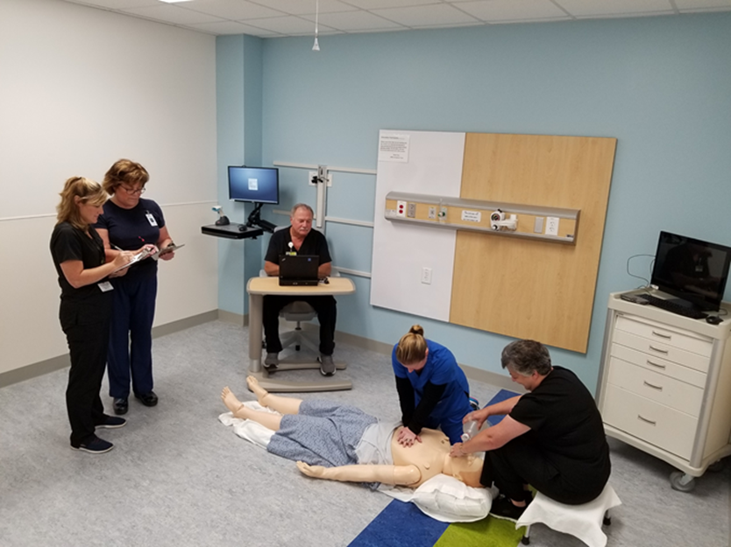
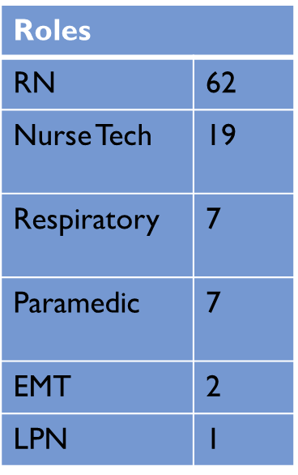
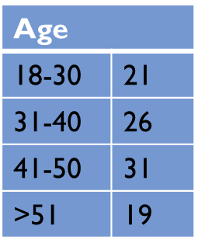
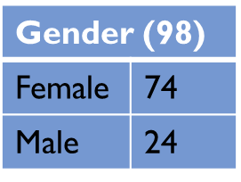
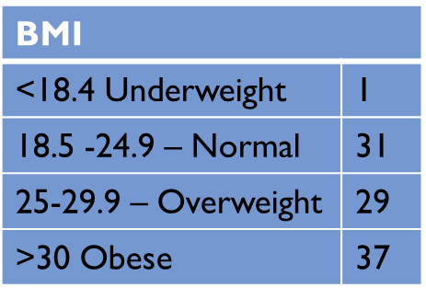
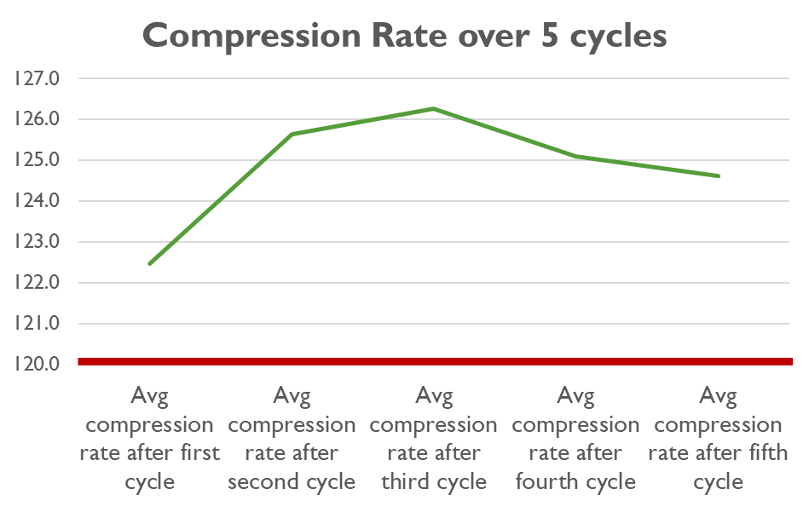
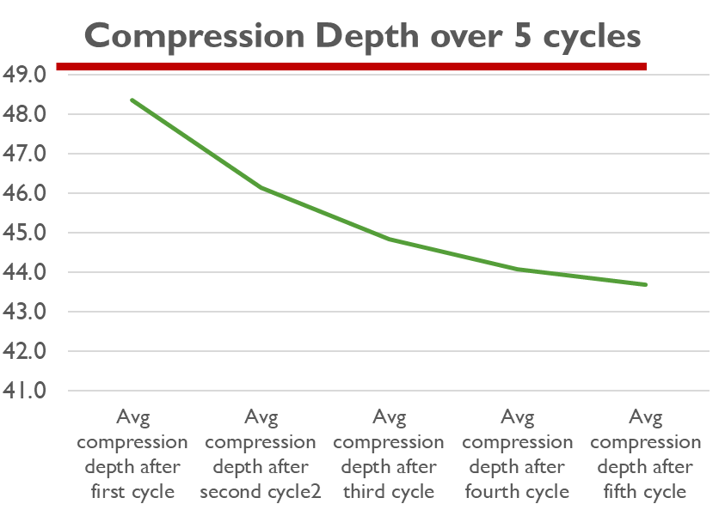
Research Week - Nursing
What Factors may contribute to optimal chest compressions, by the performer, in the hospital setting?
Cheryl Bittel MSN, APRN, CCNS, NP-C, CCRN
Problem, Purpose and Design
Data Collection Procedure
Correlational Findings Summary
Problem statement: Chest compressions (Rate and Depth) are largely inadequate during actual resuscitation events and during simulation. Studies show that over time fatigue affects quality of compressions (RAD, Lindblad), and that multiple factors, in the performer, relate to high quality CPR (Lin, Lopez)
Purpose: To examine the factors that may contribute to better quality compressions, in the hospital setting.
Design
Descriptive, correlational study
As part of the Research Team, Facilitators and Observers retained consistent roles to ensure interrater reliability
A simulation setting, along with the NGMC’s Simulation Program’s high fidelity Laerdal 3G manikin was used at each event to record rate and depth of compressions
Each participant performed one round (5 cardiac cycles) of CPR while the observers monitored the timing of compressions, the depth and rate via the Laerdal 3G manikin software. One of the Observers performed the breathing portion of CPR. Giving two breaths - one second per breath
Sex had a significant impact on depth of compressions: Males were closer to the normal depth accuracy on compressions than females
The younger the participant the greater the depth
BMI made a significant impact on depth of compressions. The higher the BMI, the deeper the compression
Adequate rate at 5th cycle, n = 24 (25%)
Adequate depth at 5th cycle, n - 22 (22%)
# of participants compressing at adequate rate and depth for each cycle - n = 4, (4%)
No significance in Rate and Depth of compressions with:
BLS vs BLS/ACLS participants
Years certified in BLS or ACLS
Last time a BLS or ACLS class was taken
Type of BLS class taken
Sample & Recruitment
Convenient sample of 98 clinicians, consisting of Registered Nurses (RN), Licensed Practical Nurse (LPN), Nurse Techs (NT), Paramedic, Emergency Medical Techs (EMT), Respiratory Therapy (RT) at all 3 hospital campuses of Northeast Georgia Medical Center (NGMC)
Inclusion criteria: English speaking BLS and/or BLS/ACLS certified direct patient care staff employed at NGMC
Exclusions Criteria: non direct care clinicians, and those who cannot kneel on the ground to perform cardiac compressions or are otherwise sick
Recruitment
Written communication in the employee newsletter and flyers on Huddle boards
Verbal communication via Huddles and rounding on day of events
Implications for Clinical Practice and Future Research
Understanding the areas of opportunity will lead to better program development and more effective practice sessions
What could be the impact of feedback pads on the performance of rate and depth?
Will the increased expectation of using EtCO² impact rate and depth of compressions?
Will an increase in quality of performance impact survival rates of cardiac arrest patients at NGMC?
Findings:
Of all participants
The Average Depth was 45.4mm: (AHA standard 50mm)
The Average Rate total was 124 per min: ( AHA standard 100-120)
Study Outcomes and Variables Studied
Outcomes measured:
Average compression Rate
Average compression Depth
Carol Means, BSN, RN, CNOR. Clinical Simulation Specialist
Christina Van Den Handel, MSN-Ed, APRN, Clinical Simulation Coordinator
Lauren Green MSN, RN Paramedic, CEN, TCRN, CCRN. Critical Care Competency Educator
Tina Hayes, MSN, RNC-OB, C-EFM. Clinical Simulation Specialist
Tim Rausch, MSN, RN, Clinical Simulation Specialist
Consultant
Joanna Carrega, PhD, RN, Nursing Faculty member, University of North Georgia
Participant characteristics examined
Gender
Age
BMI
Pre/post compression HR
Perception of fitness
Years of experience in current role
BLS vs BLS/ACLS certification
Years certified in BLS and ACLS
Last BLS course taken: Heart Code, Instructor Led or VAM
Last time compressions performed: Manikin or human
Last Code 66 (mock code)
9.2020

