Slide 1
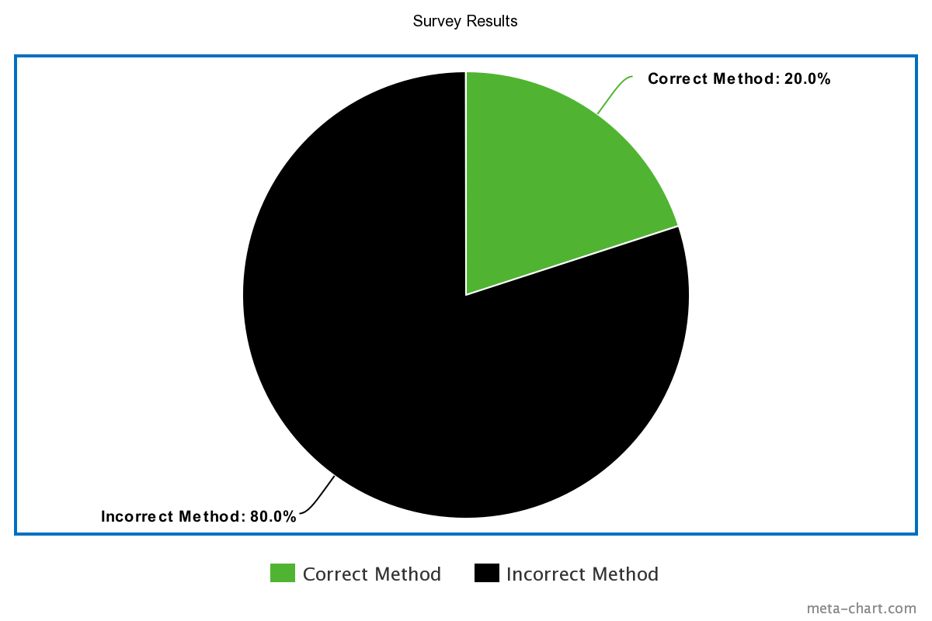
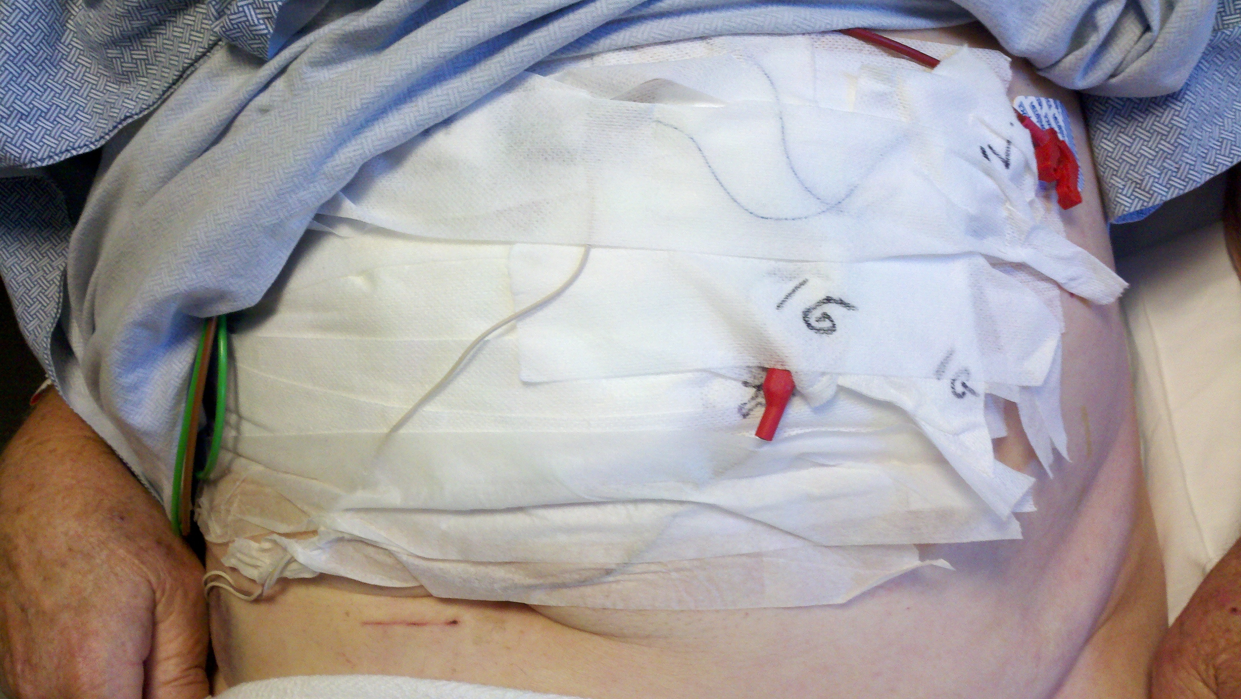
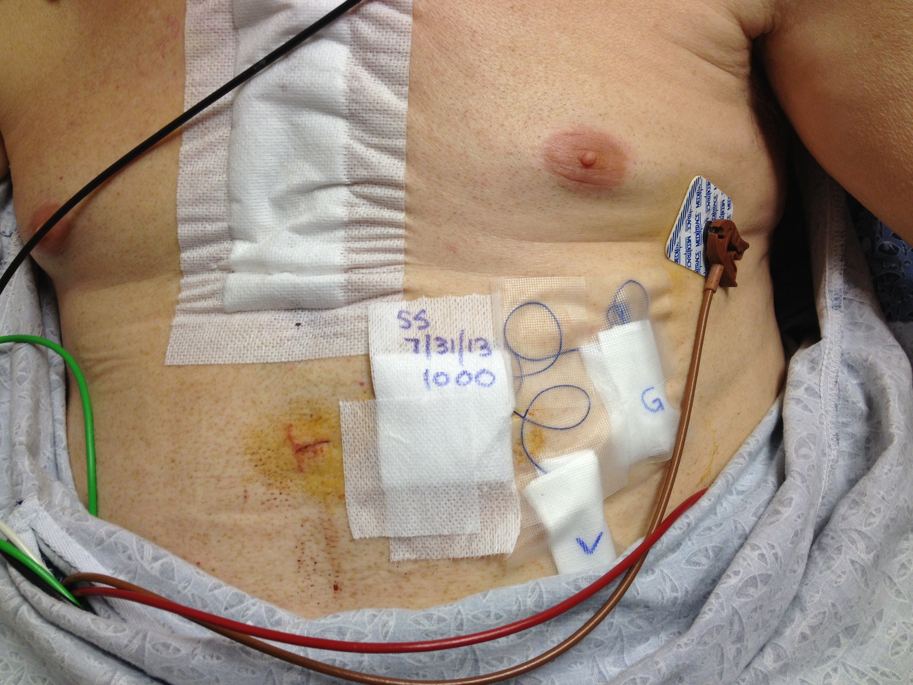
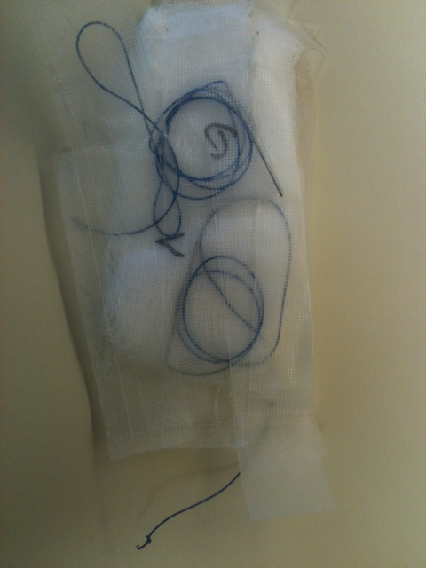
Safety and Securement of Epicardial Pacing Wires
Introduction
Project Description
Conclusions and Implications
The project design evaluates not only the current methods being used to secure epicardial pacing wires, but also evaluates the current education and policies. The units involved in the project were the CVICU and CVSU.
NGMC policies and procedures do not require a standardized method of securement of epicardial pacing wires. The survey of staff demonstrated that nurses do not utilize a standardized method of securement. Future recommendations include implementation of a standardized method and education of all CVICU and CVSU staff.
By properly securing epicardial wires the organization could potentially see a decrease in preventable complications and decrease in access time when use in needed.
There is no uniform method of securing pacer wires at Northeast Georgia Medical Center (NGMC). This is a problem for emergent access of the wires and potential risks to patients, including infection and accidental dislodgement which could result in tamponade and failure to sense and capture.
We propose a standardized method to secure wires which will allow for ease of access in case of an emergency, saving time.
Evaluation Strategy
25 nurses within S2E and CVICU were asked which method they see most.
Reference Literature
Dyal, H. K., & Sehgal, R. (2015). The catastrophic journey of a
retained temporary epicardial pacemaker wire leading to
enterococcus faecalis endocarditis and subsequent stroke. BMJ
Case Reports. doi: http://dx.doi.org/10.1136/bcr-2014-206215
McNaughton, A. (2013). Indications for
postoperative(transthoracic) epicardial pacing. British Journal
of Cardiac Nursing, 8(12), 593-595. Retrieved from
http://search.ebsco.com.libproxyb.ggc.edu/login.aspx?
direct=true&db=ccm&AN=104127100&site=eds-live&scope=site
Mennella, H. D. A.-B., & Woten, M. R. B. (2019). Epicardial pacing
wires: Caring for and using. CINAHL Nursing Guide. Retrieved
from http://search.ebscohost.com/login.aspx?direct=tru&bd
=nup&AN=T704068&site=nup-live&scope=site
Project Goals
“We recommend Margie’s Travel to anyone who will listen to us. They anticipated every need and solved every potential stressor.”
~ Henriette Andersen
Staff from all units (OR, CVICU, S2E) follow the same protocol for the securement of epicardial pacing wires
margie’s travel
Findings
4567 Main Street
Raleigh, NC 02134
Current Method
Standardized Method
Acknowledgments
(718) 555-1234
contact@margiestravel.com
Contact Information
Cheryl Bittel MSN, APRN, CCNS, NP-C, CCRN
Brittney Williamson, BSN, RN, CHFN
(Unit Manager S2E)
Necole Acton, MSN, NP-C, CTS
Akilah Robinson, BSN, RN, PCCN
(Unit Educator S2E & S2D)
Survey Participants
www.margiestravel.com
Colin Anderson BSN, RN
Robby Talley BSN, RN
Isaac Mensah BSN, RN
Kallie Mathis BSN, RN
Notes:
PICO Question: Does having a uniform securement method of epicardial pacing wires in post open heart patients reduce risks of complications and ease of access during emergency situations?

