Slide 1
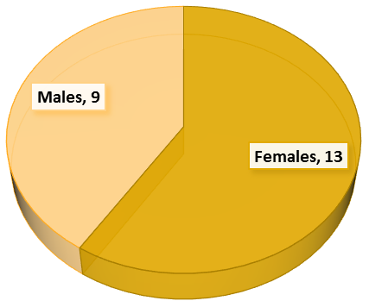
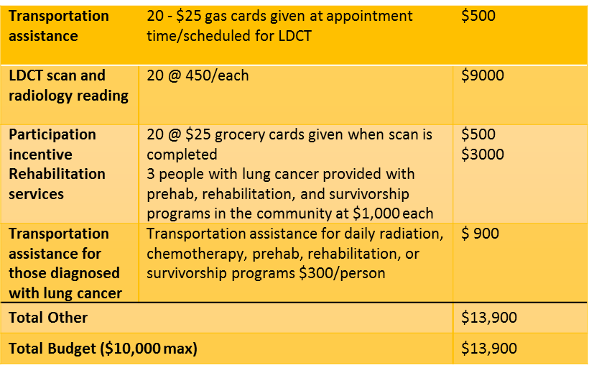
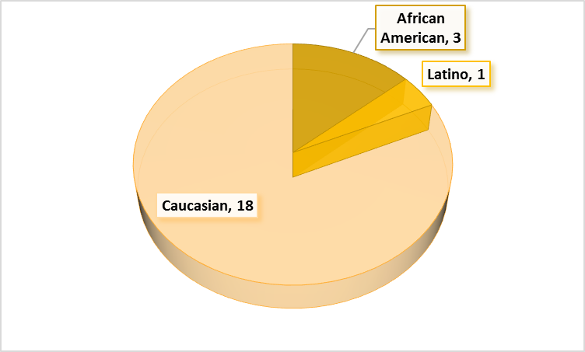
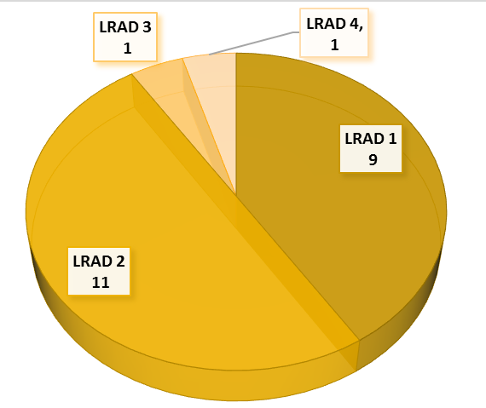
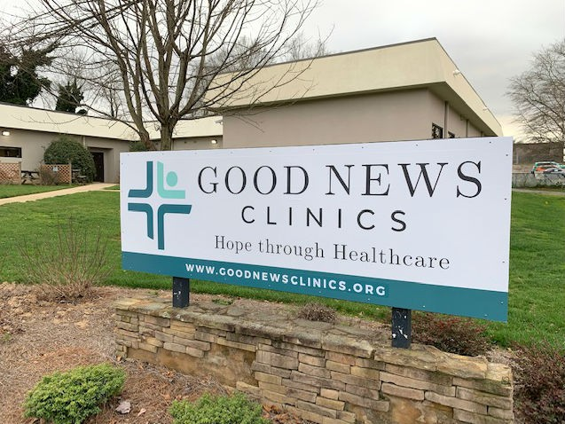
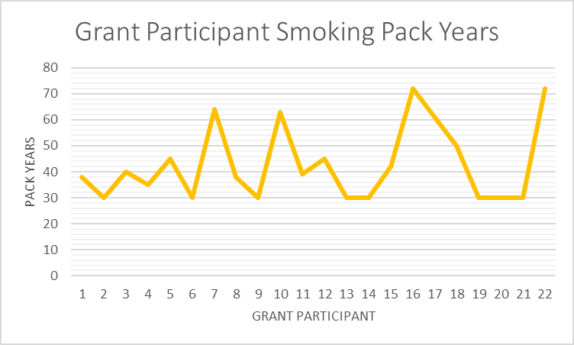
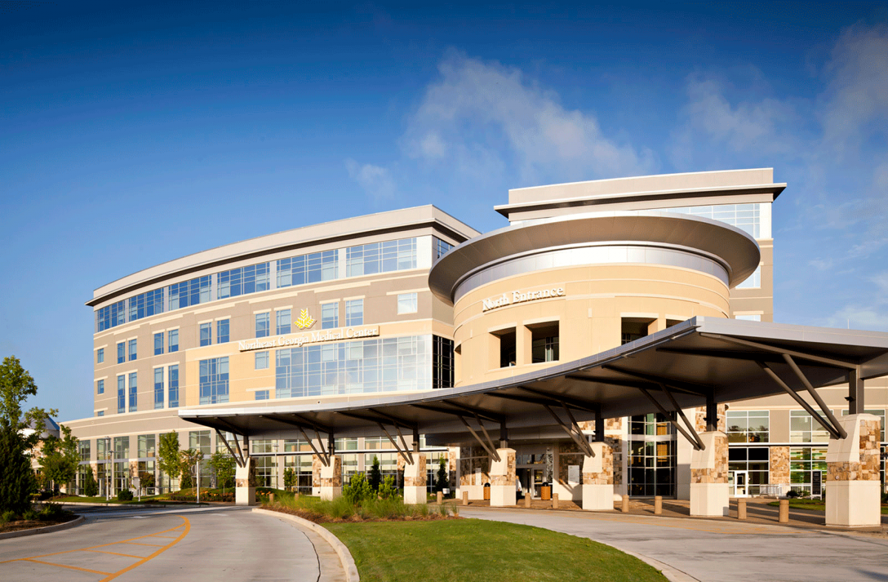
Reducing Lung Cancer Screening Disparities in Northeast Georgia
A Collaborative Grant Project
Background
Grant Goals
Grant Outcomes
References
Underserved and minority populations in many counties of Georgia have higher rates of tobacco use and increased lung cancer mortality. The same populations also experience additional stigma from providers, friends and family, and the community for continued tobacco use in the presence of known health and socioeconomic consequences. With less than 4% of the eligible insured population receiving low dose cat scan (LDCT) lung cancer screening nationally, the numbers of underinsured, uninsured, and minority populations receiving LDCT lung cancer screenings are even smaller (Jemal & Fedewa, 2017) (Japuntich, Krieger, Salvas, & Carey, 2018). In Hall County, Georgia, only one uninsured patient participated in a lung cancer screening in 2018. Barriers like transportation, lack of insurance, paid time off at work, absence of a regular healthcare provider combined with low socioeconomic status reduce the likelihood of the underserved receiving lung cancer screenings (Green, Guerrier-Adams, Schiavone, & Smith, 2013). To mitigate potential barriers to lung cancer screenings for underserved and minority populations in Hall County, Georgia, an American Cancer Society funded project was implemented. The goals of the project were to increase the number of underserved eligible candidates in Hall County, Georgia, screened for lung cancer, reduce transportation barriers for screening participants, and provide transportation assistance and rehabilitation services for participants diagnosed with lung cancer through the grant. In collaboration with Good News Clinic in Gainesville, Georgia, a goal of twenty participants was set. During the first funding period, February 2019 - July 2019, a total of eleven participants were identified and received no-cost lung cancer screening. No abnormalities or incidental findings were identified in the eleven participants. For the second funding period, August 2019 – February 2020, an additional eleven participants were identified and screened. In total, twenty-two lung cancer screenings were performed with grant funding. To reduce transportation barriers and to incentivize participants to complete lung cancer screening, participants also received gas cards at the completion of the scan. Although the results were monitored and tracked by an oncology nurse, Good News Clinic provided participants with the results of the screenings.
Reduce lung cancer screening barriers and increase lung cancer screening rates for current and past smokers in the Latino and African-American indigent populations in Hall County by offering LDCT screenings to qualified patients at Good News Clinic, Gainesville, Georgia.
Reduction of structural barriers for participants diagnosed with lung cancer through the lung cancer screening grant.
1. Travel stipend for appointments
2. Three rehabilitation visits – prehab, rehab, and
survivorship
22 grant participants
Green, P., Guerrier-Adams, S., Okunji, P., Schiavone, D., & Smith, J. (2013). African American health disparities in lung cancer. Clinical Journal of Oncology Nursing, 17(2), 180-6. Retrieved from https://search.proquest.com/docview/1347618291?accountid=34574
Jemal, A., Fedewa, S. (2017). Lung Cancer Screening With Low-Dose Computed Tomography in the United States—2010 to 2015. JAMA Oncology. 2017;3(9):1278–1281. doi:10.1001/jamaoncol.2016.6416
Japuntich, S., Krieger, N., Salvas, A., & Carey, M. (2018). Racial disparities in lung cancer screening: An exploratory investigation. Journal of the National Medical Association, 110(5), 424-427. doi:http://dx.doi.org/10.1016/j.jnma.2017.09.003
National Cancer Institute. (2019). State Cancer Profiles: Georgia. Retrieved from https://statecancerprofiles.cancer.gov/quick-profiles/index.php?statename=georgia
Grant Budget
Participants by Race
Good News Clinic patients
Good News Clinic staff
Andria Caton, MSN, RN, OCN, CHPN
Northeast Georgia Medical Center Foundation
Gainesville Radiology Group
Rachel Joiner, American Cancer Society Partner
American Cancer Society support staff
Evidence-Based Interventions
Collaboration with local organizations that care for the underserved in the community
Reduction of structural barriers for participants receiving a lung cancer screening
Stipends to assist participants with travel to lung cancer screening
Engagement of multidisciplinary chest board to review screening results and make recommendations
Screening Results by LRAD Category
Grant Outcomes
The number of uninsured clients receiving LDCT screening at the Gainesville Imaging Center Campus increased from one (2018) to twenty-two (1.2019 – 2.2020) or 2100%.
The number of African Americans receiving LDCT screening at the Gainesville Imaging Center Campus increased from 2 (2018) to 3 (2019) since the grant inception or 50% increase.
The number of Latinos receiving LDCT screenings at Gainesville Imaging Center Campus increased from 0 (2018) to 1 (2019) during the grant period or 100% increase.
Participant Smoking Pack Years
2012-2016 Georgia lung cancer incidence rates by county
Northeast Georgia Medical Center

