Slide 1
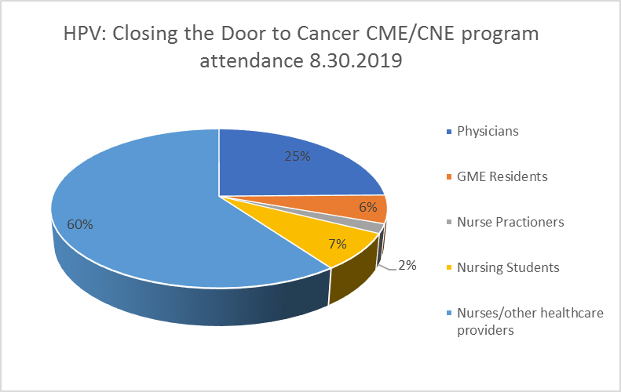
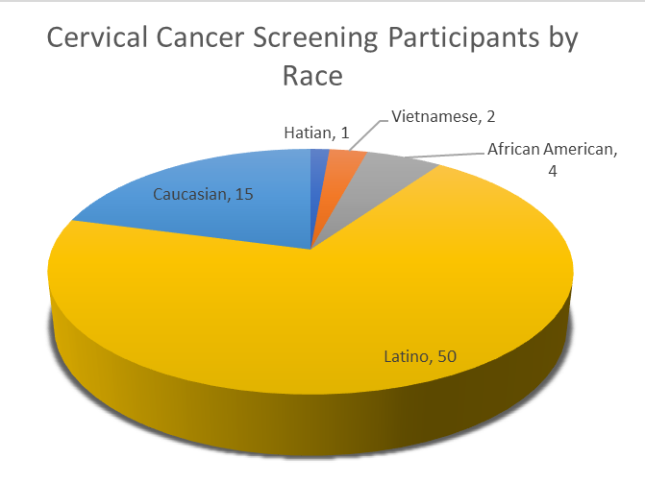
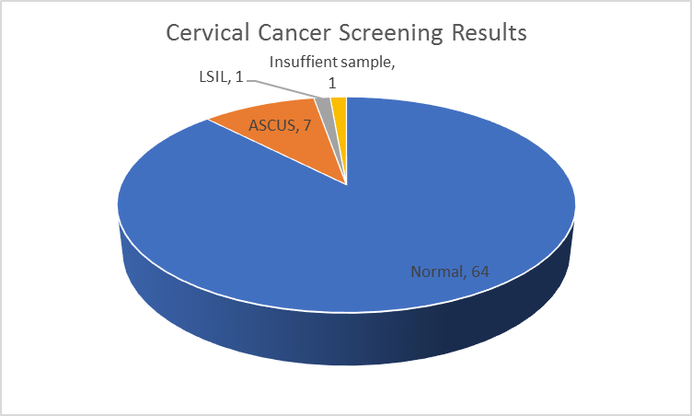
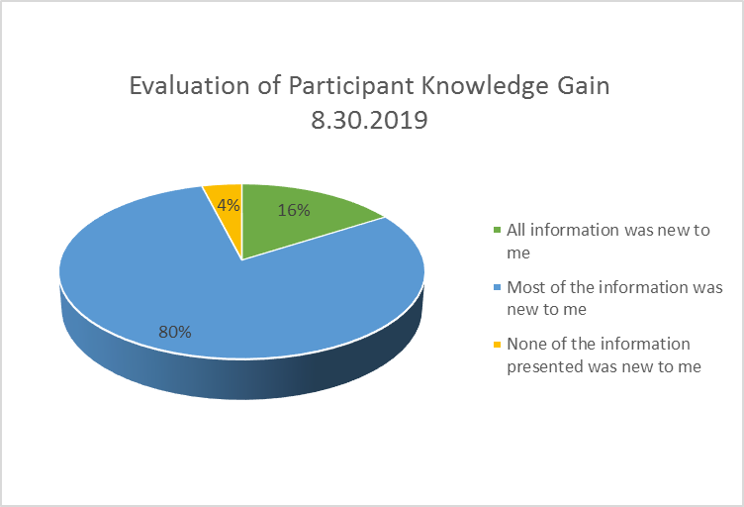
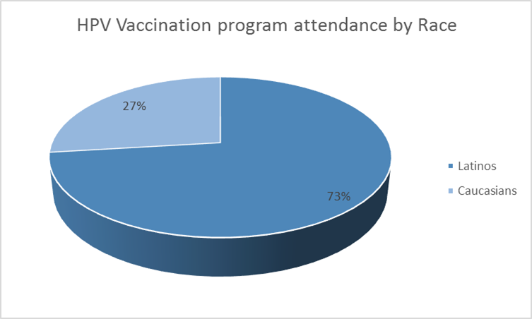
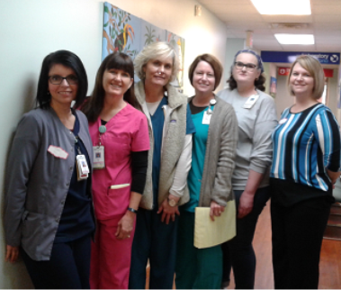
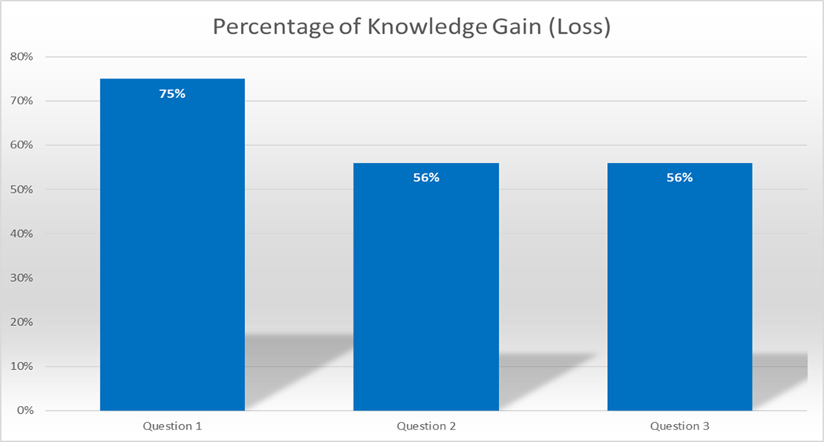
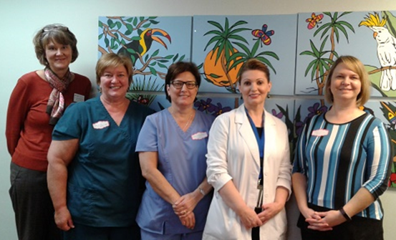
Closing the Door to Cancer: HPV Awareness & Education
HPV Small Grant Project – Andria Caton, MSN, RN, OCN, CHPN
Background
Grant Goals
Outcomes
Outcomes
The Centers for Disease Control and Prevention (CDC) estimates that over 44,000 Human Papillomavirus (HPV) related cancers occur each year in the United States (CDC, 2019). Specifically, the presence of HPV is attributable to over 90% of all anal and cervical cancers (CDC, 2019).
In 2019, Northeast Georgia Medical Center (NGMC) engaged in state-wide efforts to increase overall knowledge about HPV in at risk populations, encourage providers to promote HPV vaccinations, and to increase community awareness about cancers related to the HPV infection. To help accomplish these efforts, small grant funding in the amount of $2,500 was obtained from the American Cancer Society (ACS). Grant activities were accomplished through partnerships with Good News Clinic (Hall County indigent clinic), University of North Georgia nursing instructors, NGMC pathology, NGMC physicians, and NGMC oncology department staff, and NGMC nursing staff.
Target nurses, physician residents, primary care physicians, and pediatricians in the Northeast Georgia service area for educational efforts
Increase provider knowledge of the ACS guidelines for HPV vaccination in Northeast Georgia
Target low-income/uninsured families of the Northeast Georgia service area for educational efforts
Evaluate knowledge gains through pre and post testing
Reduce structural barriers for attendance at education
Reduce barriers for cervical cancer screenings for at risk populations for women at Good News Clinic.
Target the community at large, all races, all incomes, and insurance status for HPV vaccination awareness education
2. Provider/Nurse CME/CNE program
Screening of “Someone You Love: The HPV Epidemic”
25 in attendance
CNE and dinner provided
4. Cervical Cancer Screenings (not grant funded)
72 Cervical Cancer Screening performed at three screenings
Cost of PAP tests - $25/each Disposable speculums $1.50/each
Evidence-based interventions
References
Collaboration with local organizations that care for the underserved in the community
Reduction of structural barriers for women attending cervical cancer screenings
Provide targeted evidence-based educational materials and language appropriate programs
Provide stipends to participants to assist with travel to programs
Utilization of HPV vaccination guidelines for provider education
Engagement of a physician champion
Three HPV prevention/education programs
Offered to uninsured/underserved women who participated in the cervical cancer screenings and open to any client of Good News Clinic
2 classes provided in Spanish
1 class provided in English
American Cancer Society (2018). HPV Vaccine Facts. Retrieved 6.26.2019 from https://www.cancer.org/cancer/cancer-causes/infectious-agents/hpv/hpv-vaccine-facts-and-fears.html
Centers for Disease Control and Prevention (2019). Retrieved 6.26.2019 from https://www.cdc.gov/vaccines/ed/hpv/you-are-key.html
CDC HPV Vaccination recommendations (2018). Retrieved 6.26.2019 from https://www.cdc.gov/hpv/downloads/HCVG15-PTT-HPV-2Dose.pdf
Chesson, Harrell W., et al. (2012). “Estimates of the Annual Direct Medical Costs of the Prevention and Treatment of Disease Associated with Human Papillomavirus in the United States.” Vaccine, vol. 30, no. 42, Sept. 2012, pp. 6016–19. doi:10.1016/j.vaccine.2012.07.056
HPV Roundtable 2019 Action Plan (2019). Retrieved 6.26.2019 from http://hpvroundtable.org/wp-content/uploads/2019/06/2019-Action-Plan_HPV-Vaccination-Roundtable.pdf
Andria Caton, MSN, RN, OCN, CHPN
Andrew Green, MD, GYN Oncologist, Physician Champion
Rachel Joiner, American Cancer Society
Alison Borchet, RN, Director, Director Good News Clinic
University of North Georgia, Nurse Practitioner Instructors
Northeast Georgia Medical Center Clinical Ladder Nurses
Good News Clinic staff
Northeast Georgia Medical Center Pathology Department
Northeast Georgia Medical Center Oncology Staff
Question 1
There is a vaccine available against HPV to help prevent cervical cancer.
Question 2
The HPV vaccine does not protect against other sexually transmitted infections.
Question 3
Men and women 9 to 26 years of age can get vaccinated against HPV to prevent genital warts
February 2020

