Slide 2
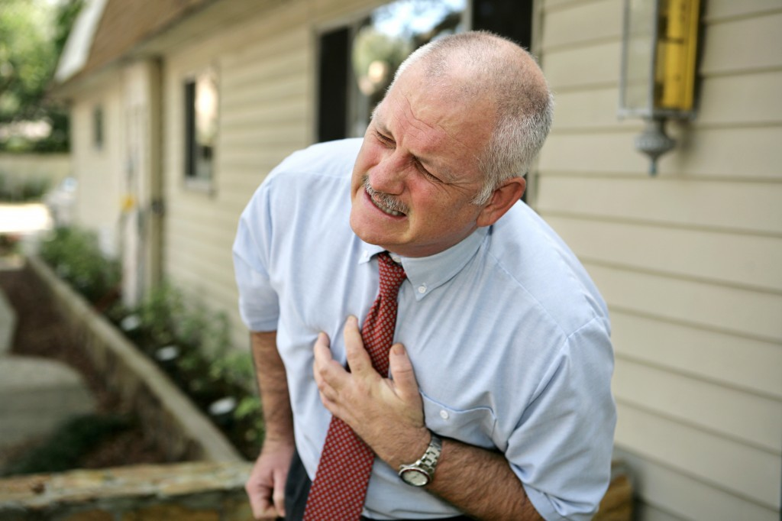
Heart Attack vs. Cardiac Arrest
Heart Attack
A heart attack occurs when an artery supplying blood to your heart becomes completely blocked. A patient might complain of chest pain and the heart continues to beat
Cardiac Arrest
A cardiac arrest occurs when the heart stops beating and breathing stops

Slide 3
Cardiac Arrest
Scope of the problem
A 40+ year old American male has a
1 in 8 chance of having
Sudden Cardiac Death
Lloyd-Jones et al. Circ 2009:119:480

Slide 4
Cardiac Arrest
Scope of the problem
> 600,000 heart related deaths per year
370,000 die of Sudden Cardiac Arrest (3rd leading cause of death in the U.S.)
1,000 die per day
1 person every 2 minutes
Less than 10% will survive
AHRQ Research Activities, December 2002: Researchers examine the risk factors for sudden cardiac arrest and management of at-risk patients.

Slide 5
After the heart stops
Every 1 minute that goes by = 10% increase in mortality
Average EMS response time ~ 8 minutes

Slide 6
How do YOU change this outcome?
Chest Compressions
Chest Compressions ONLY

Slide 7
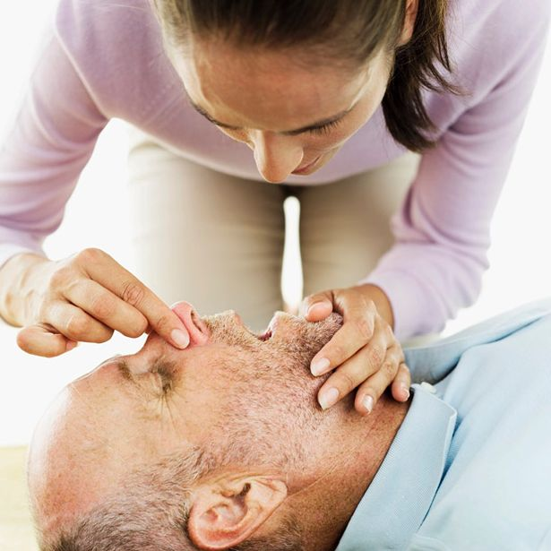
What about mouth to mouth?
Chest Compressions ONLY

Slide 8
What can you do?
If you see an adult or teen who has collapsed you must

Slide 9
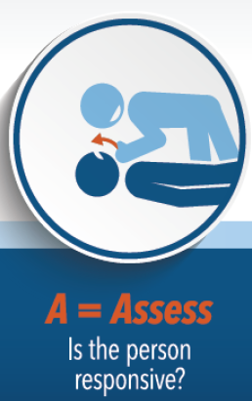
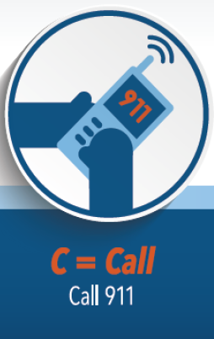
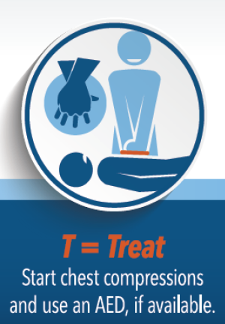
Assess for any signs of life
Call 911 or direct someone to call
Start chest compressions and have someone get an AED

Slide 10
Rotate compressors every 2 minutes if possible.
After 2 minutes of chest compressions by professional rescuers compressions lose effectiveness
Sugerman NT et al. Rescuer fatigue during actual in-hospital cardiopulmonary resuscitation with audiovisual feedback: a prospective multicenter study. Resuscitation. 2009;80:981–984

Slide 11
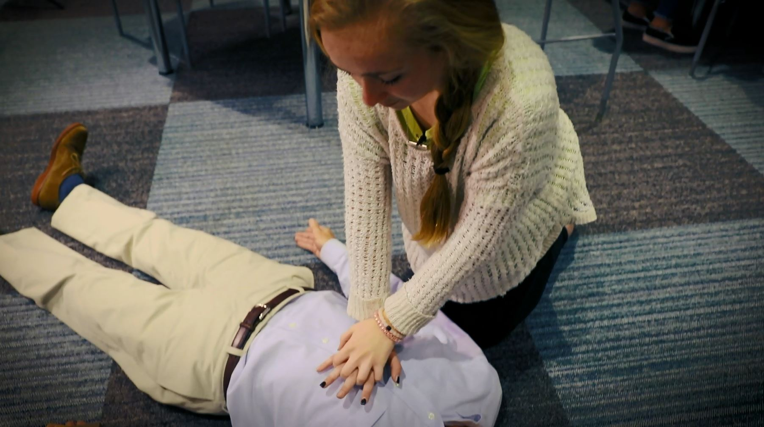
You be the hero
Teach your friends and family to ACT Now
Click to Play

